Slide 1
Implementation of a Model to Empower Family Medicine Patients to Achieve Institute of Medicine Gestational Weight Gain Recommendations (EMP-W-R)
Charity Lehn, PGY2
Northwestern McGaw Family Medicine Residency

Slide 2
Outline
Background
Methods
Preliminary Results
Discussion
Conclusions/Future Directions

Slide 3
Background
Obesity is increasingly prevalent in the U.S. and poses risks to maternal and fetal health.¹
In 2009, the Institute of Medicine issued BMI-specific recommendations for weight gain in pregnancy.²
20-40% of women gain more than the recommended amount in pregnancy.³
Lifestyle interventions have shown mixed results for achieving appropriate gestational weight gain.^{4,5}
Presently, there are no published studies that describe a low cost and highly effective Family Medicine intervention that helps American women reduce their risk of gaining an excessive amount of weight in pregnancy.
Notes:
As of 2010, 60% of mothers began pregnancy either overweight or obese.²

Slide 4
The Project
Family Medicine Midwest Maternity Care Collaborative
Sites involved:
University of Illinois – Chicago
McGaw Northwestern
Advocate Christ
University of Illinois – Rockford Dixon RTT
University of North Dakota – Minot
Coming soon … St. Mary’s and Elizabeth’s, Presence Resurrection Medical Center, Adventist Hinsdale, Loyola/Cook County
Notes:
a group of 14 Midwest Family Medicine residencies formed in 2012 in order to assist family physicians and their maternity patients. We chose weight gain in pregnancy because it is a universal issue that has been challenging for our practices to impact in a cost-effective manner.

Slide 5
Research Question
Does the proportion of women who achieve appropriate weight gain in pregnancy (per the 2009 Institute of Medicine guidelines) increase after an office-based educational intervention, and does this have any impact on rates of obesity-related complications?
Pre-pregnancy BMI | Total Weight Gain
<18.5 | 28-40 pounds
18.5-24.9 | 25-35 pounds
25-29.9 | 15-25 pounds
≥30 | 11-20 pounds

Slide 6
Methods
Phase 1: Pre-intervention Assessment
Retrospective chart review of deliveries in 2012-2013
Phase 2: Intervention Phase (2014-2016)
Distribute summary of practice data from Phase 1
Conduct educational session with the medical staff (physicians, nurses, clinical staff, etc.)
Distribute educational materials to staff and patients
Post educational material in clinic areas (optional)
Phase 3: Post-Intervention Assessment
Prospective chart review of deliveries in 2015-2016

Slide 7
Methods
Inclusion Criteria Women ages 15-45 years at the time of delivery Initiation of prenatal care by 16 weeks Singleton pregnancy Six or more prenatal visits, including one visit after 35 weeks Delivery at the hospital affiliated with the practice | Exclusion Criteria Pre-pregnancy diabetes Chronic (daily) prednisone use Prednisone use in pregnancy exceeding 21 days Pre-pregnancy hypertensive disease requiring ≥2 medications Diminished decision-making capacity

Slide 8
Methods
Outcomes
Pre-pregnancy BMI & weight
BMI & weight at delivery
Whether clinician counseled on weight gain
If counseling consistent with IOM recommendations
Delivery data:
Incidence of gestational HTN, GDM, preeclampsia and eclampsia
Incidence of Cesarean section & instrumented delivery
SGA, AGA or LGA newborn

Slide 9
Results – Phase I Baseline Characteristics

Slide 10
Results – Phase I Baseline Characteristics
Variable | Phase I Group (N=588)
Age | 27.2 ± 5.6
Baseline weight | 156 ± 38.75
Baseline BMI | 27.1 ± 7.09
Race
White | 283 (66.0%)
Black or African American | 108 (25.2%)
Asian | 36 (8.4%)
American Indian or Alaskan Native | 1 (0.2%)
Native Hawaiian or Pacific Islander | 1 (0.2%)
Ethnicity
Non Hispanic or Latino | 288 (58.8%)
Hispanic or Latino | 209 (41.2%)
Insurance Status
Medicaid | 384 (66.7%)
Other Commercial Insurance | 93 (16.1%)
HMO | 90 (15.6%)
Self Pay | 9 (1.6%)
Gravidity | 2.5 ± 1.6
Notes:
There are statistically significant differences among the participating institutions for all variables except baseline BMI, gestational age at delivery, newborn weight, induction of labor, and rates of preeclampsia and eclampsia.

Slide 11
Results – Phase I Outcomes
Outcome | Phase I Group (N=588)
Total weight gain (in lb) | 27.97 ± 13.76
First trimester | 2.72 ± 6.15
Second trimester | 16.5 ± 10.19
Third trimester | 27.8 ± 13.93
Weight gain counseling documented
Yes | 270 (46.2%)
No | 314 (53.8%)
Counseling consistent with IOM
Yes | 118 (42.8%)
No | 70 (25.4%)
N/A (not documented) | 88 (31.9%)

Slide 12
Outcome | Phase I Group (N=588)
Delivery Mode
Vaginal | 457 (77.9%)
Vacuum – assisted | 28 (4.5%)
Forceps – assisted | 3 (0.5%)
Cesarean – primary | 73 (12.4%)
Cesarean – secondary | 26 (4.4%)
Induction of Labor
Yes | 141 (26.7%)
No | 388 (73.3%)
Shoulder Dystocia
Yes | 17 (2.9%)
No | 495 (84.5%)
Maternal complications
Gestational HTN | 22 (3.7%)
Preeclampsia | 28 (4.8%)
Eclampsia | 1 (0.2%)
Gestational diabetes, diet control | 28 (4.5%)
Gestational diabetes, medication control | 15 (2.6%)

Slide 13
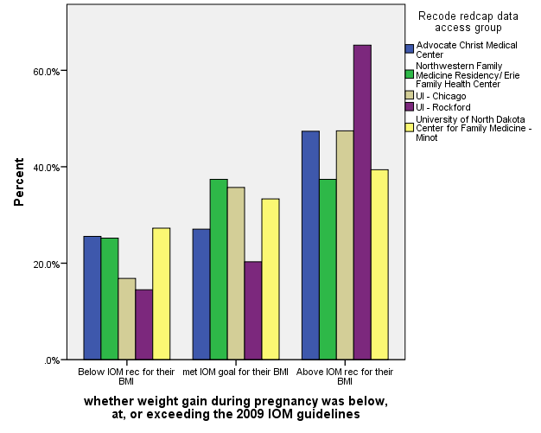
Results – Phase I Outcomes

Slide 14
Results – Phase I Outcomes
 | Weight gain counseling documented
 | No | Yes
Weight Gain Below Goal | 20.7% | 22.6%
Weight Gain At Goal | 32.2% | 31.9%
Weight Gain Above Goal | 47.1% | 45.6%

Slide 15
Discussion
Most of our patients are overweight or obese at the beginning of pregnancy.
Many patients gain more than the recommended amount.
One limitation of the study is that the timing and quality of weight gain counseling was not recorded.

Slide 16
Conclusions/Future Directions
Our baseline assessment does not demonstrate that our 2012-2013 counseling techniques were any more effective than not counseling at all.
It will be important to reassess our populations in Phase 3 to determine whether educating the clinicians and staff impacted weight gain in our populations.
We plan to include the timing of weight gain counseling in our repeat assessment to address this limitation.
Our study population will approximately double by 2016 to include other Family Medicine Midwest Collaborators.

Slide 17
References
Krukowski R, Bursac Z. "Exploring Potential Health Disparities in Excessive Gestational Weight Gain." Journal of Woman's Health. Jun 2013; 22(6): 494-500.
Weight gain during pregnancy: Reexamining the Guidelines. In: Rasmussen KM, Yaktine AL, Editors. Committee to Reexamine IOM Pregnancy Weight Guidelines Food and Nutrition Board. Board on Children, Youth, and Families. Institute of Medicine and National Research Council of the National Academies. Washington, DC: The National Academies Press; 2009.
Muktabhant B, Lumbiganon P. "Interventions for Preventing Excessive Weight Gain during Pregnancy (Review)." The Cochrane Library Collaboration. Apr 2012; 18(4): 1-96.
Guelinckx I, Devlieger R, Mullie P, Vansant G. “Effect of lifestyle intervention on dietary habits, physical activity, and gestational weight gain in obese pregnant women: a randomized controlled trial.” Am J Clin Nutr. Feb 2010; 91(2): 373-380.
Polley BA, Wing RR, Sims CF. “Randomized controlled trial to prevent excessive weight gain in pregnant women.” International Journal of Obesity Related Metabolic Disorders. Nov 2002; 26(11): 1494-502.

