Slide 1
The Educational Path to Family Medicine

Slide 2
Learning Objectives
Describe the educational requirements and steps to obtain a career in family medicine.
Describe the training family physicians receive in residency and how it prepares them to be adaptable throughout their careers

Slide 3
College freshman year
Explore medical career options: meet with advisor, visit aspiring docs, explore financial aid, etc.
College Sophomore year
Stay on track for medical school: work with pre-health advisor, attend pre-health meetings, volunteer/work in the field
College Junior year
Strategize with your advisor on a game plan: gap year, post-bac program, letters of recommendation, pre-med and required coursework
Get some experience: participate in enrichment programs, volunteer or intern
SUMMER: finalize and submit AMCAS application, continue with volunteer/work
Register for the MCAT exam: register early, compare schools, begin filling out AMCAS application.
Get more experience and review resources: fee assistance, AMCAS application and MCAT processes, research/internship experience
College senior year
Prepare for medical school interviews: consult with advisor, ask aspiring docs for interview tips
Receive letters of acceptance or rejection: if accepted, decide which school and complete FAFSA, if waitlisted or rejected speak with advisor, consider gap yea
College graduation
Get ready for medical school: buy books, find housing, attend orientation.
Notes:
College

Slide 4
Medical School year 1 (M1)
Orientation
Clinical Anatomy, Development and Physical Examination (CADE)
Introduction to Clinical Medicine 1a (ICM 1a)
Molecular Basis of Life, Defense and Disease (MBLDD)
Introduction to Clinical Medicine 1b (ICM 1b)
Biostatistics and EBM
Vacation or Electives
Medical School year 2 (M2)
Human Systems in Health and Disease 1 (HSHD1)
Introduction to Clinical Medicine 2a (ICM 2a)
Human Systems in Health and Disease 2 (HSHD2)
Introduction to Clinical Medicine 2b (ICM 2b)
Study for Step 1
M3 Orientation, Clerkships
Medical School year 3 (M3)
Surgery (8 wks)
Internal Medicine (8 wks)
Neurology (4 wks)
OB/GYN (6 wks)
Psychiatry (6 wks)
Pediatrics (6 wks)
Family Medicine (6 wks)
Medical School year 4 (M4)
Study for Step 2 CK, CS during fall semester
Acting Internship (4 wks)
ICU (2 wks)
Palliative (1 wk)
Graduation
Ambulatory (4 wks)
Electives (22-24 total weeks)
Apply to residencies
Notes:
Medical school

Slide 5
Medical School

Slide 6
Overview of Medical School Timeline
Year 1
Year 2
Year 3
Year 4
Basic Sciences +/- Clinical
Basic Sciences +/- Clinical
Step 1
Specialty Considerations
Clinical Rotations
Residency Applications
Clinical Rotations
Step 2
AI/Selective Considerations

Slide 7
Medical School Exams
USMLE
Step 1
Step 2
COMLEX
Step 1
Step 2
MD
DO
Notes:
All family physicians begin their training by graduating from an accredited school of medicine or osteopathic medicine. During medical school, students take board exams, either steps 1 and 2 of the United States Medical Licensing Examination (USMLE) or levels 1 and 2 of the Comprehensive Osteopathic Medical Licensing Examination of the United States, and complete core clerkships, or periods of clinical instruction. Passing both exams, core science courses, and the clerkships grants students the Doctor of Medicine (MD) or Doctor of Osteopathic Medicine (DO) degree, which entitles them to start full clinical training in a residency program.

Slide 8
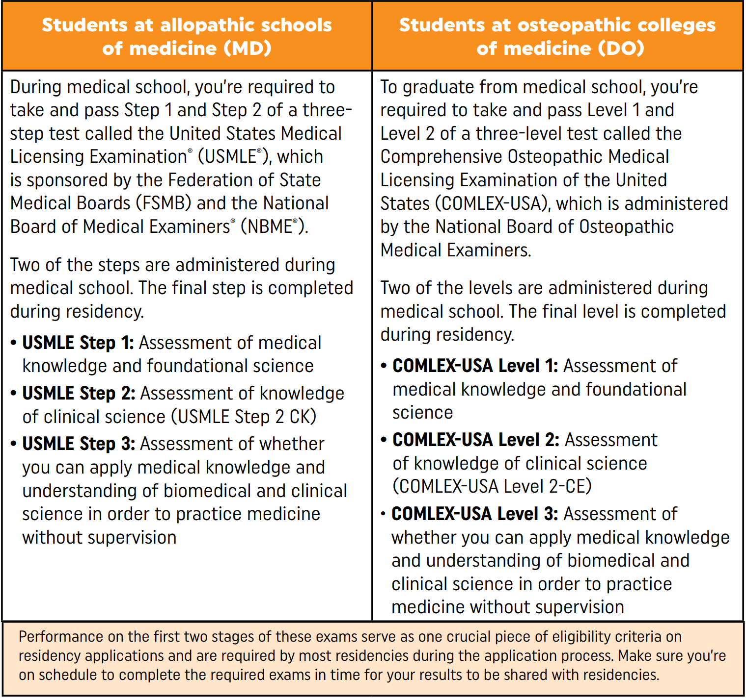
Licensing Requirements
Notes:
Source: AAFP Strolling through the Match, 2023 https://www.aafp.org/students-residents/medical-students/become-a-resident/match/strolling-through-the-match.html

Slide 9
Clinical Rotations
Pediatrics
OBGYN
Internal Medicine
Family Medicine
Psychiatry
Surgery
Emergency Medicine
Radiology
Neurology
Notes:
Many medical schools also include emergency medicine, radiology, and neurology as core rotations, though the rotations may very in length.
Rotations provide you with the opportunity to develop the skills you need to excel as a family physician. You will strengthen procedural and cognitive skills, practice patient interaction skills, and the experience will serve as a reference point in the journey toward choosing your specialty.
After rotating through a core clinical specialty, you will be tested on your knowledge in standardized shelf exams. To prepare for the family medicine shelf exam, many medical students use the AAFP’s practice board review questions, which medical student members can access for free.

Slide 10
Specialty Considerations
Aspirations
original goals, current goals
Professional Values
intellectual stimulation, lifestyle, autonomy, service
Doctor-Patient Relationship
setting, clinical situation, type of patient
Daily Schedule
patient visits, surgical procedures, combo
Lifestyle & Income
pace of life, family, friends, hobbies, vacation, loan payment
Practice Setting
Community, academic, hospital, etc.
Skills & Personality
interpersonal, analytical, technical, etc.
Residency Training Requirements
Length of training, positions, comparison, fellowships, retention
Overall Outlook
practice opportunities, trends or recent changes, practice scope
Notes:
Aspirations
What were your original goals when you decided to become a physician?
Have your goals changed during medical school? If so, how?
Professional Values
What do you value about the role of a physician? Consider things like intellectual challenge, the ability to help others, the respect it commands from others, the security of the lifestyle, the luxury of the lifestyle, or the ability to work autonomously.
Which aspects do you value the most?
Doctor-Patient Relationship
What type of doctor-patient relationships do you find the most rewarding?
Are there particular clinical situations or types of patient encounters that make you uncomfortable or for which you feel unsuited?
Daily Schedule
Would you prefer to concentrate on patient visits, surgical procedures, or a combination of both?
Lifestyle & Income
What pace of life do you envision for yourself (time for family, time for other interests, vacation, etc.)?
What is your goal in terms of income? How quickly do you want to pay off your student loans?
Practice Setting
In what type of community do you see yourself practicing? What type of clinical setting?
Do you have a preference for community, academic or hospital settings?
Skills & Personality
During medical school, have you displayed an uncanny knack for a particular aspect of medical care?
What skills (interpersonal, analytical, technical, etc.) do you value the most in yourself, and how do they affect your perception of the specialty or specialties to which your abilities are best suited?
Residency Training Requirements
How long is the required training for the specialty?
What does residency training prepare you to do?
How many residency positions are available?
What are the differences between training programs within the same specialty (e.g., geographic or institutional differences)?
What potential is there for further training following residency (e.g., subspecialty training or fellowships)?
Overall Outlook
What practice opportunities are available (e.g., demand for physicians, competition for patients or practice sites)?
What current trends or recent changes in practice patterns impact the specialty (e.g., cost of professional liability insurance, changes in Medicare reimbursement policies, healthcare legislation)?
What are the foreseeable additions to the repertoire of the specialty (e.g., new models of practice, new technologies, new drugs, new techniques)?

Slide 11
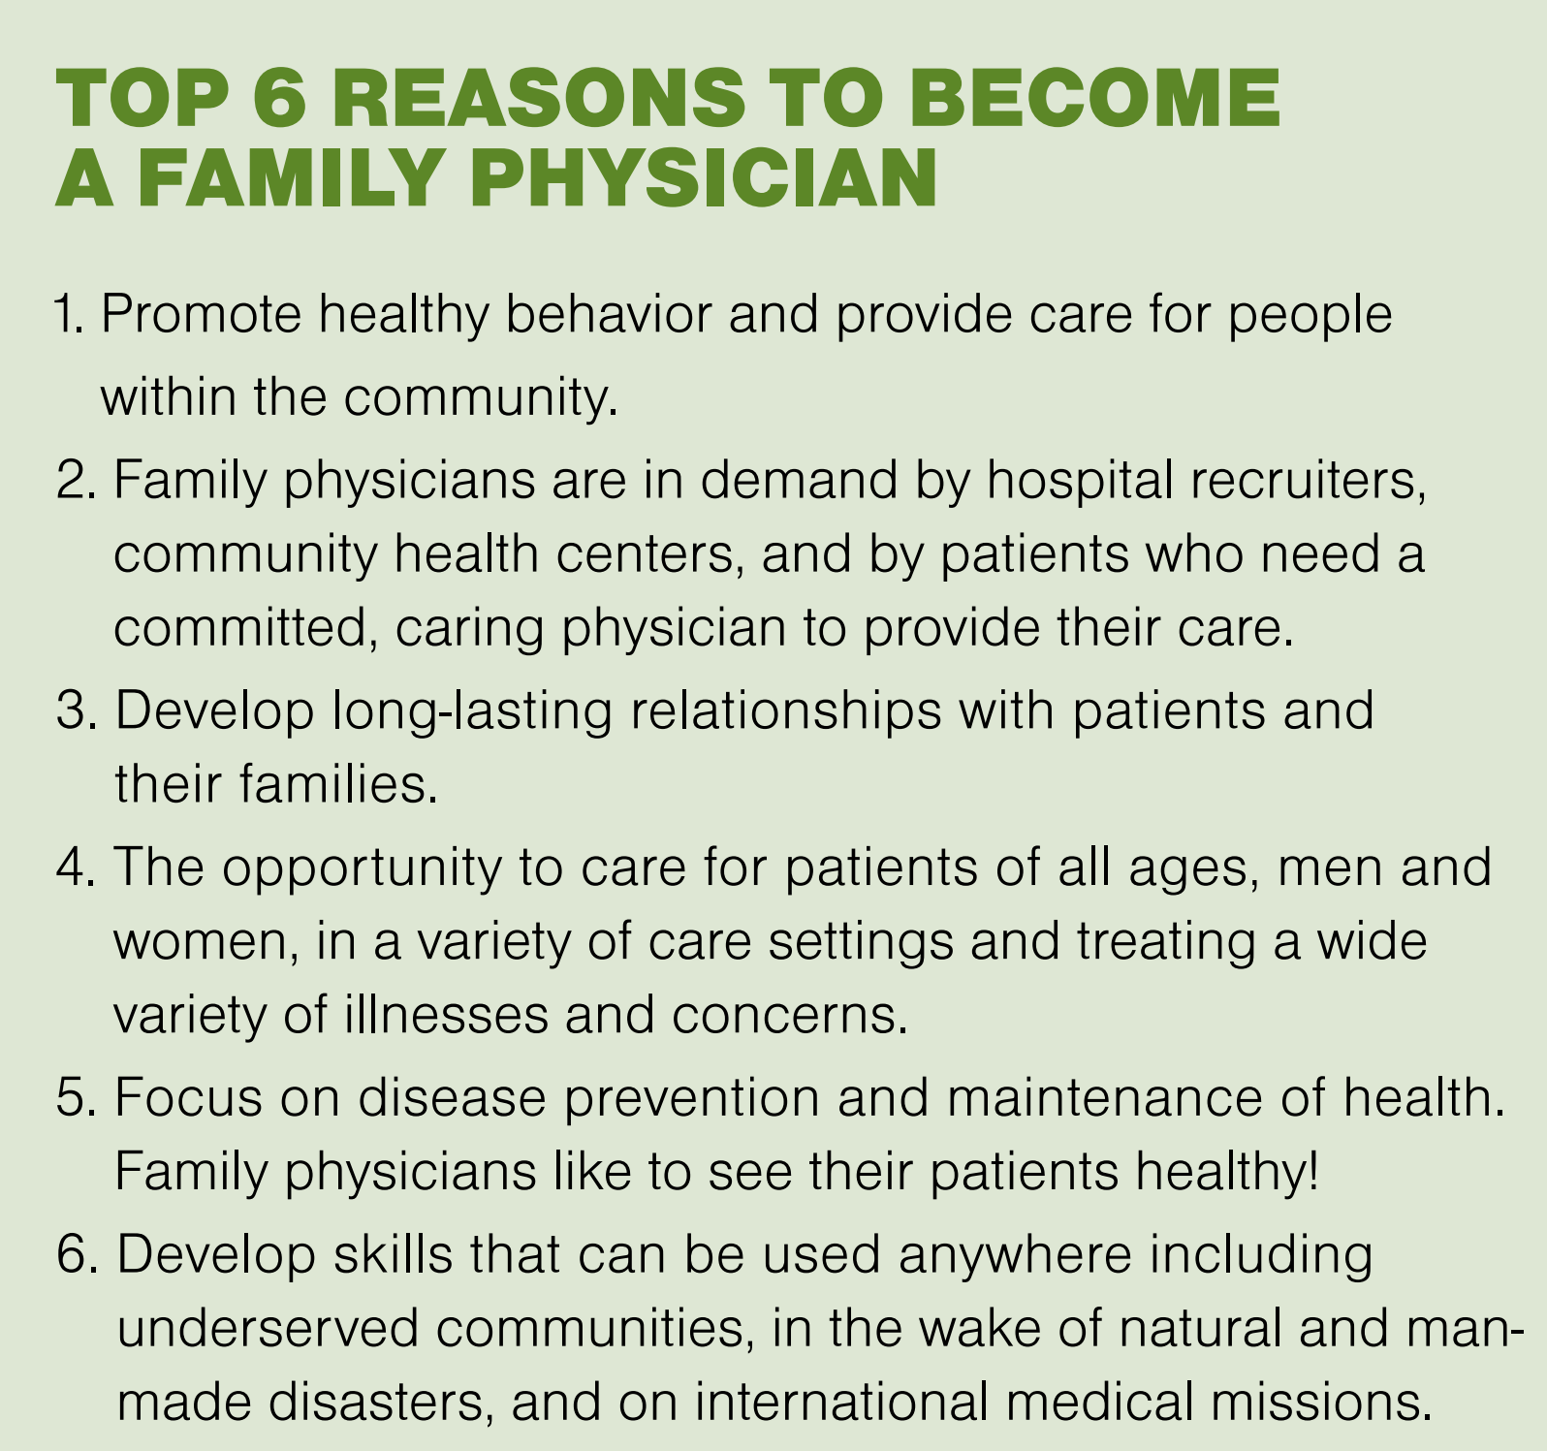
Notes:
Source: AAFP Strolling through the Match, 2023 https://www.aafp.org/students-residents/medical-students/become-a-resident/match/strolling-through-the-match.html

Slide 12
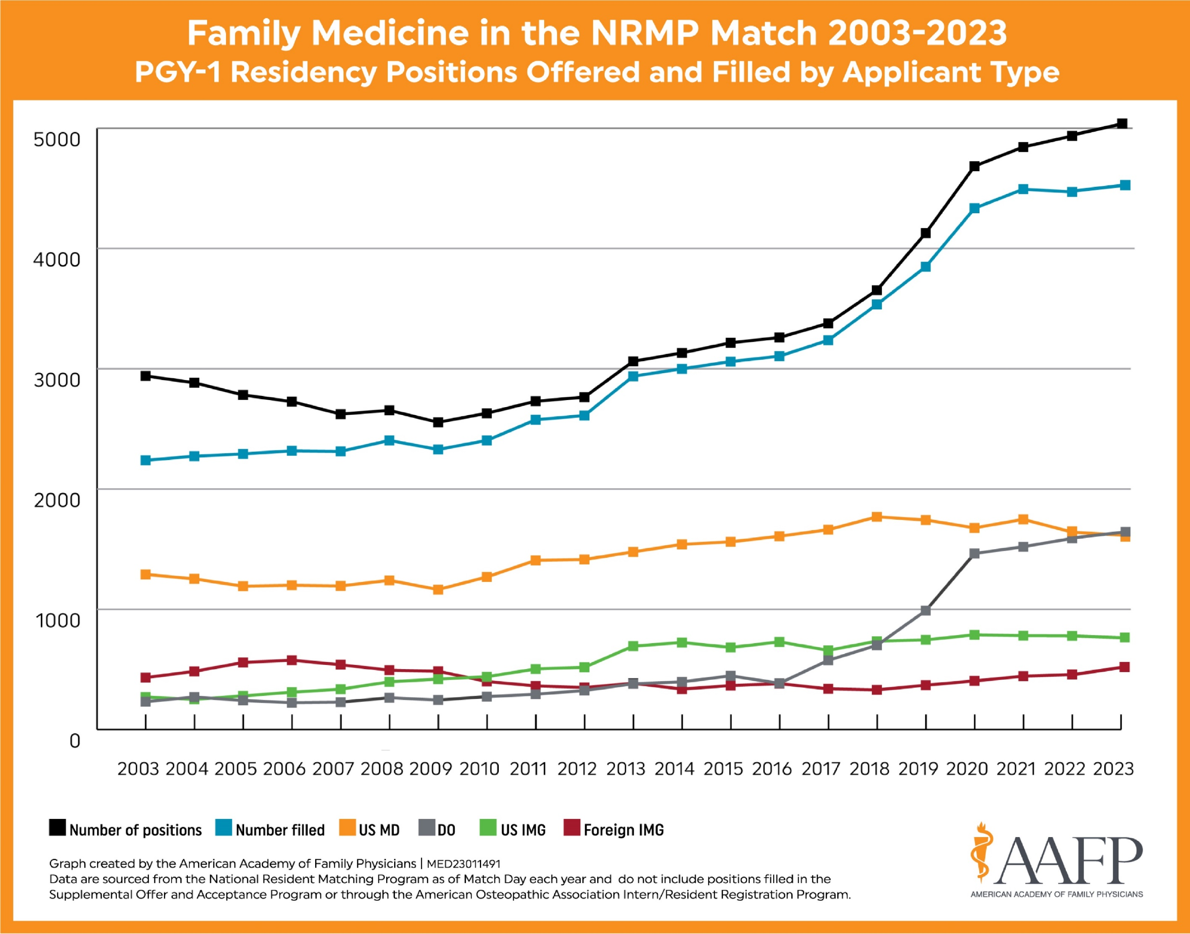
Family Medicine Match Trends 2003-2023
Notes:
Source: AAFP Match Results for Family Medicine, https://www.aafp.org/students-residents/residency-program-directors/national-resident-matching-program-results.html

Slide 13
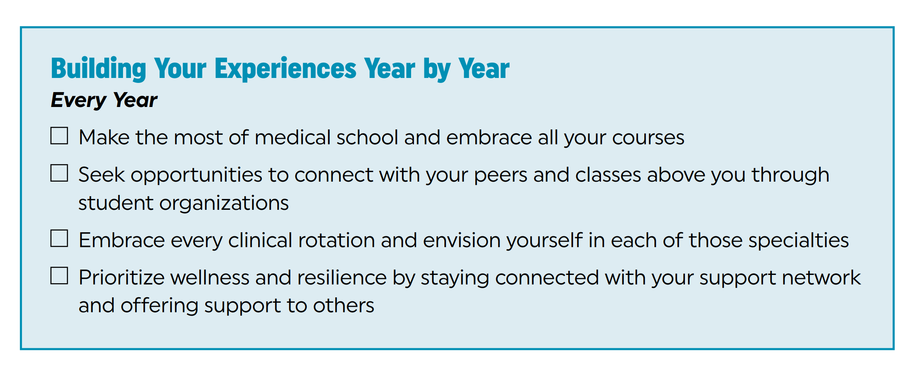
Notes:
Source: AAFP Strolling through the Match, 2023 https://www.aafp.org/students-residents/medical-students/become-a-resident/match/strolling-through-the-match.html

Slide 14
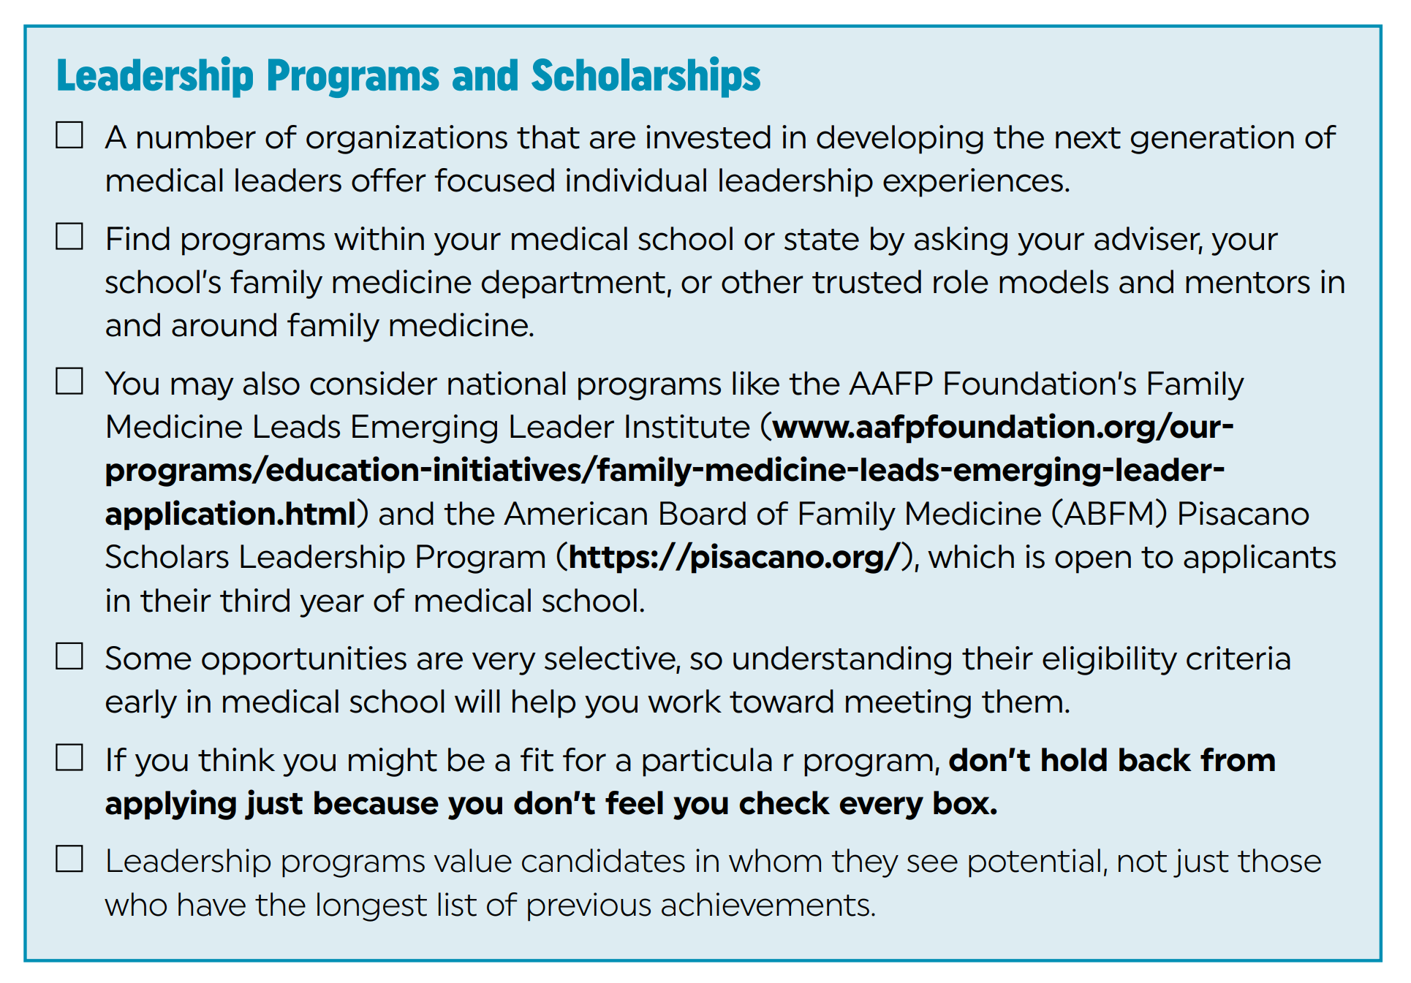
Notes:
Source: AAFP Strolling through the Match, 2023 https://www.aafp.org/students-residents/medical-students/become-a-resident/match/strolling-through-the-match.html

Slide 15
International Medical Graduates
ECFMG Certification
Step 1: Meet medical education credential requirements
Step 2: Apply for ECFMG certification
Step 3: Meet examination eligibility requirements
It’s crucial to verify your eligibility within each U.S. state and to each program before you apply for the USMLE.

Slide 16
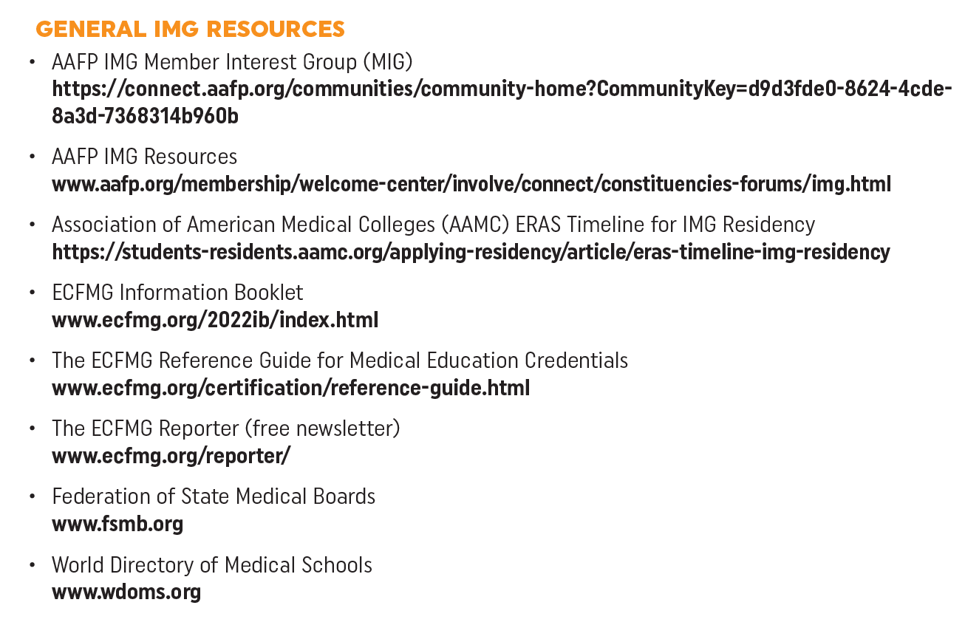
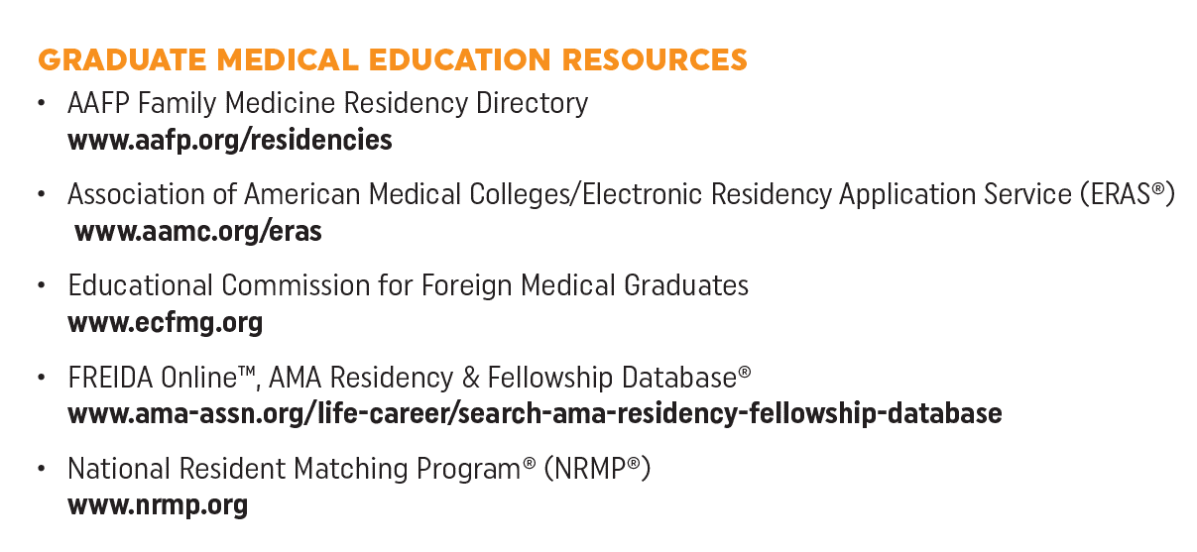
Notes:
Source: AAFP Strolling through the Match, 2023 https://www.aafp.org/students-residents/medical-students/become-a-resident/match/strolling-through-the-match.html

Slide 17
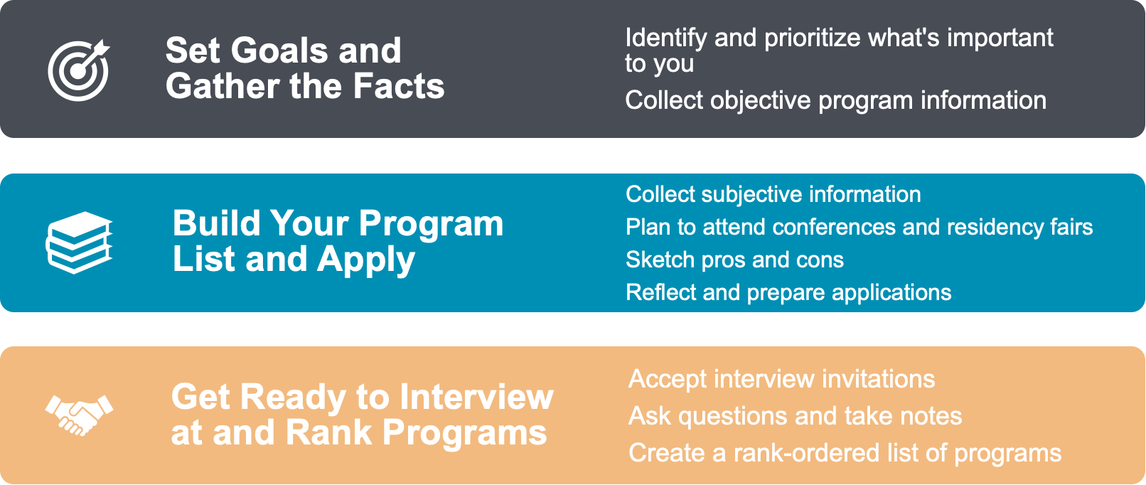
Finding the Right Residency Program

Slide 18
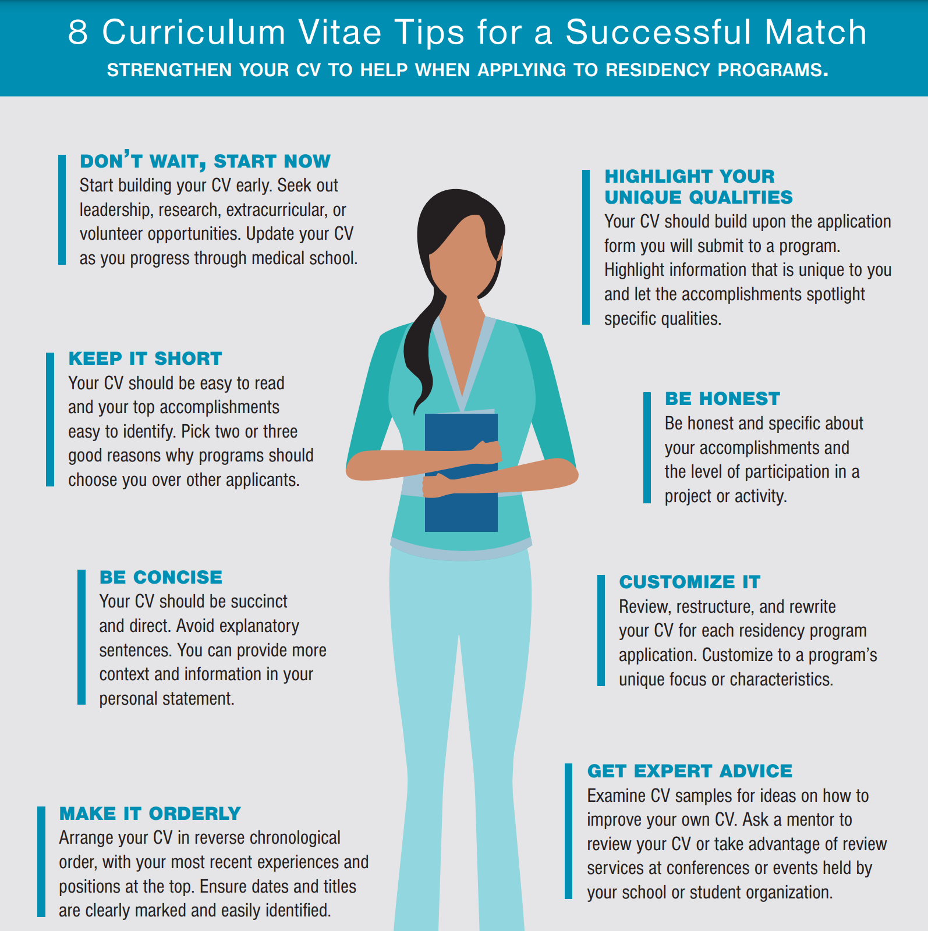
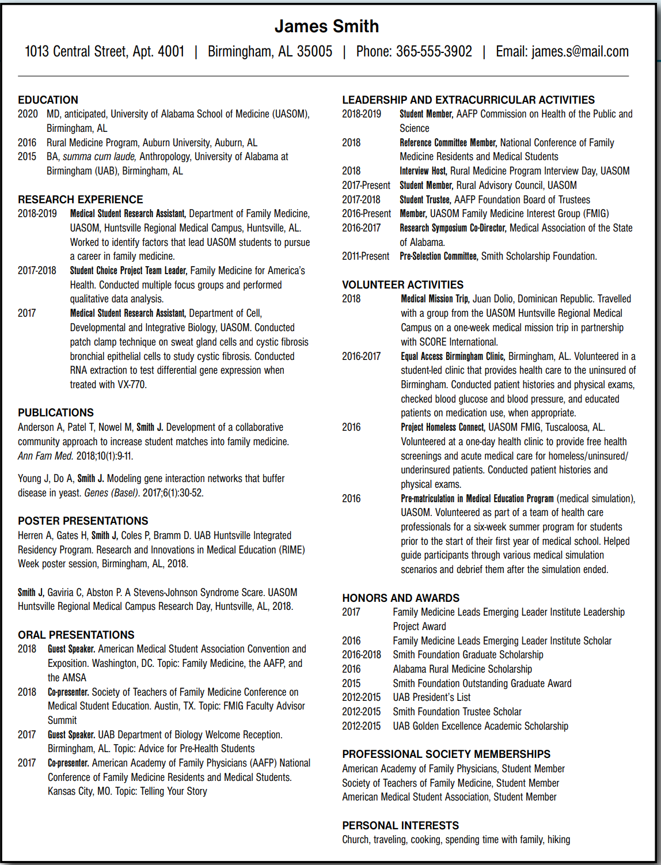
Notes:
Source: AAFP Strolling through the Match, 2023 https://www.aafp.org/students-residents/medical-students/become-a-resident/match/strolling-through-the-match.html

Slide 19
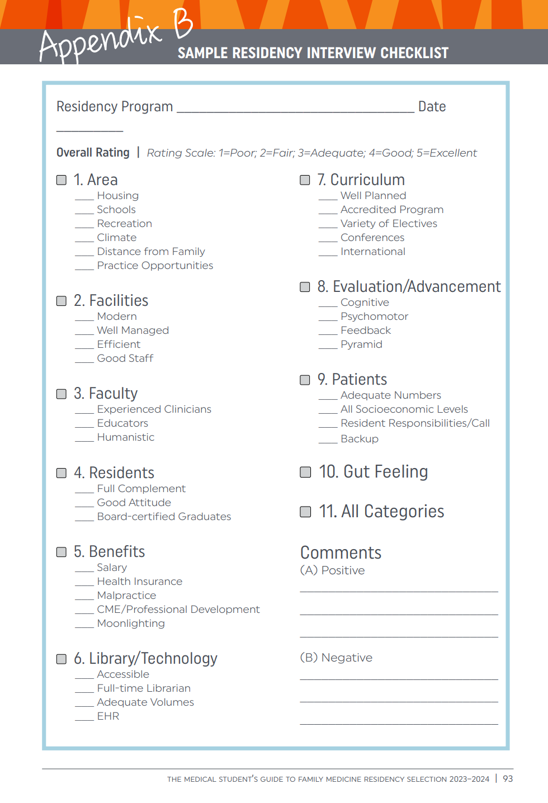
Notes:
Source: AAFP Strolling through the Match, 2023 https://www.aafp.org/students-residents/medical-students/become-a-resident/match/strolling-through-the-match.html

Slide 20
Seven Do’s of Residency Selection
DO ask your FM chair and faculty for advice.
DO keep an open mind about the quality of each program.
DO look for the training program that best meets your unique needs and goals.
DO be wary of any source that attempts to rank programs.
DO contact physicians who are doing their residencies in your chosen field.
DO talk to students who have rotated through a program or who attend that institution.
DO apply to programs that interest you.
Notes:
7 Do’s of Residency Selection
Making and narrowing your list of potential programs can be difficult. Know where to look (and where not to) for guidance.
DO ask the chair and other faculty members in the family medicine department which residency programs they consider the best fit for your interests and why. In addition, ask why they chose their own training program.
DO keep an open mind about the quality of each program. Consider a residency based on attributes such as geographic location, curriculum, unique rotation and elective opportunities, and community engagement rather than solely on the name value of the institution.
DO look for the training program that best meets your unique needs and goals. Different programs excel for different reasons, and individual residency candidates may value the same program for different reasons.
DO be wary of any source that attempts to rank programs, such as the U.S. News & World Report ranking of medical schools for primary care or the Doximity ranking for family medicine residencies. Their methodologies rely on reviews, not on objective data or statistics.
DO contact physicians who are doing their residencies in your chosen field and ask them why they chose their programs and what other programs they considered. Find out about the practice settings and lifestyles of alumni from programs you’re considering.
DO talk to students who have rotated through a program or who attend the institution with which a program is affiliated, if possible. They can give an objective perspective.
DO apply to programs that interest you. Consider applying to a larger number of programs if you have had academic or test-taking challenges, if you’re applying to programs in popular geographic areas, or if you’re applying to combined (i.e., dual-specialty) programs.

Slide 22
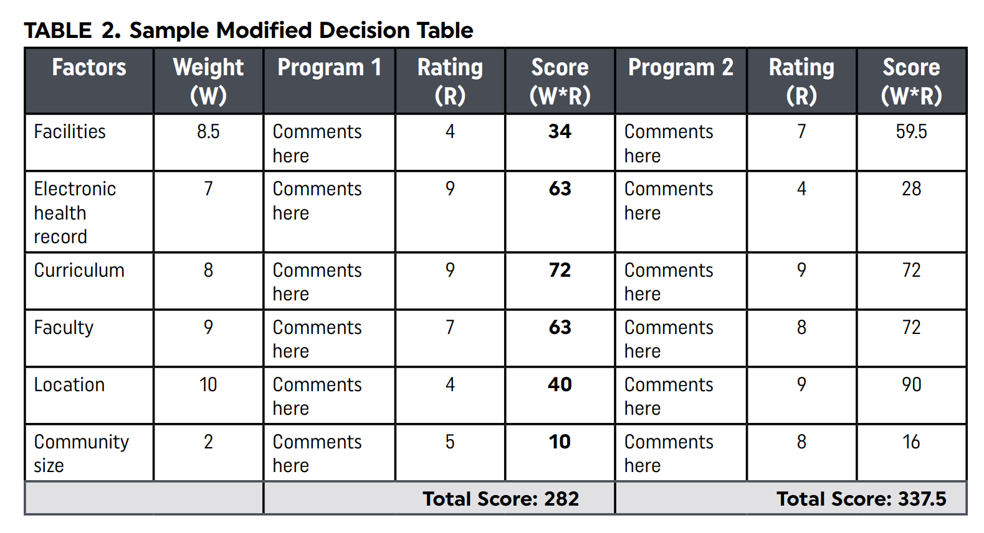

Slide 23
2023-24 Strolling Through the Match Guidebook
Features of the Guide
How to use signaling, past experience, and geographic preference in residency applications
Side-by-side comparison of residency training experiences in the primary care specialties
Match statistics and strategies for successful match into family medicine
Events and conferences with residency fairs
Interview question lists on a variety of subjects
Guidance for international medical graduates
Tips on interviewing and writing CVs and personal statements
Residency selection steps and program evaluation advice
Real stories from students who have matched into family medicine
Virtual interview advice
Updated statistics on the SOAP

Slide 24
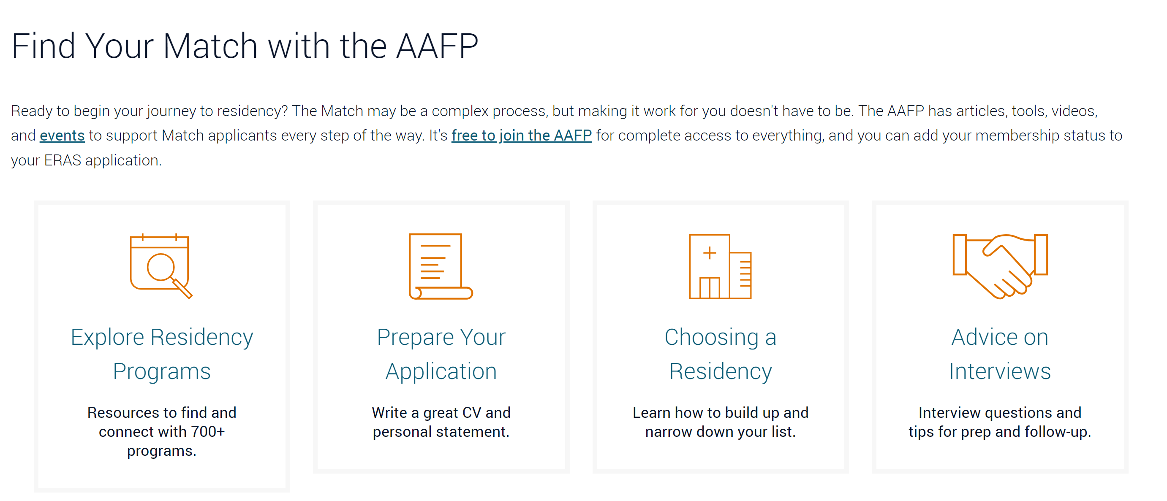

Slide 25
Wellbeing During Interview Season
Know your worth
Put things in perspective
Build yourself up
Reach out for support
Let go of mistakes

Slide 26
Residency

Slide 27
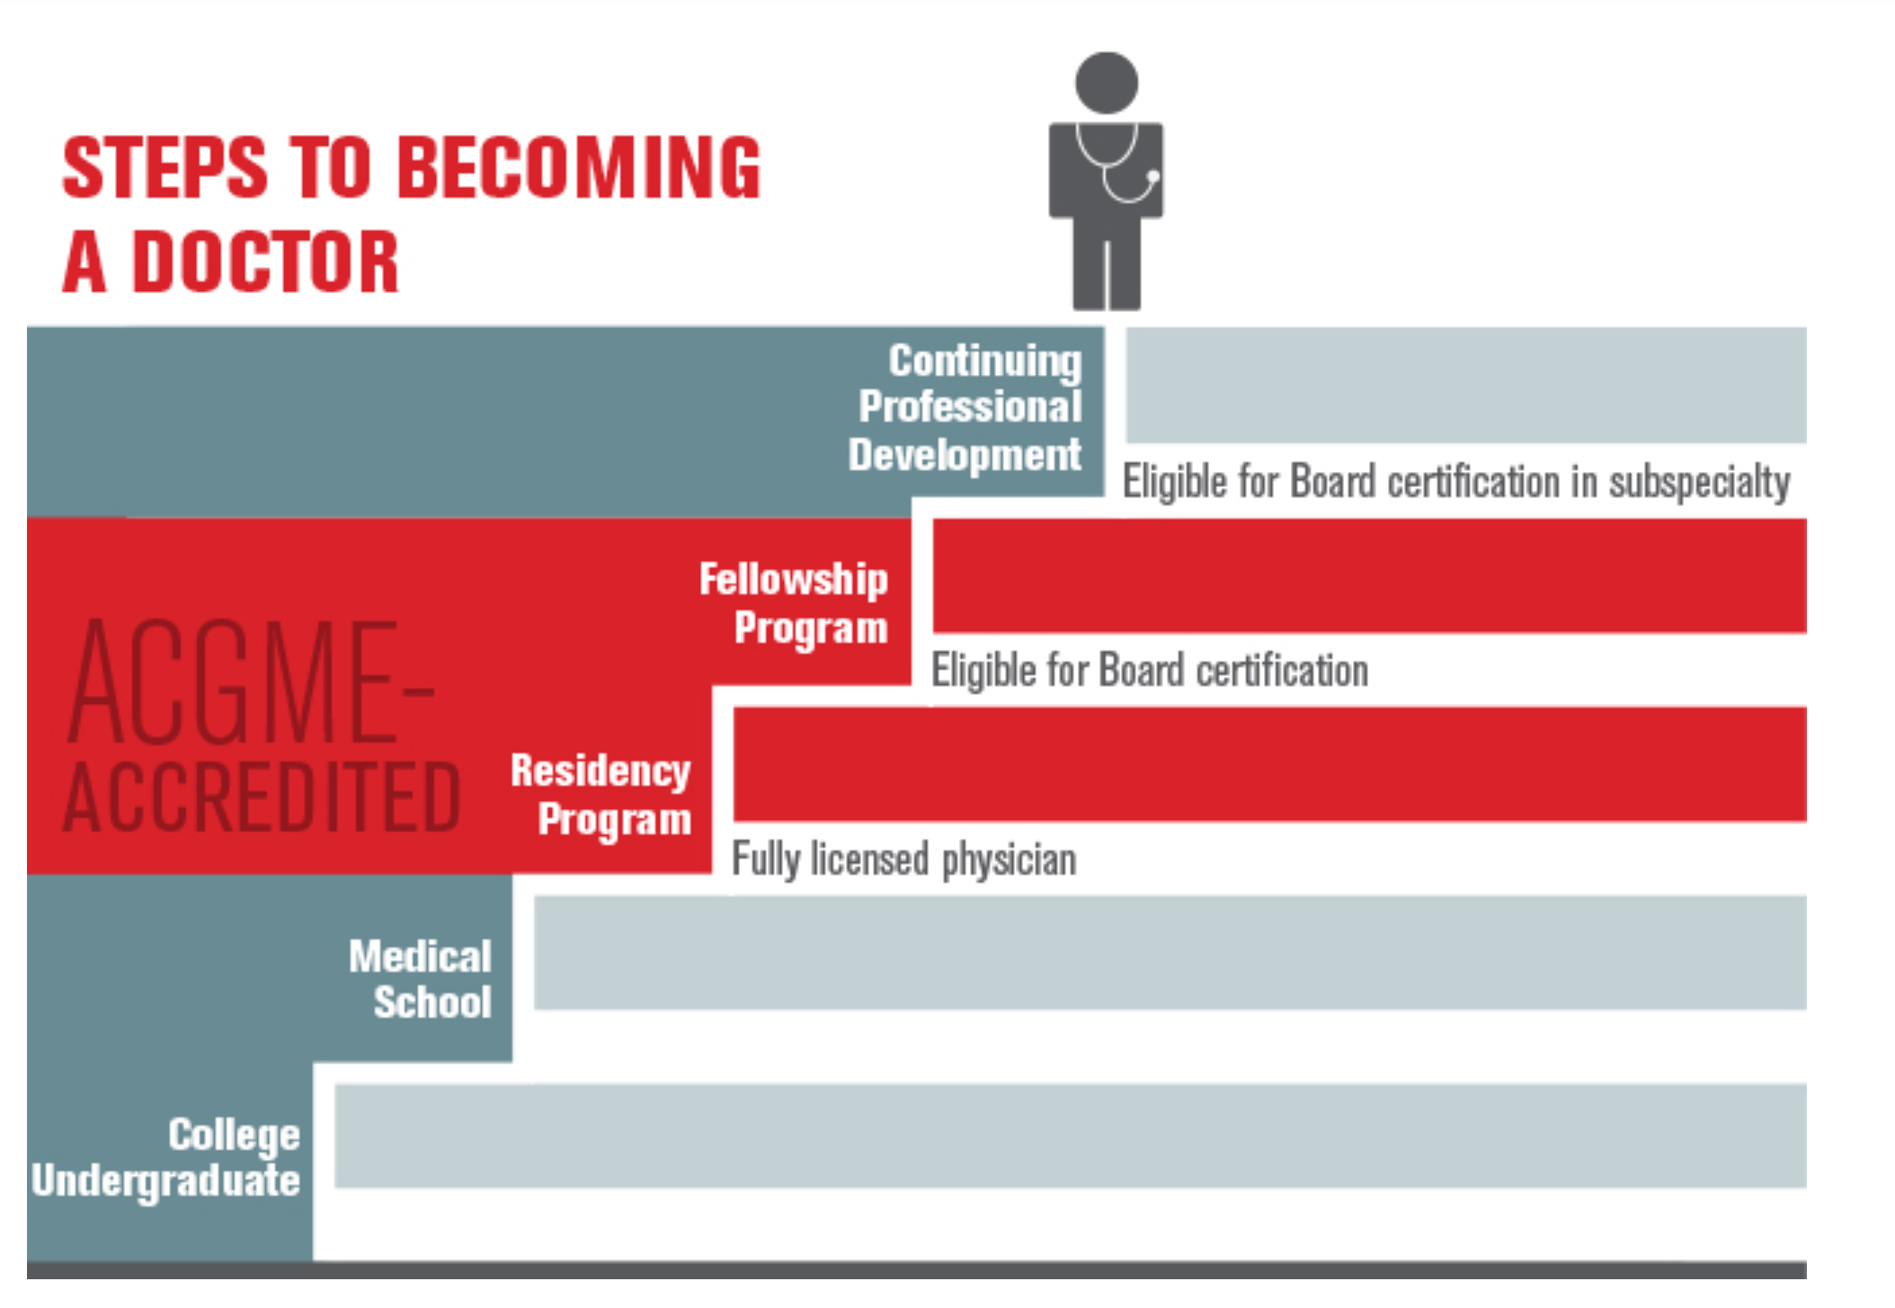
https://www.acgme.org/about/overview/ accessed 7/11/23
Notes:
Graphic source: https://www.acgme.org/about/overview/ accessed 7/11/23

Slide 28
Overview of Residency Timeline
PGY 1
PGY 2
PGY 3
Yr 4
Pediatrics
OBGYN
Adult Medicine
Specialty Surgery
Surgery
Behavioral Health
Ambulatory Care
Geriatrics
Community Health
Advanced Training

Slide 29
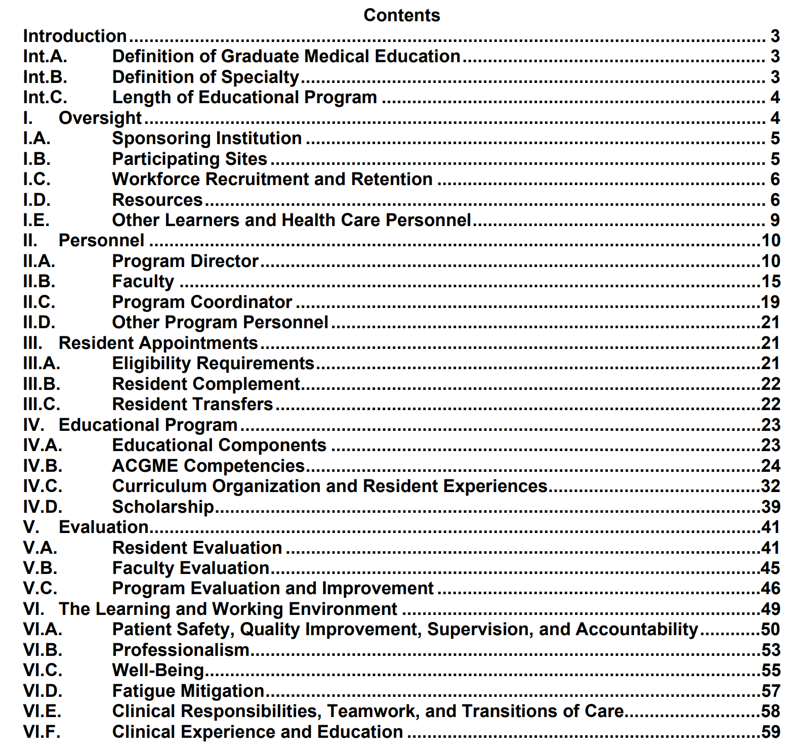

Slide 30
ACGME FM Updates
Panel metrics instead of the 1,650 face-to-face visits
Panel management includes telehealth and care in multiple settings.
Continuity of care measured, along with a minimum number of hours delivering care in the family medicine practice.
Patient advisory committees to address the health needs of the community.
Resident assessment and coaching with individual learning plan (ILP)
6 months of elective time —based upon the ILP and future practice goals
Two-tier pregnancy care requirement.
Notes:
Update this slide

Slide 31
Training in Family Medicine
Three to four-year residency
Ambulatory medicine
Hospital medicine
Pediatrics
OBGYN
Surgery & Special Surgery
Community Medicine
Health Care Systems
Community Medicine
Geriatrics
Sports Medicine
Musculoskeletal Medicine
Electives, etc.
Fellowship Opportunities
Women’s Health/OBGYN
Geriatrics
Sports Medicine
Adolescent Medicine
Hospice & Palliative Med
Clinical Informatics
Emergency Medicine
Faculty Development
International Medicine
Research
Rural Medicine
Substance Abuse

Slide 32
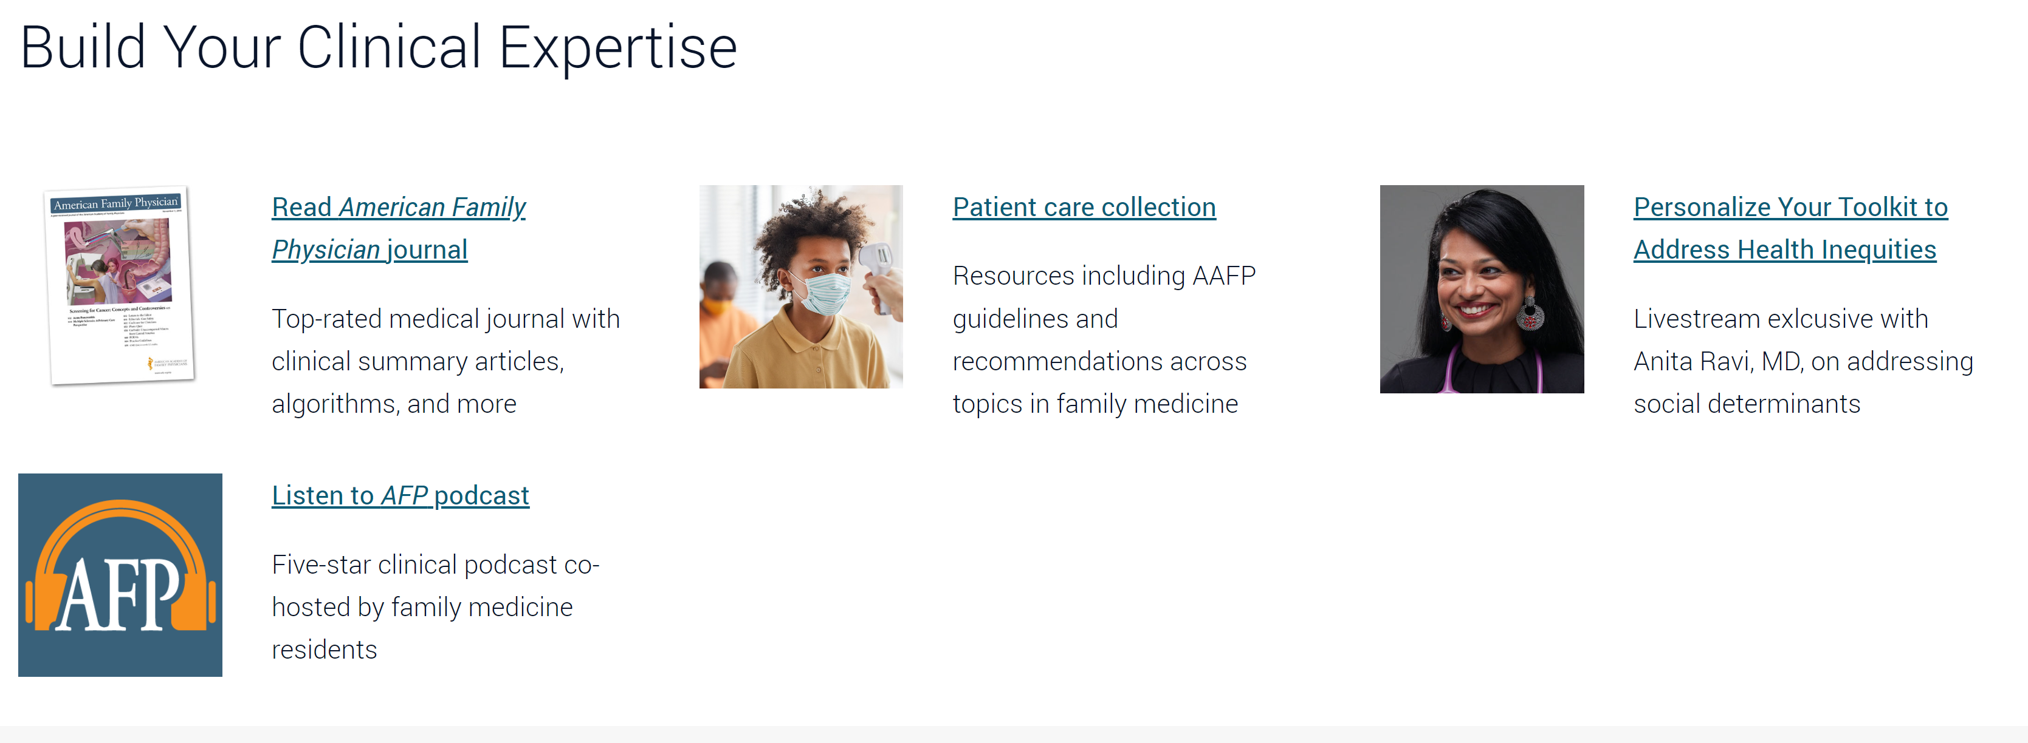

Slide 33
Preparation for your first Board Exam
Board Exam
PGY3 ITE
Exam Score
PGY2 ITE
PGY1 ITE
Board Exam Preparation
Review and Study
Review and Study
Review and Study
Notes:
AAFP image source: https://www.aafp.org/students-residents/residents/transition-into-practice/prepare-for-board-exam.html

Slide 35
Notes:
AAFP resources

Slide 36
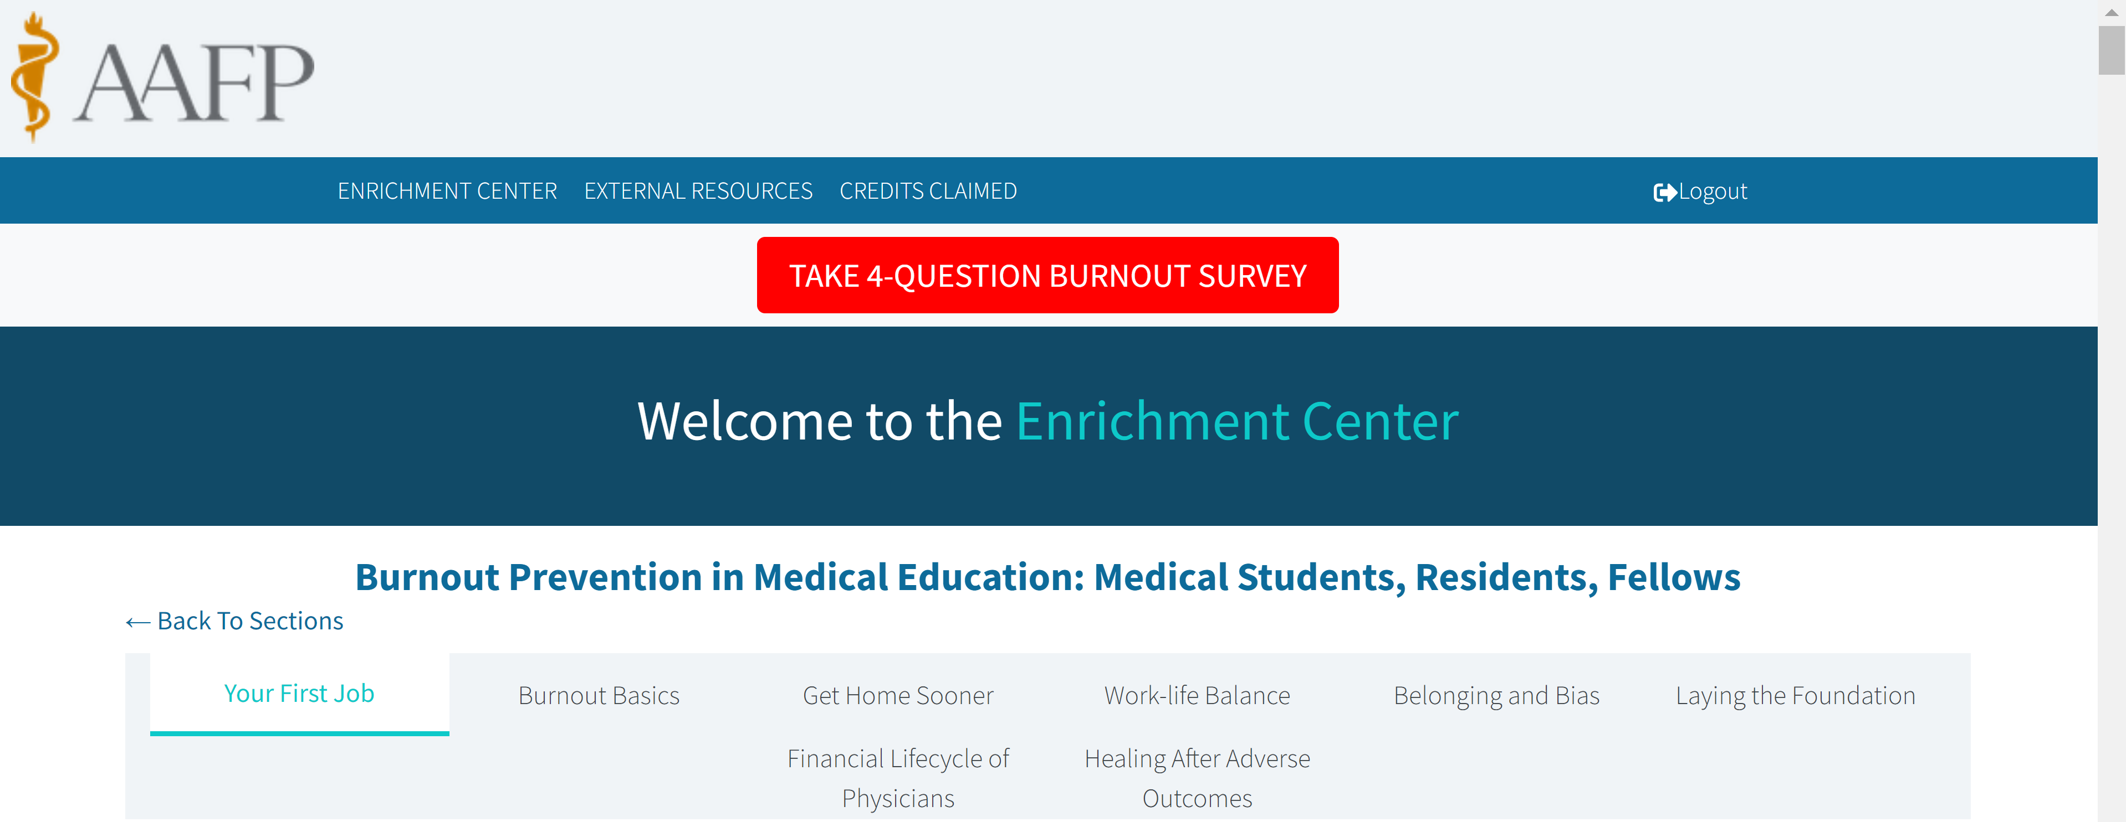

Slide 37
AAFP Advocacy to Strengthen the Workforce
THCGME Reauthorization
GME Reform
Distribution of year-end legislation slots
Rural Workforce Production (inc. training opportunities)
Wellbeing/Burnout
Loan Repayment
Workplace Harassment
Conrad 30 Visa Program
Notes:
It is projected that we will face a shortage of up to 48,000 primary care physicians by 2034
THCGME Reauthorization
The program has trained 1,700+ primary care physicians and dentists, 63% of whom are family physicians.
Program and funding expires in 2023 – will press for long-term extension/permanency
Working closely with THC Coalition to build support for program
Introduction of the DOC Act – legislation to permanently authorize the THCGME program
AAFP to support this legislation and efforts to extend the program.
GME Reform
Distribution of year-end legislation slots (100 slots)
Rural Workforce Production Act – new training opportunities for rural areas (AAFP endorsed legislation)
Seeking additional transparency on allocation of funding – legislation expected to be introduced that AAFP would support.
Loan Repayment
REDI Act – legislation that would delay repayment of loans until after residency programs conclude
AAFP has endorsed this legislation and will be building support for enactment.
Wellbeing/Burnout/Harassment
Supporting policies that aim to push back on anti-evidence-based care or direct attacks on clinicians
Push back on misinformation efforts push by select Members of Congress
Potential legislation in the future that seeks to address broader workforce challenges
Conrad 30 Visa Program
Program has brought 15,000+ foreign physicians into underserved and rural communities
22% of these foreign physicians are family doctors
One-year extension of program (expires December 2023).
AAFP endorsed legislation that would extend/make permanent the Conrad 30 program.
Note: the AAFP recently submitted testimony to the Senate Health, Education, Labor and Pensions Committee pressing several of these issues.
Updated/reviewed: March 2023

Slide 38
Expand and support high-quality family medicine GME positions
GME funding advocacy
Program Resources:
Residency Program Solutions and Criteria for Excellence
Residency Leadership Summit
Curriculum Guidelines
Resident Resources for Programs:
Chief Resident Leadership
Career, practice, leadership and well-being resources
Board preparation
Notes:
To support an increase in the number of students choosing family medicine, we also need more family medicine residency positions. These need to be in high-functioning practice environments to train our future family physicians.
The AAFP actively advocates for additional GME financing in the areas of most need, particularly in rural and medically underserved areas.
The AAFP supports programs to start up, expand, innovate, and continually improve through Residency Program Solutions (RPS) consultations by a panel of experienced program director consultants. RPS also supports programs to implement the new family medicine requirements through self-assessment and guidance contained in the Criteria for Excellence resource.
The Residency Leadership Summit is designed to assist programs in the nuts and bolts of running residency programs. Over 1000 residency leaders attend each year.
Additionally, AAFP supports both residents and residencies with resources for career, practice, and clinical topics as well as training opportunities in leadership and well-being.
Updated/reviewed: March 2023

Slide 39
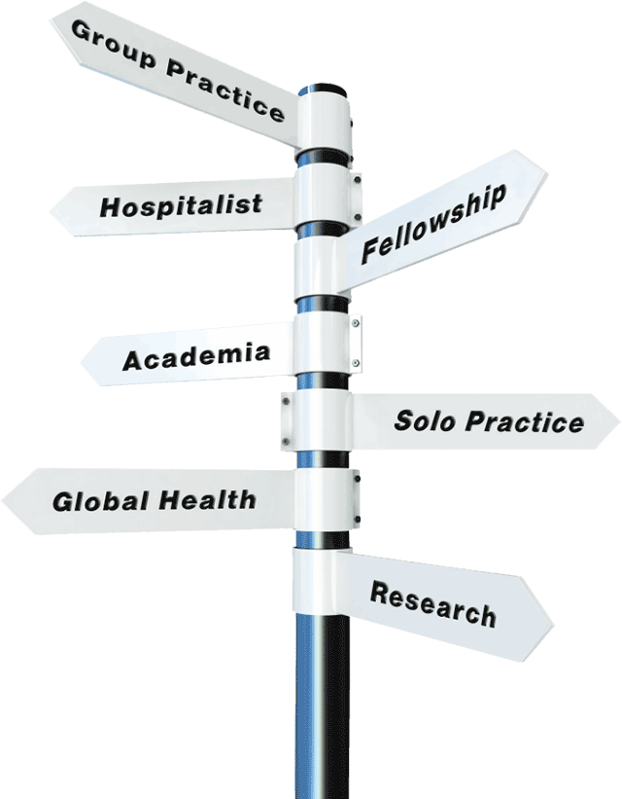
After Residency…now what?
What kind of practice is right for me?
Although a small percentage of new family physicians choose to pursue alternative practice styles, most join traditional practices that provide personalized, comprehensive, continuous patient care. The 21st century model of American primary care – the patient-centered medical home (PCMH) – is patient-focused and delivered by teams led by family physician. Learn more about being part of a PCMH practice.
You probably have a general notion of your ideal practice. If not, use the AAFP’s Practice Preference Worksheet to identify priorities such as practice style, community type and geographic location.

Slide 40
I know what I want. Now what?
AAFP’s Careers section contains articles and worksheets to help you:
Polish your CV
Learn about negotiating employment contracts
Identify prospective employers
View current job listings
Track your job search progress

Slide 41
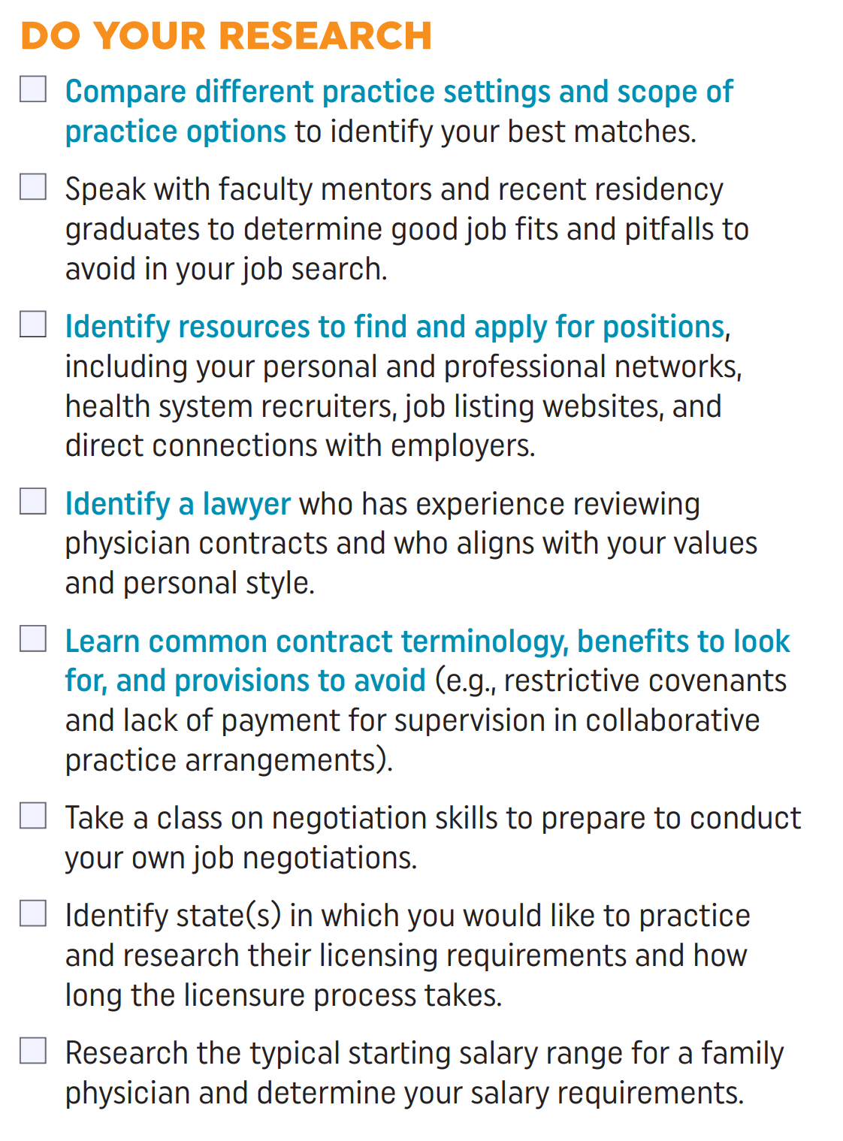
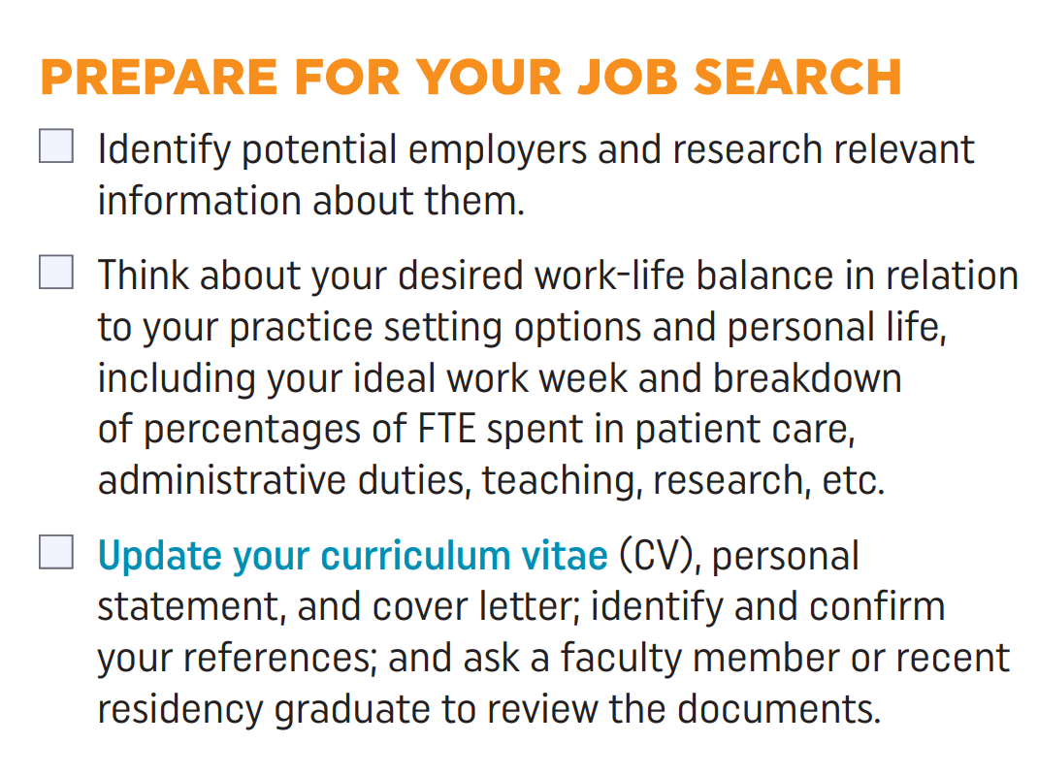
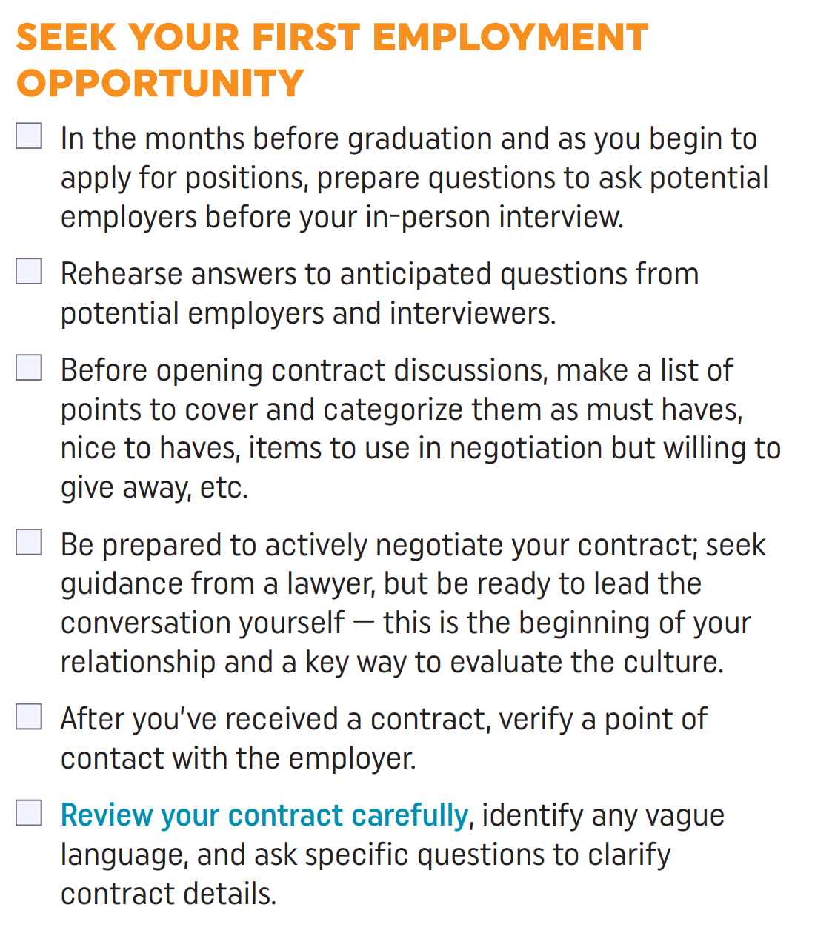
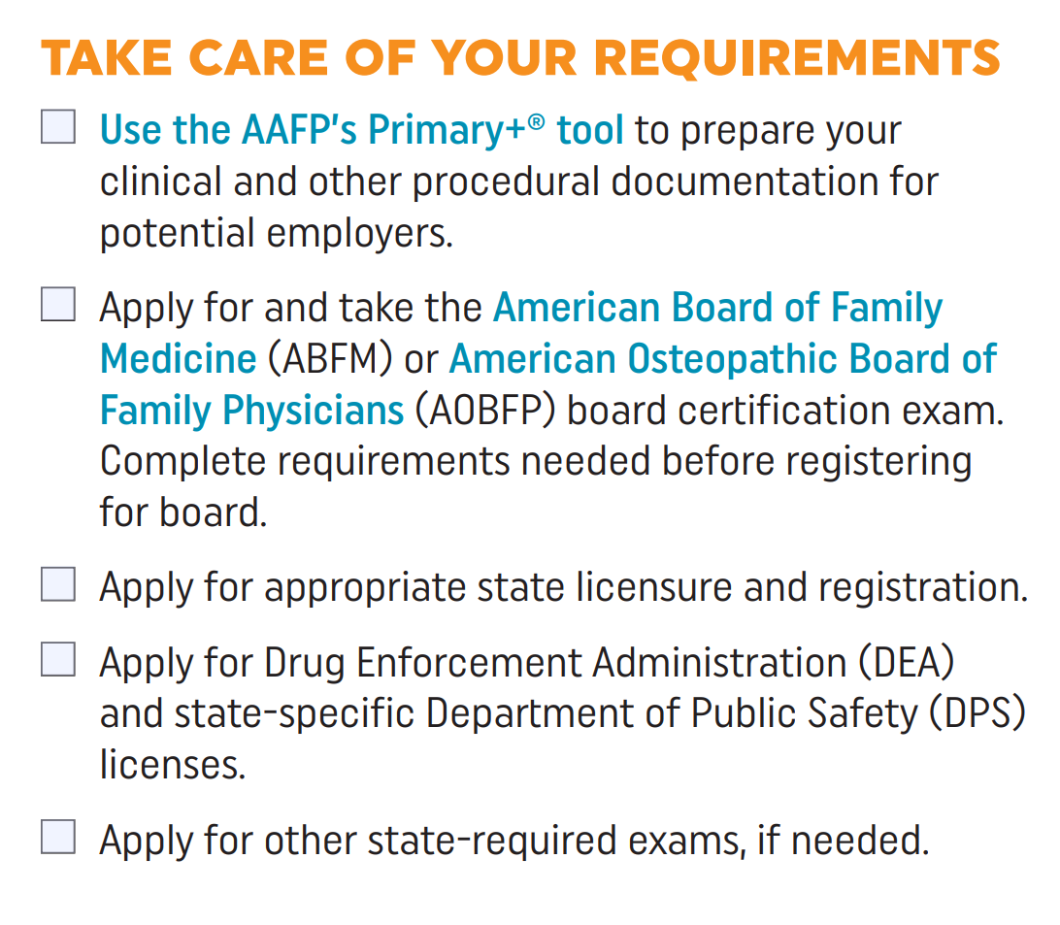
Resident Employment Preparation
Notes:
Source: AAFP Strolling through the Match, 2023 https://www.aafp.org/students-residents/medical-students/become-a-resident/match/strolling-through-the-match.html

Slide 42
After Residency

Slide 43
Practice Settings
Office practices
Community health centers
Hospitals
Nursing homes
University-based health centers
Urgent care centers
Emergency rooms

Slide 44
Practice Options
Practice Models
Part-time vs. Full-Time Practice
Multispecialty Group Practice
Direct Primary Care
Practice Ownership
Partnership
Employee Status
Rural or Urban Practice
Solo vs. Group Practice
Professional Roles
Inpatient Medicine
Maternity Care
Sports Medicine
Procedures
Research
Emergency Medicine and Urgent Care
Medical Education
International & Wilderness Medicine
Public Health

Slide 45
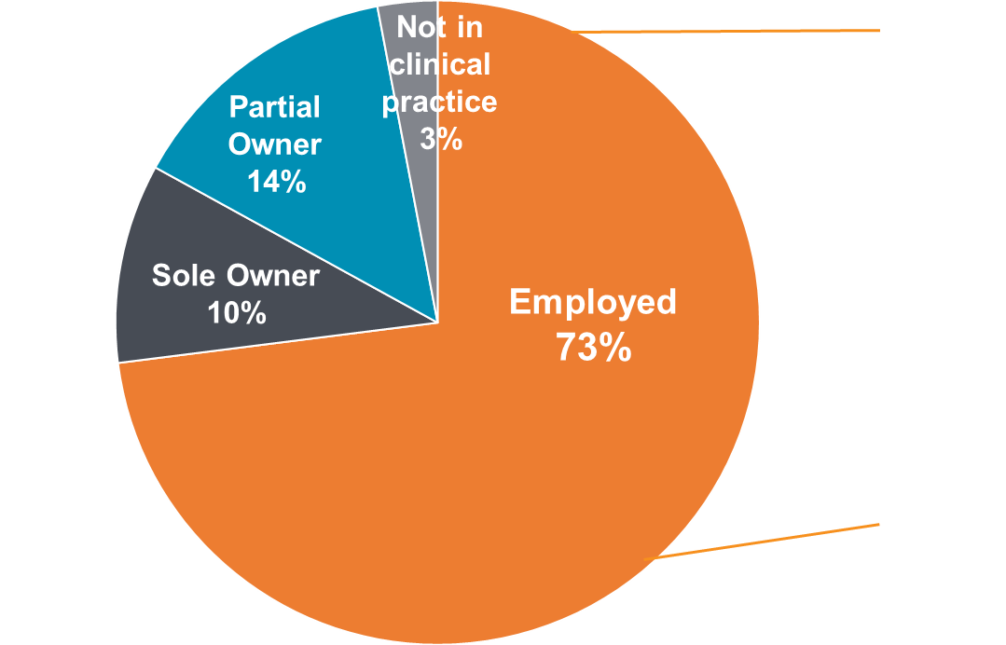
Employment Profile
Employer
Hospital or health system | 54%
Physician group | 18%
FQHC/Community health center | 11%
Federal (military, VA, Dept. of Defense) | 5%
Insurance or managed care organization | 3%
State or local government | 2%
Locum tenens groups/staffing organization | 1%
Other | 6%
Source: Member Census
Notes:
Please note: If the options provided on the Member Census don’t fit the description of members’ employers, they have the option to write in the type of employer under “other.”
Updated/reviewed: March 2023

Slide 46
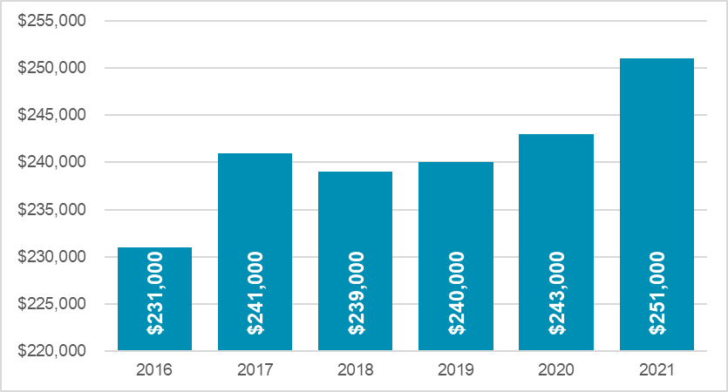
2022 Average Starting Salaries for Family Medicine
Source: 2022 Review of Physician and Advanced Practitioner Recruiting Incentives, Merritt Hawkins
Notes:
Chart source: https://www.merritthawkins.com/trends-and-insights/article/reports/2022-review-of-physician-advanced-practitioner-recruiting-incentives/
https://www.merritthawkins.com/uploadedFiles/MerrittHawkins/Content/News_and_Insights/Articles/mha-2022-incentive-review-final.pdf

Slide 47
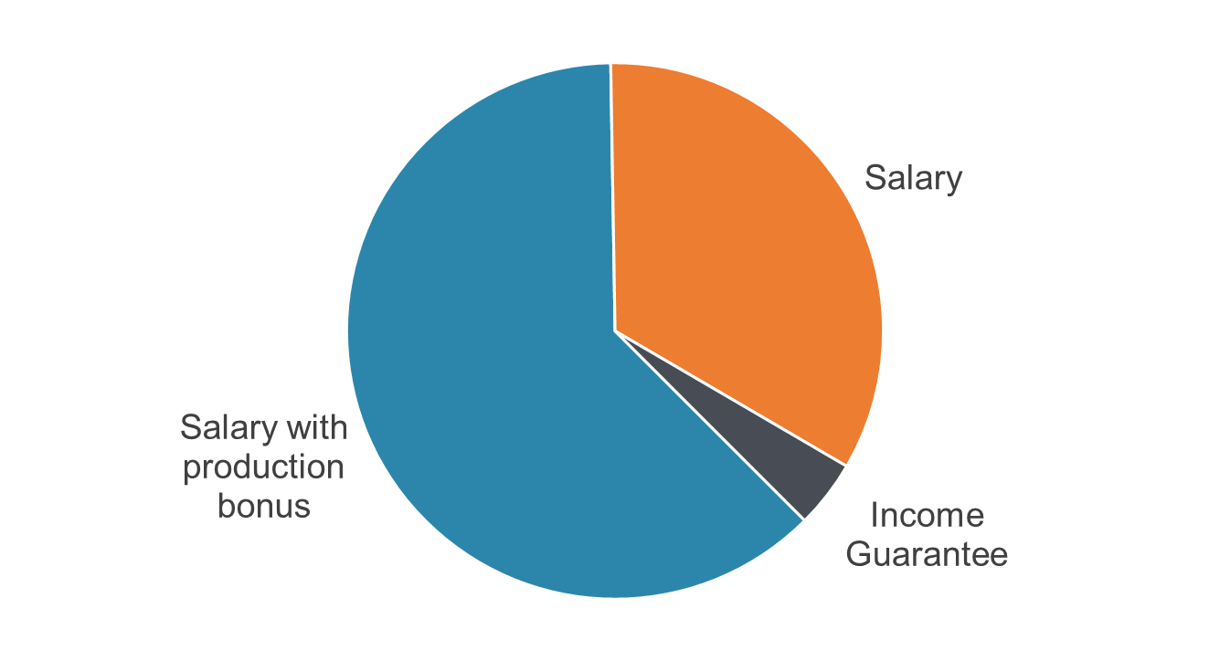
Types of Physician Compensation Structures, 2022
Source: 2022 Review of Physician and Advanced Practitioner Recruiting Incentives, Merritt Hawkins

Slide 48
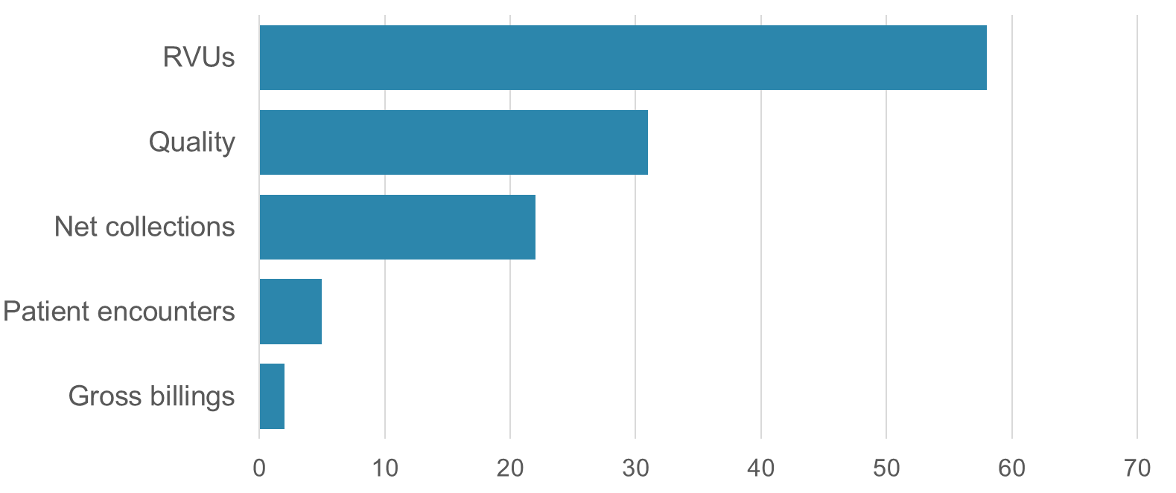
Common Bonus Metrics
Source: 2022 Review of Physician and Advanced Practitioner Recruiting Incentives, Merritt Hawkins

Slide 49
Who we are…

Slide 50
Meet Family Physicians
One specialty, many possibilities
Notes:
To understand how many possibilities you’ll have in your career if you become a family physician, you have to meet family physicians. In the first two years of medical school, however, this can prove a challenge. It might not be until your clinical rotations that you meet a practicing family doctor. Even then, you’ll have experienced maybe one practice setting, when the reality is that family medicine often looks different from clinic to clinic. This is in large part due to family physicians being trained to have a broad set of skills that equip them to care for any person, regardless of the patient’s age, gender, or health status. These qualities make them highly adaptable no matter what environment they find themselves in after training. In fact, family physicians are often characterized as the pluripotent stem cells of the health care system because they serve communities in an incredible number of ways. I hope to show you the scope of opportunities you’ll have in family practice through some of their stories. Here are some of the people I hope you keep in mind as you think about family medicine.

Slide 51
AAFP Member Survey Results
Weekly
51
47%
16%
61 office visits
13 e-visits
8 hospital visits
1 nursing home visit
1 home visit
Average hours per week
Hospital Privileges
Deliver babies
24%
$232,000
In first seven years of practice
Mean income

Slide 52
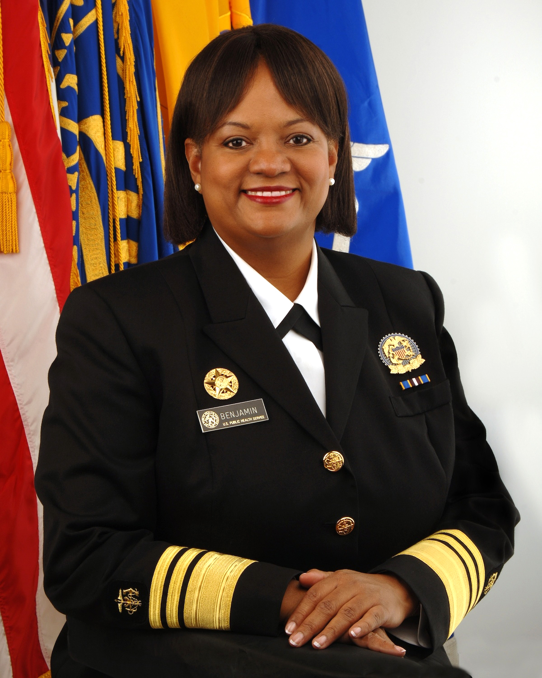
Regina Benjamin, MD, MBA
Appointed United States Surgeon General by Barack Obama in 2009
Background as rural family physician in southern Alabama
Recipient of 22 honorary degrees
First African-American woman elected to the American Medical Association Board of Trustees
Philosophy: people should enjoy becoming and staying fit
As Surgeon General, made prevention, breastfeeding, and healthy housing priorities

Slide 53
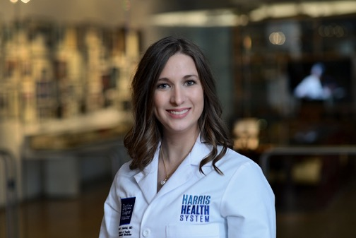
Shannon Barkley, MD, MPH
Has worked as a physician, researcher, and faculty member
Has provided health care to underserved communities in urban areas of the United States, as well as Guatemala, Botswana, and Kenya
Current World Health Organization Technical Officer for Primary Health Care Services, providing technical assistance to countries as they seek to improve their primary health care systems
Co-founded the Guatemala Health Initiative at the University of Pennsylvania

Slide 54
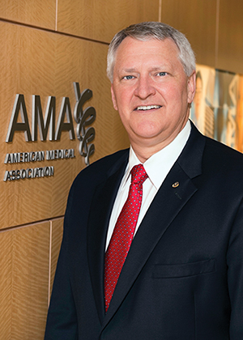
David Barbe, MD, MHA
Past President of the American Medical Association (inaugurated 2017)
Leading strategies focused on better health for Americans with pre-diabetes and hypertension
Began serving on Board of Trustees in 2009
Developed AMA policy on areas including increasing insurance coverage, health system reform, and Medicare reform
Former chair and president of Missouri State Medical Association

Slide 55
Anita Ravi, MD, MPH, MSHP
Former reproductive health fellow at the Centers for Disease Control and Prevention
Public health interest led her to family medicine
Championing a national effort to improve medical education on trafficking
Founded the PurpLE Clinic in NYC, which serves persons who have experienced trafficking and assault
Storyteller and comic artist who advocates for patients through narrative

Slide 56
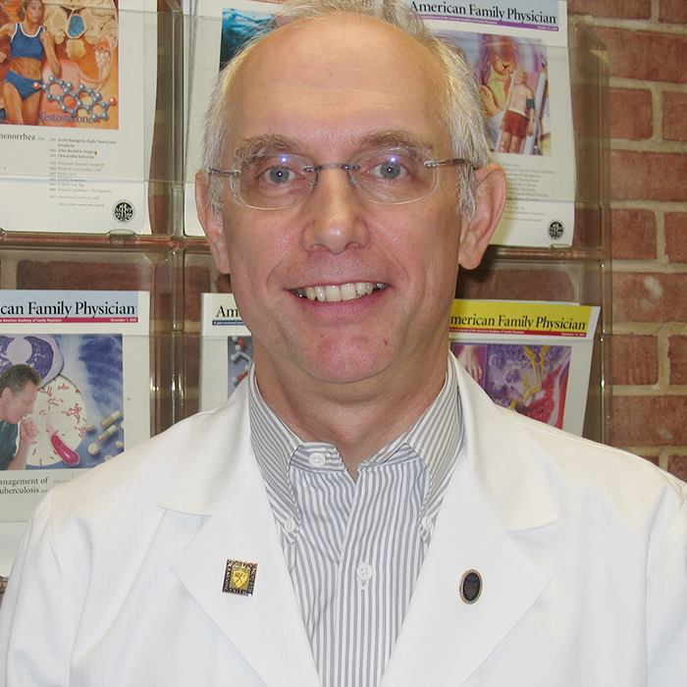
Jay Siwek, MD
Editor-in-Chief of peer reviewed American Family Physician journal for 30 years
Wrote multiple articles as a health columnist for national publications including Washington Post
Spent a decade as the tour physician for the National Symphony Orchestra
Developed a practice-based research network for family physicians in Washington, D.C.
Created fellowships in health policy, community medicine, and medical editing at Georgetown University Medical School

Slide 57
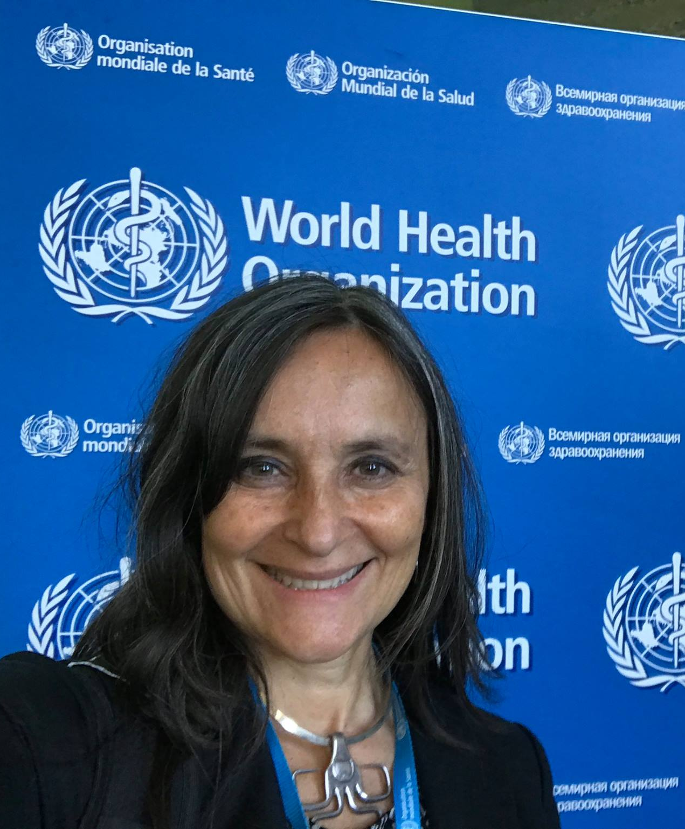
Viviana Sandra Martinez-Bianchi, MD
Executive board member of the World Organization of Family Doctors (WONCA)
WONCA Liaison to the World Health Organization
Health Disparities Team Chair at Family Medicine for America’s Health
Global health expert who has taught in South America and publishes in Spanish and English

Slide 58
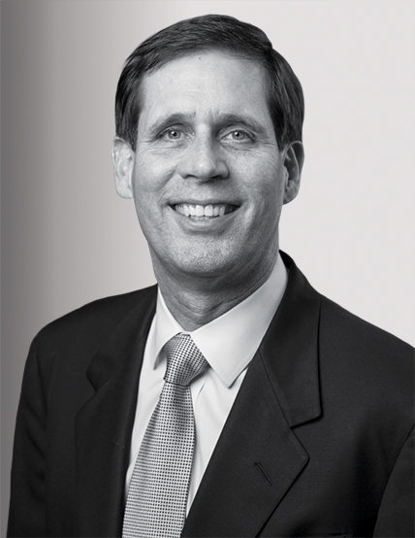
Thomas Allen Cornwell, MD
Named one of the most creative people in business by Fast Company for his innovation in the use of house calls to save money and improve care
Founded the nonprofit Home Centered Care Institute
Partnered with Massachusetts senator Ed Markey to introduce a bill making home-based care a Medicare benefit

Slide 59
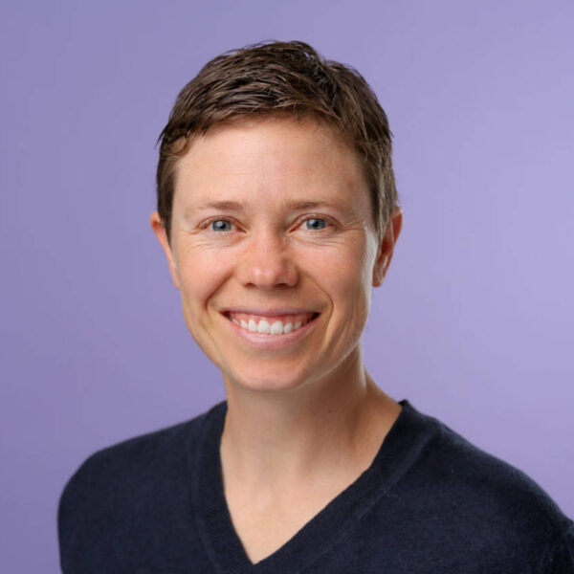
Isabel Lowell, MD
Advocate for a primary care system that serves the health needs of transgender patients
Founder of the Gender Clinic at Emory University
Founder of QMed, which provides affirming care for transgender patients of all ages through in-person visits and via telemedicine, helping to reach patients across the US
Board member of the Transgender Health and Education Alliance

Slide 60
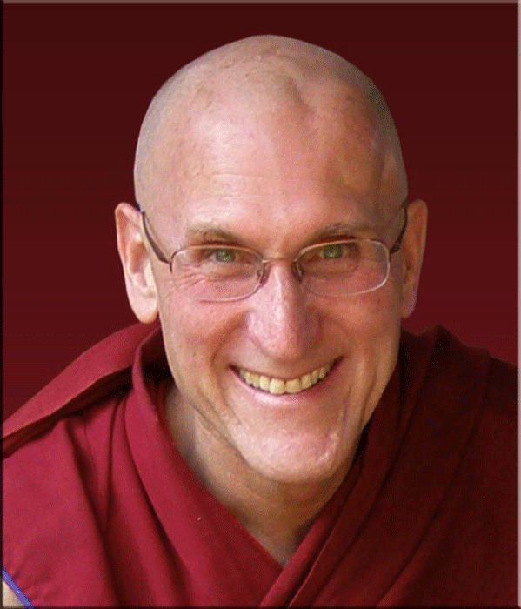
Barry Kerzin, MD
Personal physician to the Dalai Lama
Ordained Buddhist monk with a background in philosophy
Founder of Altruism in Medicine and the Human Values Institute
Writer, professor, speaker, and contributor to medical research on the effects of meditation on the mind and body
Dedicated to creating a world where all can receive compassionate, accessible, and culturally comprehensive care

Slide 61
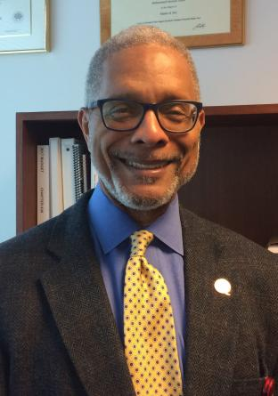
M. Norman Oliver, MD, MA
Virginia Department of Health Deputy Commissioner for Population Health
Holds joint faculty positions in the departments of Public Health Sciences and Anthropology at the University of Virginia
Co-founder of the UVA Center on Health Disparities
President of the North American Primary Care Research Group (2017-2018)
Researches the social determinants of health and efforts to reduce racial and ethnic health disparities

Slide 62
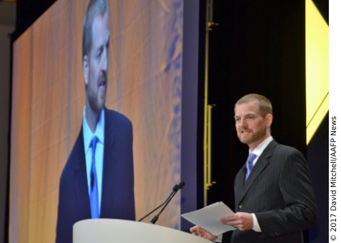
Kent Brantly, MD
Became a family physician with the goal of serving a medical missionary who could help anyone regardless of age, gender, or disease process.
Treated patients with Ebola during an outbreak in Liberia
Advocate for organizations that provide support and front-line aid in West Africa
Recognized by Time magazine as a person of the year for his role alongside other medical professionals treating Ebola during 2014 outbreak
Author and public speaker; delivered invocation at 2015 National Prayer Breakfast

Slide 63
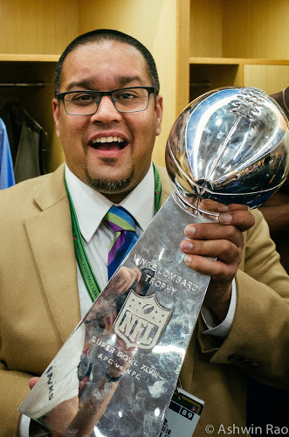
Ashwin Rao, MD
Team physician for the Seattle Seahawks and the University of Washington Huskies Intercollegiate athletes
Studied family medicine and completed a sports medicine fellowship
Elected Member, Board of Directors and Co-Chair of Education Committee, American Medical Society for Sports Medicine
Musculoskeletal ultrasonography expert (diagnosis and procedural), percutaneous tenotomy expert
Cares for Olympic athletes and professional runners in practice

Slide 64
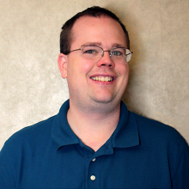
Mark Ryan, MD, FAAFP
Mark Ryan, MD, FAAFP, practices family medicine in Richmond, VA, where he teaches, volunteers, travels, and tweets!
He is assistant clinical professor of family medicine for Virginia Commonwealth University, and medical director for the school's international/inner city/rural preceptorship. He works in three different practices.
One is the faculty practice in downtown Richmond, where most of the patients are uninsured and receive care under the health system's patient assistance program.
He also works in a satellite clinic in south Richmond seeing mostly pediatrics patients, 90% of whom are Spanish-speaking. He also teaches in a free clinic one evening a week and spent four years working in rural private practice before joining the VCU faculty. Dr. Ryan is also very active on social media.
@RichmondDoc
smhcop.wordpress.com
richmonddoc.tumblr.com
richmonddoc.blogspot.com

Slide 65
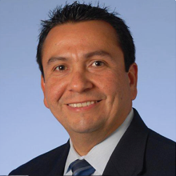
Javier F. Sevilla-Martir, MD
Javier F. Sevilla-Martir, MD, has acquired many titles in his ten years as a family physician. He practices and teaches at the Indiana University Methodist Family Medicine Center, which is in inner-city Indianapolis and serves a diverse community that includes system employees and a significant underserved population.
Originally from Honduras, Dr. Sevilla-Martir is bicultural and bilingual, and is able to offer services to Spanish-speaking families, as well as support students interested in learning medical Spanish. Dr. Sevilla-Martir was the 2011 Taylor Excellence in Diversity Award winner, an honor from the university.
He served as an associate professor of clinical family medicine, director of Hispanic/Latino health, international medicine, and global health for the IU department of family medicine and is assistant dean of diversity for the school of medicine.

Slide 66
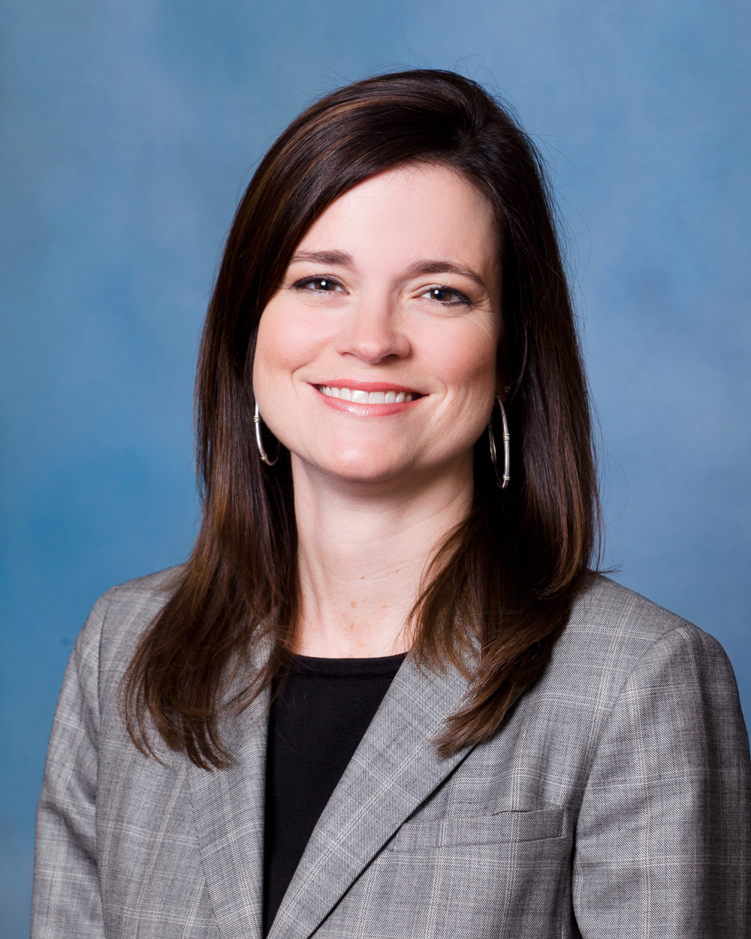
Beverly Flowers Jordan, MD, FAAFP
Beverly Flowers Jordan, MD, FAAFP, practices family medicine in the rural community of Enterprise, Alabama. She is part of a four-physician partnership that employs a certified registered nurse practitioner and provides ancillary services to its patients, which include the population of the farming community around Enterprise and the local military base. She has a certificate of added qualification in sports medicine, and also served as chair of the board of directors of the Alabama Academy of Family Physicians.

Slide 67
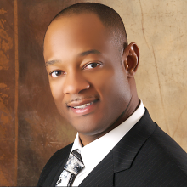
DeVry C. Anderson, MD
DeVry C. Anderson, MD, started his career as a military surgeon, completing an internship in orthopedic surgery before serving in the military. He went back to complete a family medicine residency in 2009 and now serves as a military surgeon for the Warrior Transition Brigade, Fort Hood, TX, and as owner and chief medical officer for Quick Care Walk In Clinic (quickcaretoday.com) in North Austin, TX.
Dr. Anderson uses his training for the management of simple fractures and common sports injuries, occasionally working the sidelines for high school sporting events. He also has Federal Aviation Administration designation as an Aviation Medical Examiner, which allows him to offer health care to both military and civilian pilots. Through his two practices, he is able to serve two very distinct medical communities.
At his military practice, Dr. Anderson focuses on full-spectrum adult medicine and flight medicine, often seeing issues common to pilots, soldiers and veterans returning from war, including behavioral health and sports injury components coupled with routine health maintenance and screening. The Quick Care clinic services a predominately Spanish-speaking and underserved population, and the care is focused on urgent care medicine, patient education and access to care for a population that might otherwise only be able to utilize the emergency room for routine care.

Slide 68
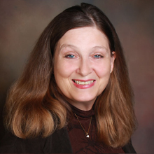
Joane G. Baumer, MD
Dr. Joane G. Baumer's 32 years in family medicine have included sports medicine, women's care, and global health initiatives.
Dr. Baumer is chair of the department of family medicine at JPS Health Network Family Health Center in Fort Worth, Texas, a teaching clinic for the family medicine residency and geriatric residency that also serves as the international health clinic for the Immigration and Naturalization Service.
Located in an urban community that serves a diverse population, the department provides clinical services to multiple sites in the county through a centrally located hospital, a surgicenter, a sports and pain clinic, four family health practices, two residency practices, and 19 school-based clinics in neighborhoods.

Slide 69
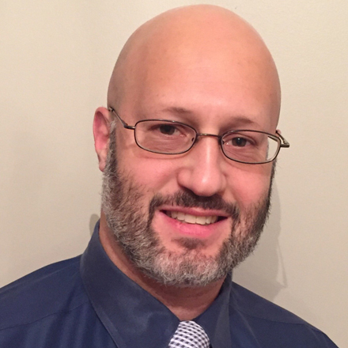
Marc Price, DO
Marc Price, DO, says he was a family physician even before graduating medical school in 1999. In private practice in Malta, N.Y., Dr. Price worked for a large group practice before deciding to open his own solo practice. Dr. Price sees about 100 patients per week in his practice and said it's the clinical patient interactions that attracted him to family medicine.
He is also heavily involved in advocacy efforts on behalf of family medicine, serving on the AAFP Commission on Governmental Advocacy and is a past president of the New York State Academy of Family and delegate to the AAFP.
Notes:
TIM

Slide 70
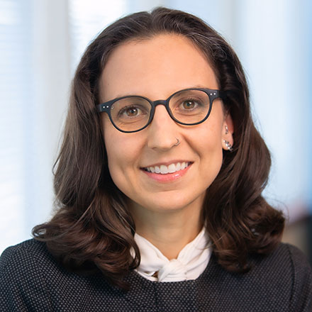
Sarah C. Nosal, MD, FAAFP
Sarah C. Nosal, MD, FAAFP, vice president for Innovation & Optimization and chief medical information officer at The Institute for Family Health, an FQHC network with 27-plus Mid-Hudson, Bronx, Manhattan, and Brooklyn locations.
As CMIO she secured financial support for IT infrastructure and helped her institution become a regional leader in data sharing and ensuring equitable information access. Nosal's focus is on care of marginalized communities with two decades of practice in the South Bronx.
She also serves as for NYU and Einstein student-run free clinics.

Slide 71
How the AAFP Invests in You

Slide 72
PPPLEWAAT
DEI
DEI
Payment | Pathway (Pipeline) | Practice
Leadership | Education | Well-Being
Administrative Complexity | Advocacy | Technology

Slide 73
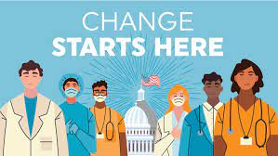
Join us!
Sept 22- 25, 2024
Sheraton Grand Hotel
Phoenix, AZ
April 18-20, 2024
Family Medicine Advocacy Summit
Sun, May 19 - Tues, May 21, 2024
Washington, DC
FMX is Sept 25 – 28, 2024
Aug 1-3, 2024
Notes:
National Conference
The Academy keeps medical students and residents active and engaged in family medicine and their future as family physicians by hosting the National Conference of Family Medicine Residents and Medical Students each summer.
Next year’s conference will be held in Kansas City, MO July 27-29, 2023. The resident and student congresses will be during this event as well.
Objective is to educate medical students on, and garner interest in, family medicine; reaffirm residents’ decisions to join family medicine.
Advocate for family medicine.
Foster leadership development and member empowerment.
Offer unique educational opportunities and clinical workshops.
Provide networking opportunities.
Provide a forum for residency programs.
Encourage and strengthen AAFP membership.
The AAFP Foundation generously supports this event by providing 250 Family Medicine Leads Scholarships in the amount of $600.
FMX (Family Medicine Experience) is the AAFP’s largest annual meeting.
FMX will be held in Chicago, Oct. 26-30, 2023
FMX is the PREMIER event for family physicians and industry leaders to come together to advance the specialty of family medicine by bringing the best the AAFP has to offer in Education, Patient & Practice Solutions and Networking Opportunities.
FMX offers exclusive courses that provide attendees with the latest Family Medicine content updates.
FMX is THE place for Family Physicians to recharge and refuel
Congress of Delegates has historically been held just ahead of FMX each year
2023 COD will take place in Chicago Oct. 25-27, 2023
The Congress of Delegates is the Academy’s policy-making body. During the annual meeting, new officers are elected, and members can participate in reference committee hearings.
Leadership conference is held each Spring, in Kansas City, MO. It consists of ACLF and NCCL. The 2023 leadership conference will be held May 9-11.
The Annual Chapter Leader Forum (ACLF)
This meeting is an excellent opportunity to hone leadership skills, especially as it relates to current or future participation in leadership roles in chapters.
Over three days, participants network with peers and AAFP leaders, receive training on working with the media, understand different roles and responsibilities of the board and board members, and more, through nearly 40 breakout sessions.
National Conference of Constituency Leaders (NCCL) is held each Spring.
Leadership and policy development event for current and aspiring leaders where you can:
Gain and enhance skills to become an articulate policy advocate and an effective leader.
Meet others who share similar interests.
Develop your voice and be heard.
Elect national officers.
5 member constituencies:
Women
Minorities
New physicians
LGBT physicians
International medical graduates
Updated/reviewed November 2022

Slide 74
In Summary
The educational path in family medicine is both rewarding and demanding.
Graduate medical education is transforming the future.
We have numerous resources at your disposal.
Stay involved with the AAFP.
Take care of you.

