Slide 1
The Business of Medicine
Lauren S. Hughes, MD, MPH, MSc, MHCDS, FAAFP
Associate Professor, Department of Family Medicine, University of Colorado School of Medicine
State Policy Director, Farley Health Policy Center, University of Colorado Anschutz Medical Campus

Slide 2
Learning objectives
Describe how health care systems work.
Explain why family medicine is integral to the future of health care.
Address myths.

Slide 3
Learning objective details
Describe the components of the U.S. health care system and how it works
Clarify the difference between health care costs, prices, and charges.
Identify the main drivers fueling increased health care spending in the U.S.
Provide an overview of health coverage, with a special focus on public insurance programs.
Discuss the value of primary care to the health of the nation, the challenges primary care currently faces and explain why family medicine is integral to the future of health care.

Slide 4
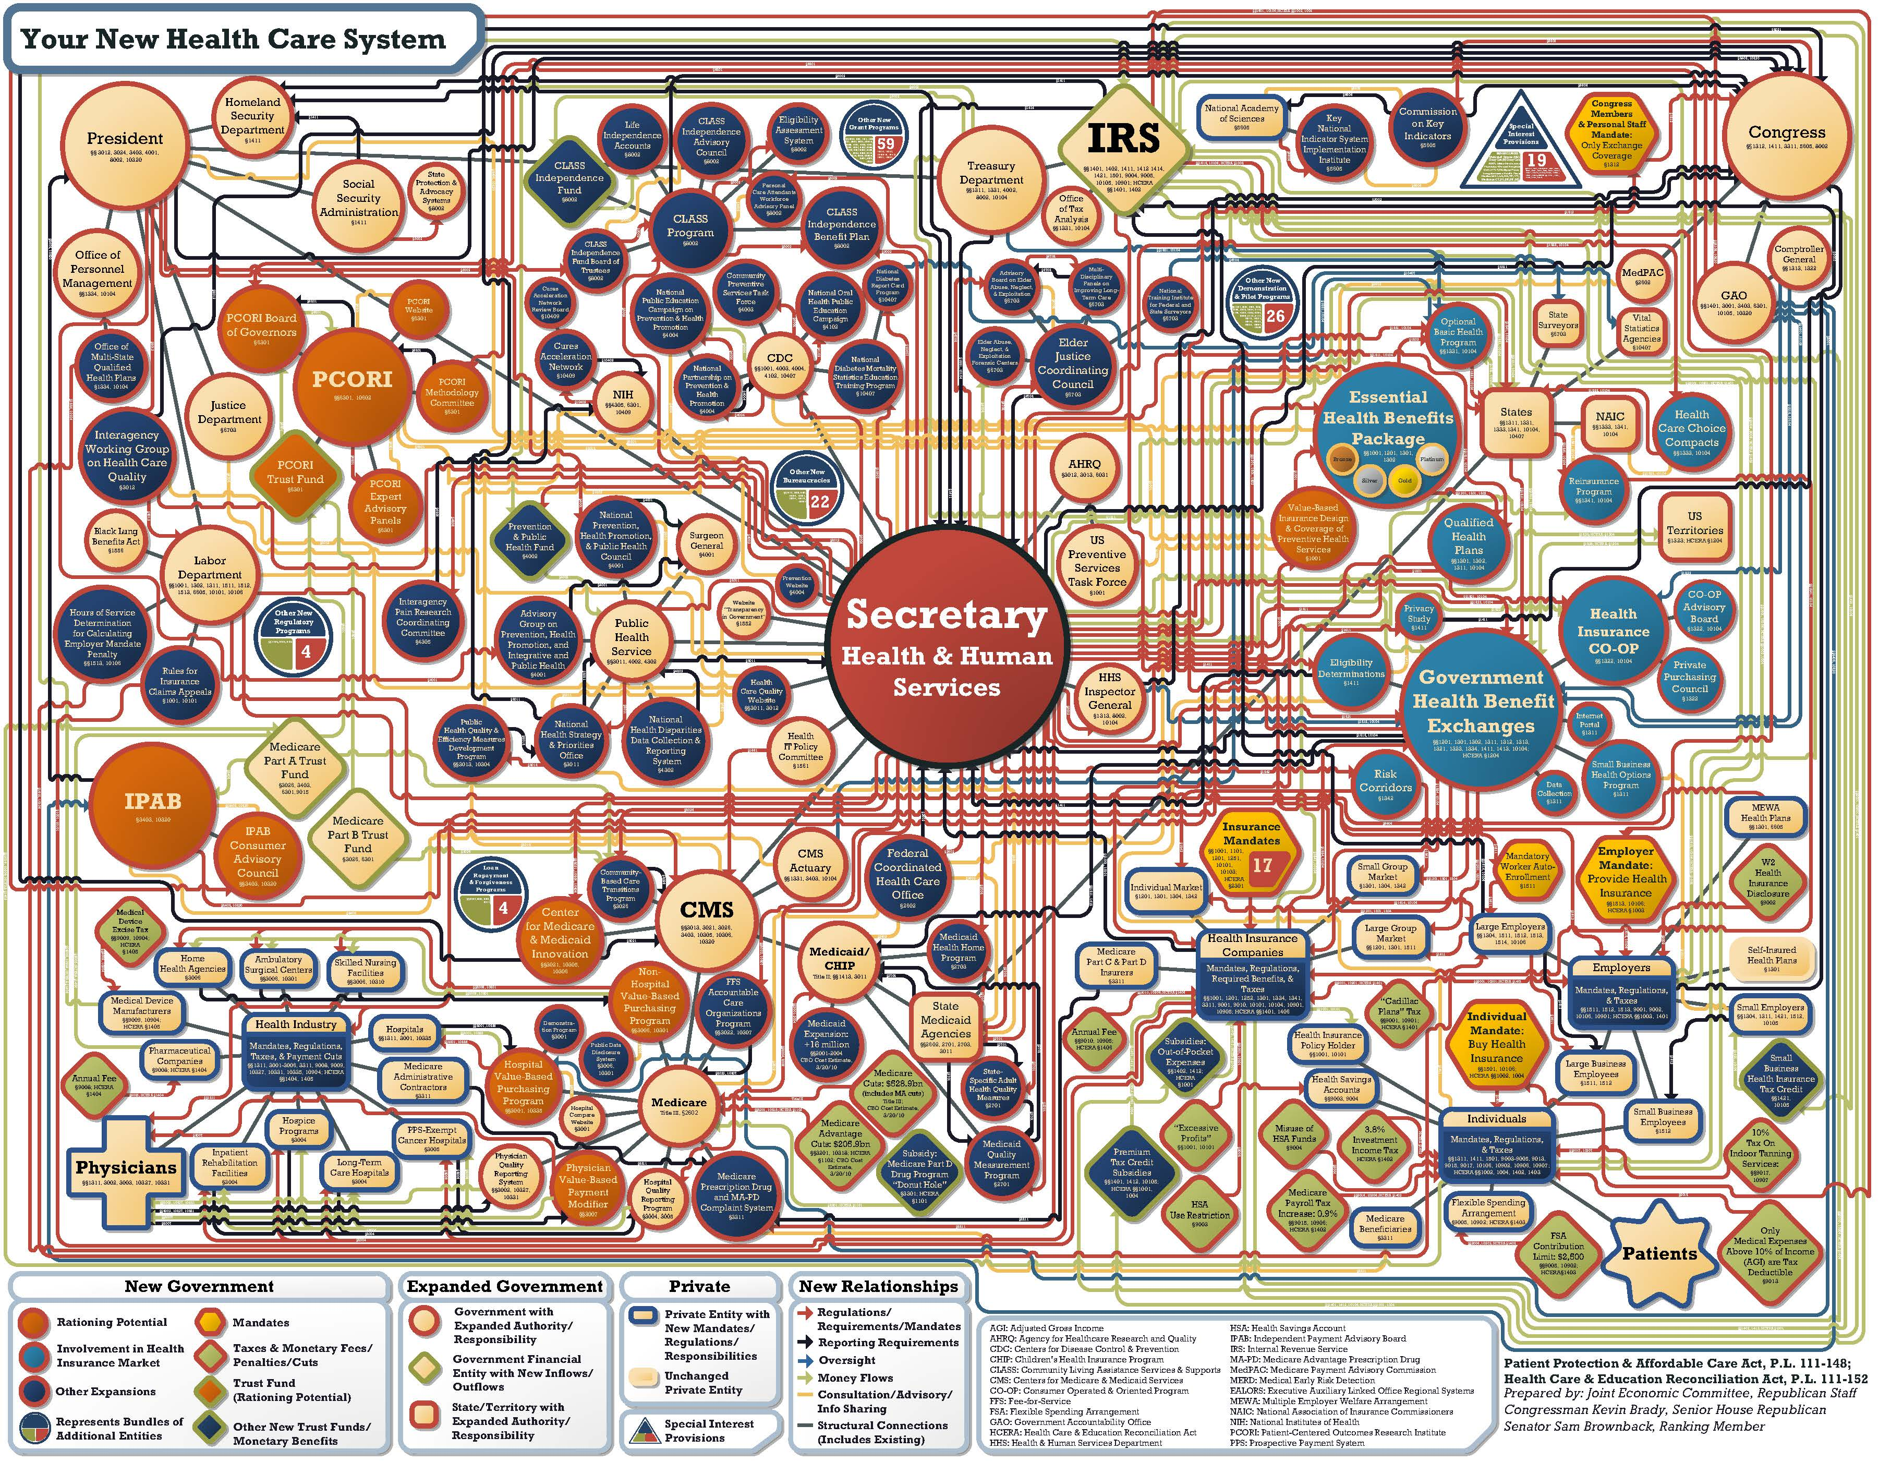
How the U.S. health care system works
https://www.jec.senate.gov/public/_cache/files/8e6dbf03-ca4a-44be-9de4-a100c43fb5c8/obamacare-chart-high-resolution.pdf.
Notes:
Key points:
Health care organization, financing, and delivery are complex topics! Today is meant to give a high-level overview.
I will be presenting static snapshots of various health care concepts that may not fully capture the dynamic nature of health care.
Data can be defined, collected, analyzed, and presented in a variety of different ways and are likely to change over time.
Citation: https://www.jec.senate.gov/public/_cache/files/8e6dbf03-ca4a-44be-9de4-a100c43fb5c8/obamacare-chart-high-resolution.pdf.

Slide 5
Health care system overview
External Forces
History
Financial Constraints
Political Landscape
Socioeconomic Structure
Consumer Preferences
Health Policy
Funding
Care Delivery
Reimbursement
Regulations
Federal vs. State Policy
Financing of the American Health Care System
Organization and Delivery of Medical Care
Outcomes
Health Status
Access
Quality
Cost
Equity
Population Health
Adapted from: https://sphweb.bumc.bu.edu/otlt/MPH-Modules/HPM/AmericanHealthCare_Overview/.
Notes:
Adapted from: https://sphweb.bumc.bu.edu/otlt/MPH-Modules/HPM/AmericanHealthCare_Overview/.

Slide 6
The majority of health care spending ignores major cost drivers of health
The majority of health care spending ignores these major cost drivers
Determinants of Health Model based on frameworks developed by: Tarlov AR. Ann N Y Acad Sci 1999; 896: 281-93; and Kindig D, Asada Y, Booske B. JAMA 2008; 299(17): 2081-2083.
Notes:
Citation: https://eadn-wc03-6094147.nxedge.io/cdn/wp-content/uploads/2019/05/Six-Slides-to-Help-State-Leg-Improve-Health.pdf.
Social and economic factors have a larger impact on health outcomes than the health care system.
Health outcomes can be thought of primarily as both the length and quality of life.
Legislative and regulatory policies can impact all the social determinants of health (SDoHs).
Most premature deaths in the U.S. are attributable to health behaviors (smoking, diet, exercise, etc.) and genetic predispositions.
Health in all policies:
An approach to policy making that systematically considers the health implications of decisions across sectors, seeking synergies and avoiding harmful health effects of policies outside the health care sector.
Today, we will mostly focus on the health care system, factors such as health insurance coverage, access, cost, workforce, and quality of care.

Slide 7
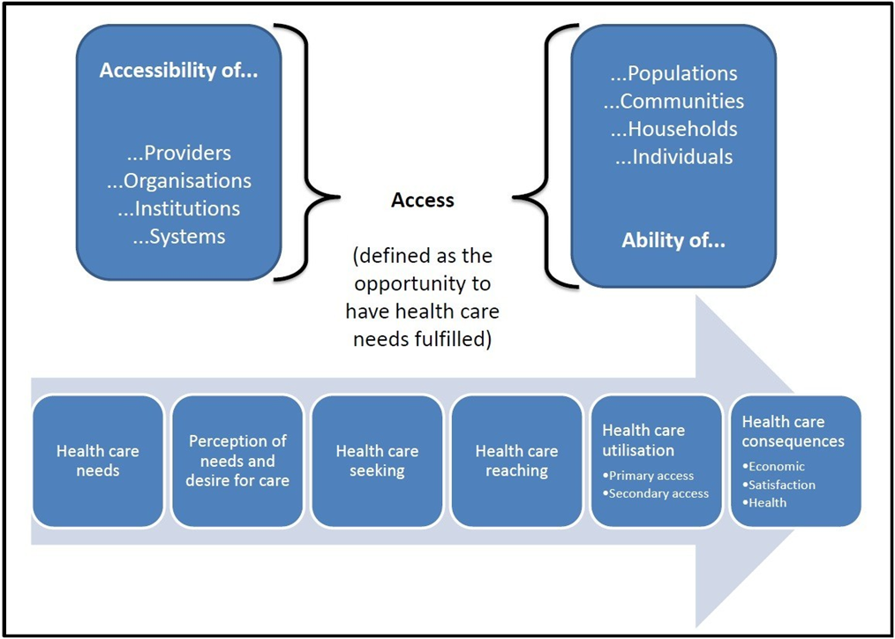
A conceptual framework for accessing health care
Levesque, JF., Harris, M.F. & Russell, G. Patient-centred access to health care: conceptualising access at the interface of health systems and populations. Int J Equity Health 12, 18 (2013). https://doi.org/10.1186/1475-9276-12-18.
Notes:
Citation: Levesque, JF., Harris, M.F. & Russell, G. Patient-centred access to health care: conceptualising access at the interface of health systems and populations. Int J Equity Health 12, 18 (2013). https://doi.org/10.1186/1475-9276-12-18.

Slide 8
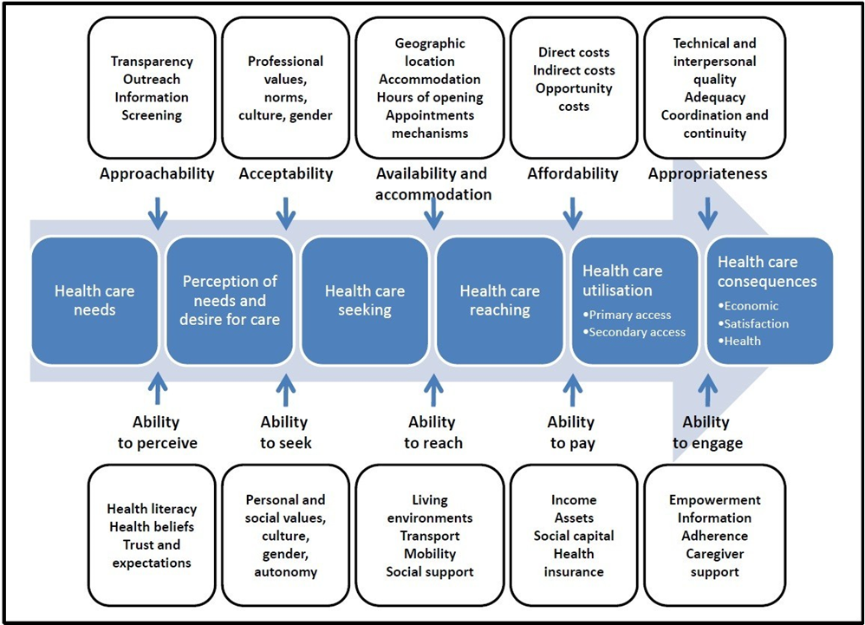
A conceptual framework for accessing health care
Levesque, JF., Harris, M.F. & Russell, G. Patient-centred access to health care: conceptualising access at the interface of health systems and populations. Int J Equity Health 12, 18 (2013). https://doi.org/10.1186/1475-9276-12-18.
Notes:
Citation: Levesque, JF., Harris, M.F. & Russell, G. Patient-centred access to health care: conceptualising access at the interface of health systems and populations. Int J Equity Health 12, 18 (2013). https://doi.org/10.1186/1475-9276-12-18.

Slide 9
Definitions: Health care cost vs. price vs. charge
Cost varies depending on who incurs the expense:
To the patient - what is paid out-of-pocket (e.g., premiums, deductibles, co-payments, co-insurance, etc.). Insurance premiums constitute a separate category of costs for patients, independent of utilization.
To the health care provider - direct and indirect expenses incurred to deliver health care services
To the insurer - amount paid to providers for services rendered
To the employer - expenses incurred by providing health benefits (e.g., premiums, claims paid, etc.)
Price indicates the total amount a health care provider expects to be paid by payers and patients for health care services.
Charge is the dollar amount a health care provider sets for services rendered before negotiating any discounts. The charge can be different from the amount paid.
https://www.brookingshealth.org/why-brookings-health/health-care-value/understanding-medical-prices/charge-cost-price.

Slide 10
What is driving increased costs?
Two primary drivers: price and utilization ​
Breaking it down:​
Rising prices related to new technology; administrative costs in the provider payment and insurance systems; hospital consolidation resulting in less competition​
Lack of transparency about care or costs​
Nearly half of Americans don't choose their health care plans​
Aging population​
Rising chronic disease; impact of health behaviors​
Predominant fee-for-service system that favors quantity over quality​
Provider practice patterns, including referrals, use of procedures and tests, and protection against malpractice
Notes:
Citations: https://www.pgpf.org/blog/2022/02/why-are-americans-paying-more-for-healthcare. ​
https://www.commonwealthfund.org/publications/fund-reports/2021/aug/reducing-health-care-spending-what-tools-can-states-leverage. https://www.peoplekeep.com/blog/eight-reasons-for-rising-health-care-costs. ​
https://www.q-corp.org/sites/default/files/TCOC_PhaseII_BenchmarkBrief_2018_Final_1.pdf.

Slide 11
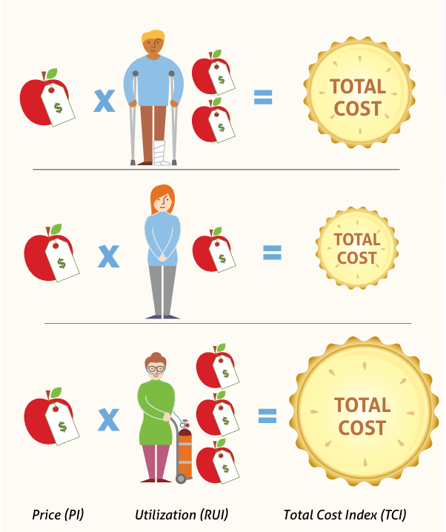
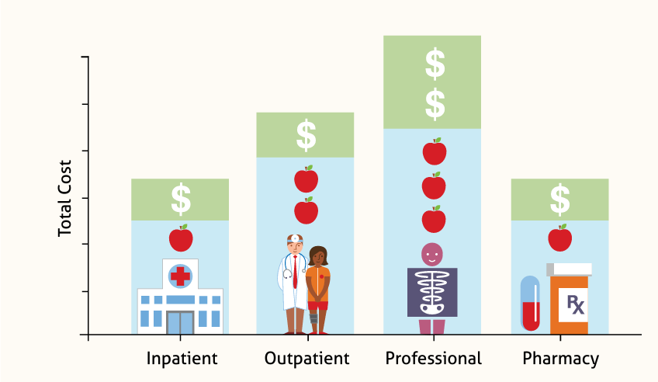
Price x utilization = Total cost
https://www.q-corp.org/sites/default/files/TCOC_PhaseII_BenchmarkBrief_2018_Final_1.pdf.
Notes:
Citation: https://www.q-corp.org/sites/default/files/TCOC_PhaseII_BenchmarkBrief_2018_Final_1.pdf.

Slide 12
Cost drivers: A few more definitions
Gross domestic product (GDP)​
The value of all goods and services produced in the U.S. as expressed in four components: personal consumption, business investment, government spending, and net exports.​
National health care expenditures​
"… represent the amount spent on health care and related activities such as private and public health insurance, health research, and public health activities." (CDC)​
Often expressed as a % of GDP​
Personal health care expenditures​
"… are outlays for goods and services relating directly to patient care, such as hospital care, physicians' and dentists' services, prescription drugs, eyeglasses, and nursing home care." (CDC)​
Largest share of national health care expenditures

Slide 13
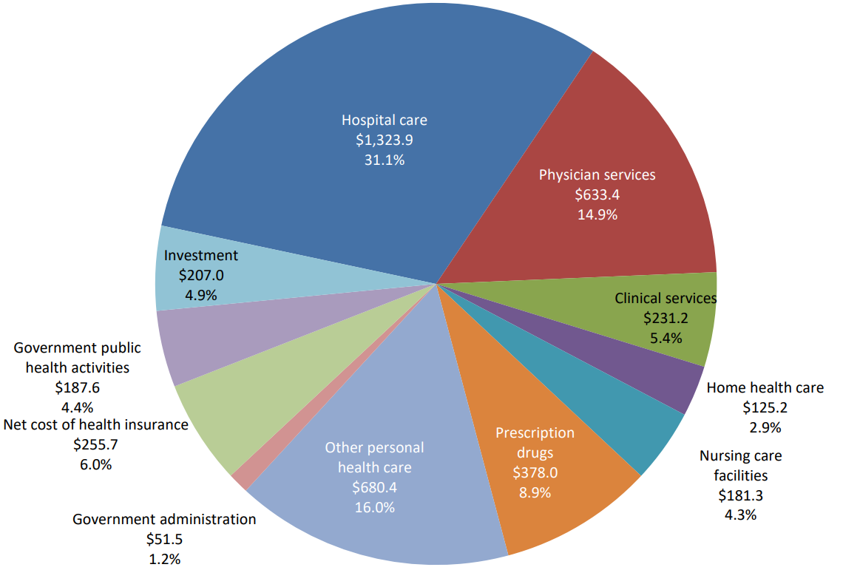
In 2021, the U.S. spent $4.25 trillion on health care
$12,914 per capita
31% on Hospital Care
15% on physician service
9% on prescription drugs
https://www.ama-assn.org/about/research/trends-health-care-spending.
Notes:
Physician services spending is defined as spending in establishments where physician services are the primary activity while clinical services spending is defined as spending made in establishments classified as outpatient care centers. Under the North American Industry Classification System (NAICS), establishments are classified based on the primary activity performed at the location and spending in the establishment consists of payments to the establishment (including payments to employees of the establishment)

Slide 14
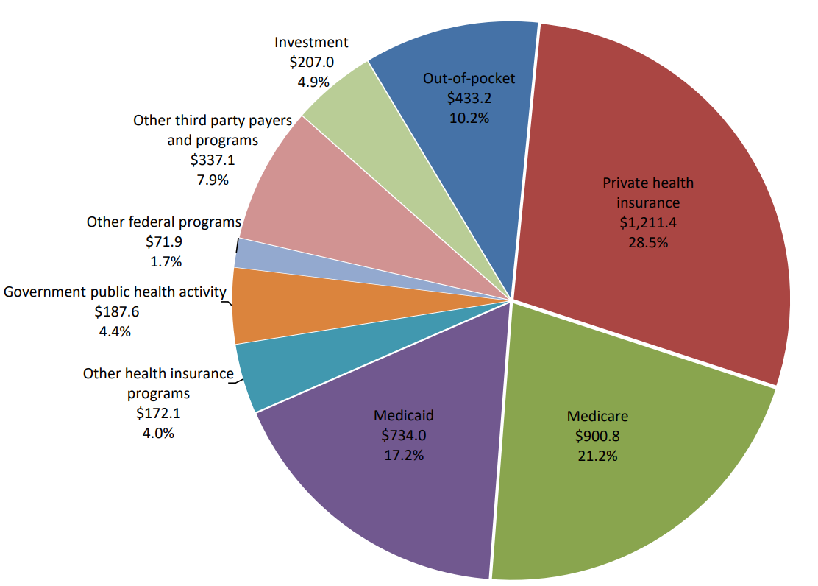
2021 U.S. health care spending by source of funds
28.5% from private health insurance
21% from Medicare
17% from Medicaid
10% from Out-of-pocket costs
Who pays the bills?
25% from employer contributions to ESI insurance premiums
7% from employee contributions to ESI insurance premiums
https://www.ama-assn.org/about/research/trends-health-care-spending.
Notes:
Physician services spending is defined as spending in establishments where physician services are the primary activity while clinical services spending is defined as spending made in establishments classified as outpatient care centers. Under the North American Industry Classification System (NAICS), establishments are classified based on the primary activity performed at the location and spending in the establishment consists of payments to the establishment (including payments to employees of the establishment)

Slide 15
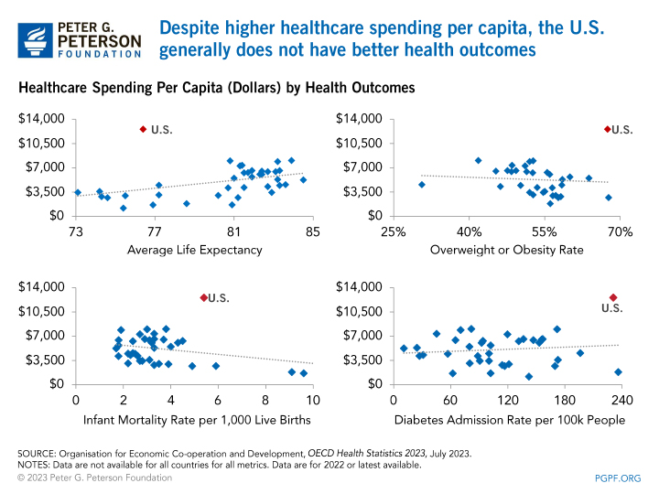
U.S. not realizing better health outcomes despite spend
https://www.pgpf.org/blog/2022/02/why-are-americans-paying-more-for-healthcare.
Notes:
Citation: https://www.pgpf.org/blog/2022/02/why-are-americans-paying-more-for-healthcare.

Slide 16
Different types of health insurance coverage
US Population
Insured
Uninsured
Public Insurance
Private Insurance
Medicaid
Medicare
Other Public
Employer Sponsored
Individual Plans
Exchanges
Adapted from: http://vista-care.com/health-insurance-fits-public-vs-private/.
Notes:
Publicly-funded insurance (Medicaid, Medicare, Tricare, others)​
Private insurance (Employer-sponsored, Individual, Exchanges, others)
Citation: http://vista-care.com/health-insurance-fits-public-vs-private/.

Slide 17
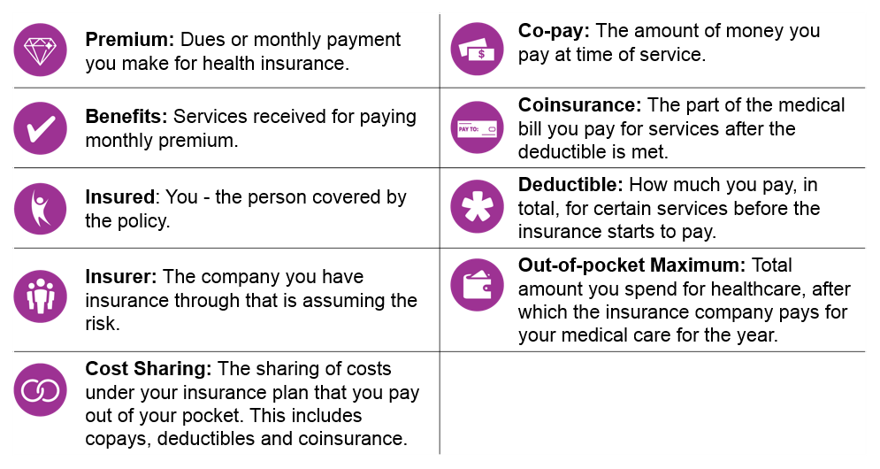
Common health insurance terms
https://www.mhsindiana.com/newsroom/uhhi.html.
Notes:
Follow this link for additional insurance terms:​
https://healthnetwork.com/blog/infographic/common-health-insurance-terms/.
Citation: https://www.mhsindiana.com/newsroom/uhhi.html.

Slide 18
Insurance churn
Employer Sponsored Insurance
Uninsurance
Medicaid, CHIP
Marketplace
Patients who experience churn often have to change primary care doctors and specialists.​
Studies show that those who experienced churn and had a gap in coverage were more likely to have the following outcomes:​
Skipped doses or stopped taking prescription medications when changing insurance​
Overall quality of medical care declined​
Overall health declined​
More likely to go to an emergency department because they did not have an outpatient appointment ​
Increased difficulty paying medical bills

Slide 19
Types of public insurance
Public
State
Federal
Medicaid
CHP+
Medicare
VA
Tricare
Notes:
TRICARE is the health care program for service members (active duty, Guard/Reserve, retired) and their families around the world. A higher percentage of Coloradans are in TRICARE than nationally – particularly in Colorado Springs area. VA, or Veterans’ Affairs rates in Colorado are similar to those nationally. We are going to focus on the Medicaid and CHP+ because that is where you all have more levers and ability to make changes.

Slide 20
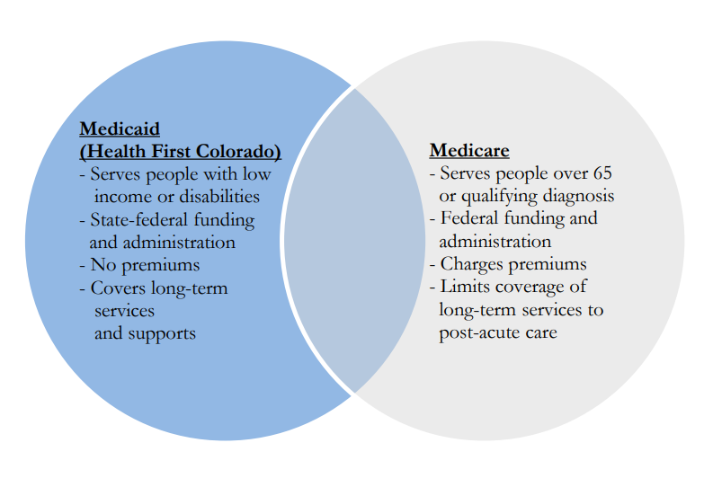
Medicaid vs. Medicare
Dual Eligible
https://leg.colorado.gov/sites/default/files/fy2023-24_hcpbrf1.pdf.
Notes:
In general, people can have multiple type of coverage, can have Medicaid in addition to private, VA, etc. One of the more common types of dual insurance are for those who have Medicaid and Medicare. Tend to have lots of focused attention so calling that out. This group usually includes the poorest and sickest of our population. And, many of the activities and approaches that states think about with cover this population
Colorado is 2nd fastest growing state for older adults, not clear what the impact of long COVID will be.
The duals are very costsly (xxx% of costs, xxx% of people). Only invest and don’t invest upstream – continue this approach generally.

Slide 21
What are Medicaid and the Children's Health Insurance Program (CHIP)?
56 federal/state (territory) partnerships that are jointly administered and funded
Together account for ~10% of federal dollars
Medicaid: created in 1965 (Title XIX of the Social Security Act)
Coverage for health/related services for low-income: children and families, seniors, and people with disabilities
Entitlement program
Those eligible have right to enroll and receive medically necessary services
Federal and state governments obligated to fund
Children’s Health Insurance Program (CHIP) - created in 1997 (Title XXI of the Social Security Act)
Coverage for pregnant women and kids with income over Medicaid limits
Not an entitlement - funds are capped overall and for each state
Notes:
Can talk about FMAP here at a high level.
Talk about that Medicaid is often largest line item in states' budgets (and that it's largest source of federal funds for states).
Mention % of kids covered and % of Medicaid births financed by Medicaid.
https://www.kff.org/medicaid/issue-brief/medicaid-financing-the-basics/#:~:text=Medicaid%20and%20CHIP%20Accounted%20for,Federal%20Outlays%20in%20FFY%202023.
1.Medicare, VA, and TRICARE are administered at the federal level.
2.Medicaid is a state-federal program that is evolving and gives states flexibility in establishing eligibility, benefits, payments to providers, and delivery systems within established minimums and guidance from the federal government.
3.Medicaid has tremendous impact:
1.It is both the largest item for state budgets and the largest single source of federal dollars into states
2.It is the largest payer of long-term services and supports for the elderly and for individuals with disabilities and also for mental health/substance use disorder services.
3.It covers (with CHIP) more than 40% of births.

Slide 22
Mandatory benefits
Physician services
Pediatric or family nurse practitioner services
Early and Periodic Screening, Diagnostic, and Treatment (EPSDT) services for <21
Family planning services and supplies
Federally qualified health centers (FQHCs)
Freestanding birth centers
Home health services
Inpatient hospital services
Laboratory and x-ray services
Non-emergency medical transportation to medical care
Nurse midwife services
Nursing facility services (>21)
Outpatient hospital services
Rural health clinic services
Tobacco cessation counseling and pharmacotherapy for pregnant women
https://www.macpac.gov/subtopic/mandatory-and-optional-benefits/.
Notes:
A few slides back I mentioned optional and mandaotry eligible popultions. There are similar provisions for benefits. In order to get that federal match, states have to provide these services.
BH is not specifically called out here but many of the benefit categories would cover BH services, for example, physician servcies, FQHCs and RHS provide BHE services, as do hospitals.

Slide 23
Optional benefits
Respiratory care services
Home and community-based services
Community supported living arrangements
Personal care services
Private duty nursing services
Primary care case management
Health homes for enrollees with chronic conditions
Other licensed practitioners’ services (e.g., podiatrist, optometrist)
Services for certain diseases (tuberculosis, sickle cell disease)
Chiropractic services
Program for All-Inclusive Care for the Elderly (PACE) services
Services furnished in a religious, non-medical health care institution
Prescription drugs
Dental services for adults
Intermediate care facilities for individuals with intellectual disabilities
Services in an institution for mental disease
Clinic services
Occupational therapy
Physical therapy
Speech, hearing, and language disorder services
Targeted case management
Prosthetic devices
Hospice services
Eyeglasses
Dentures
Other diagnostic, screening, preventive, and rehabilitative services
https://www.macpac.gov/subtopic/mandatory-and-optional-benefits/.
Notes:
States get to decide if they want to cover these services. CO covers the vast majority after HCPF was given statutory and spending authority.
A couple of examples of services we don’t provide are health homes and the last entry (very few states, <10 provide #26. This might be a bit dated but as of 2016, according to MACPAC all states covered prescription drugs and optemetry, home health services IMD, and nearly all (50) covered prosthetic services,

Slide 24
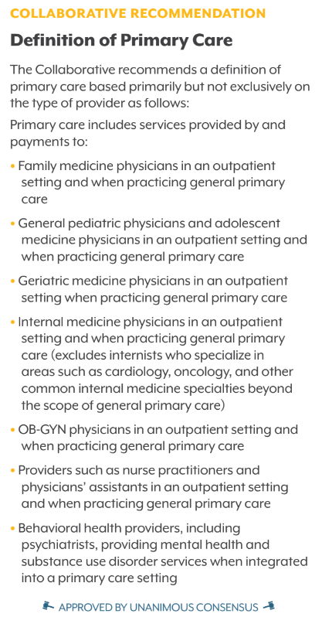
Definition of primary care
What is Primary Care?
Primary care is the provision of integrated, equitable, and accessible health care services by clinicians who are accountable for addressing a large majority of personal health care needs, developing a sustained partnership with patients, and practicing in the context of family and community. Integrated care encompasses the provision of comprehensive, coordinated, and continuous services that provide a seamless process of care. ~ Primary Care Payment Reform Collaborative
Colorado's Primary Care Payment Reform Collaborative Recommendations, First Annual Report.
Notes:
This definition was created by the Primary Care Payment Reform Collaborative, informed by an earlier definition from the IOM but one that incorporated equity.
Describe WHO provides these services, in addition to describing what is considered primary care.

Slide 25
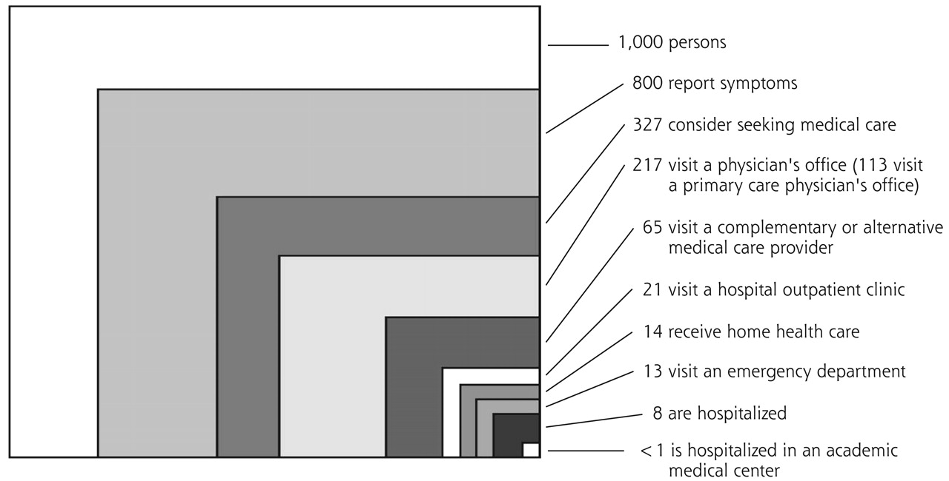
The ecology of medical care
Shows the proportion of Americans who seek various types of health care services in an average month.​
Primary care remains the largest platform of health care delivery in the U.S.
The ecology of medical care revisited. Note: All numbers refer to discrete individual persons and whether or not they received care in each setting in a typical month. From: Green LA, Fryer GE Jr, Yawn BP, Lanier D, Dovey SM. The ecology of medical care revisited. N Engl J Med. 2001;344:2021–2025.10 Reprinted with permission from the Massachusetts Medical Society. Copyright© 2001 Massachusetts Medical Society. All rights reserved.
Notes:
Citation: https://www.graham-center.org/content/dam/rgc/documents/publications-reports/reports/PrimaryCareChartbook2021.pdf.
Figure 1 below shows the proportion of Americans who seek various types of health care services in an average month. For every 1,000 people in the United States: – 800 report symptoms – 327 consider seeking medical care – 217 visit a physician’s office (of which 113 visit a primary care physician) – 104 visit a specialist physician – 65 visit a complementary or alternative medical care provider – 21 visit a hospital-based outpatient clinic – 14 receive health services at home – 13 visit an emergency department – Eight are hospitalized – Less than one person is hospitalized in an academic medical center.

Slide 26
Where patients and families access primary care
Federally qualified health centers and/or look-alikes
Rural health clinics
Solo and small group practices
Large group, multi-specialty practices
Hospital- or health system-owned practices
School-based health centers
Integrated health care delivery system clinics
Direct primary care
Venture-backed primary care clinics
Notes:
Coloradans access primary care – in line with the PCPRC definition – in multiple settings that will look and feel differently in different locations around the state based on the underlying needs of the communities.
These sites include …
You do not see urgent care, retail clinics, or virtual only options here, as they do not provide the full range of primary care services or embody the philosophy of primary care that fulfills the extent of the PCPRC definition.
[1) Because we don't have a system and/or the data to track on location and types of primary care settings, we can't answer the basic question about proportion of patients who seek care at each of these sites. 2) The heterogeneity of how care is organized, financed, and delivered at each of these sites needs to be kept in mind when crafting policy solutions.]
Additional resources:
https://www.coloradohealthinstitute.org/research/direct-primary-care-new-way-deliver-health-care
https://www.dpcare.org/
https://www.healthcaredive.com/news/oak-street-enter-21st-state-with-launch-colorado-clinics/625036/

Slide 27
Benefits of primary care
“There is lots of evidence that a good relationship with a freely chosen primary care doctor, preferably over several years, is associated with better care, more appropriate care, better health, and much lower health costs.”
~ Dr. Barbara Starfield
Dr. Starfield's findings have been confirmed multiple times over the years:
As the percent spend for primary care increases, emergency department use, total hospitalizations, and ambulatory care-sensitive hospitalizations decrease. (Investing in Primary Care: A State-Level Analysis)
Across 13 industrialized countries, stronger primary care infrastructure was associated with lower total health care costs and lower per capita health expenditures. (Primary Care in High-Income Countries: How the United States Compares)
Greater supply of primary care physicians (per 10,000 people) is associated with lower rates of all-cause mortality, low birth weight, infant mortality, poor self-reported health, and improved life expectancy. (The Impact of Primary Care: A Focused Review)
Barbara Starfield, The Lancet.

Slide 28
Primary care is challenged: system, provider POV
Primary care infrastructure isn't well financed
Reimbursement to the primary care clinic for services rendered during visits is often inadequate to support the team
Services outside of the standard visit with a clinician are not well compensated or accounted for in payments, e.g., care coordination, patient education, behavioral health integration, responding to messages in the patient portal
Fewer US medical graduates are choosing primary care specialties; excellent training environments are harder to find
Administrative requirements continue to rise
Mental and behavioral health needs of patients – and co-workers – are substantial
Primary care teams are still catching up with the COVID-19 backlog
Burnout is steadily increasing
Research support for primary care and how best to organize, finance, and deliver it falls short compared to disease-specific inquiries
The US Department of Health and Human Services is Taking Action to Strengthen Primary Care, National Academy of Medicine.
Notes:
This is from the systems or the provider point-of-view.

Slide 29
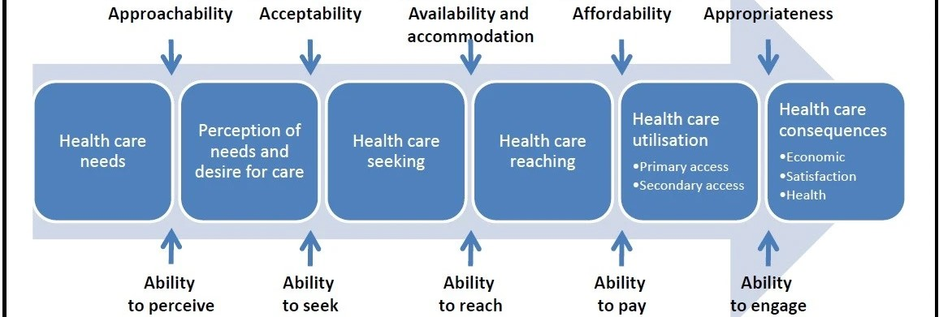
Primary care is challenged: system, provider POV
Access to appointments – either in-person or virtual
can be frustratingly slow or limited due to shortage of providers
Typical primary care hours aren't available when patients need to be seen and appointment times are often too short to address multiple concerns
Additional access challenges abound for patients with language, disability, geographic, and/or transportation barriers, as well as those without robust sick leave
The US Department of Health and Human Services is Taking Action to Strengthen Primary Care, National Academy of Medicine.
Difficult to see one clinician or team over time
A plethora of options exist that can be hard to navigate = virtual only, retail health, urgent care
Care and information exchange across settings isn't as seamless as it could be
Needed services may not be affordable, especially for uninsured or underinsured individuals
Notes:
This is from the patients' point-of-view.

Slide 30
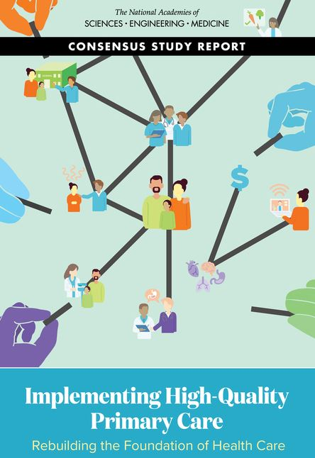
Primary care at the national level
This May 2021 NASEM report has spurred considerable action to strengthen primary care:
State-level initiatives that Colorado can consider adapting for our context
The release of the first-ever national primary care scorecard
The launch of the NASEM Standing Committee on Primary Care
Notes:
Abstract for the findings from the scorecard:
"The 2021 National Academies of Sciences, Engineering, and Medicine (NASEM) report Implementing High-Quality Primary Care: Rebuilding the Foundation of Health Care proposed the development of a scorecard to better monitor and ensure accountability for progress toward high-quality primary care in the United States. This first national primary care scorecard finds a chronic lack of adequate support for the implementation of high-quality primary care in the United States across all measures, although performance varies across states. The scorecard finds:
Financing: The United States is systemically underinvesting in primary care.
Workforce: The primary care physician workforce is shrinking and gaps in access to care appear to be growing.
Access: The percentage of adults reporting they do not have a usual source of care is increasing.
Training: Too few physicians are being trained in community settings, where most primary care takes place.
Research: There is almost no federal funding available for primary care research.
Given declining life expectancy, racial and ethnic health disparities, the current epidemic of mental health needs, the ongoing COVID-19 pandemic, and other nationwide issues that primary care can help address, these findings represent an urgent call to policymakers and other stakeholders. It is time to accelerate adoption of policies that will demonstrably increase investment in high-quality primary care, create a robust primary care workforce, and enable analysis and learning around the impact of primary care."

