Slide 1
Personal Finance

Slide 2
Learning Objectives
At the end of this presentation, active participants will be able to demonstrate a baseline understanding of:
Financial implications of a career in family medicine
Personal finance tips and tools
Resources for additional support

Slide 3
My Story
Relationships
Diversity
Flexibility
Impact
Notes:
I chose/fell in love with family medicine because of:
-the deep, longitudinal relationships we are able to build with our patients and the trust they place in us,
-the ability to care for a diverse array of patients at all stages of life
-the flexibility in practice settings available to us (I practice inpatient and outpatient medicine, I also care for patients at all stages, including prenatal care)
-my belief that primary care is an essential good for the health of society.

Slide 4
My Story
Notes:
BUT I’m also a personal finance nerd who was going to be coming out of medical school with a six-figure debt burden.
Thankfully, I discovered that being a family medicine physician can be rewarding in many ways, including financially.
Let’s talk about how.

Slide 5
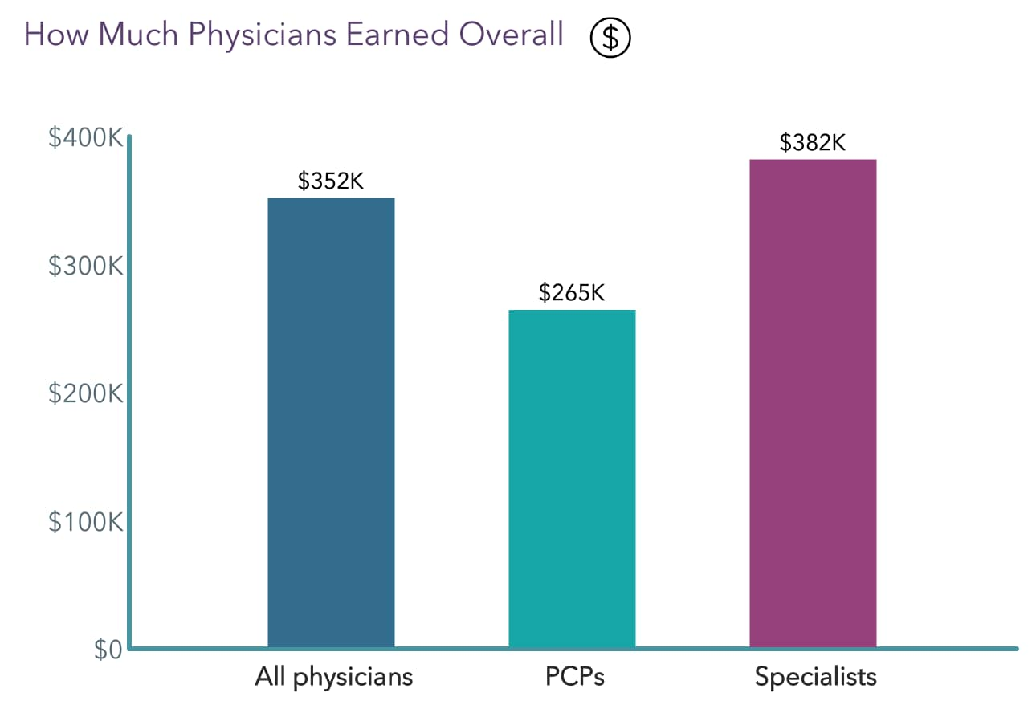
Physician earnings
2023
Kane, L. (2023, April 14). Medscape Physician Compensation Report 2023: Your Income vs Your Peers’. Medscape.com. https://www.medscape.com/slideshow/2023-compensation-overview-6016341#2
Notes:
We’ll start with the basics.
We are not trying to convince you that you will somehow make more money as a family medicine physician than as a specialist.
The current compensation models in our healthcare system are such that specialists tend to have higher incomes than generalists.
But this does illustrate that the difference is not insurmountable and a career in FM is not, in any way, a “bad” financial decision.

Slide 6
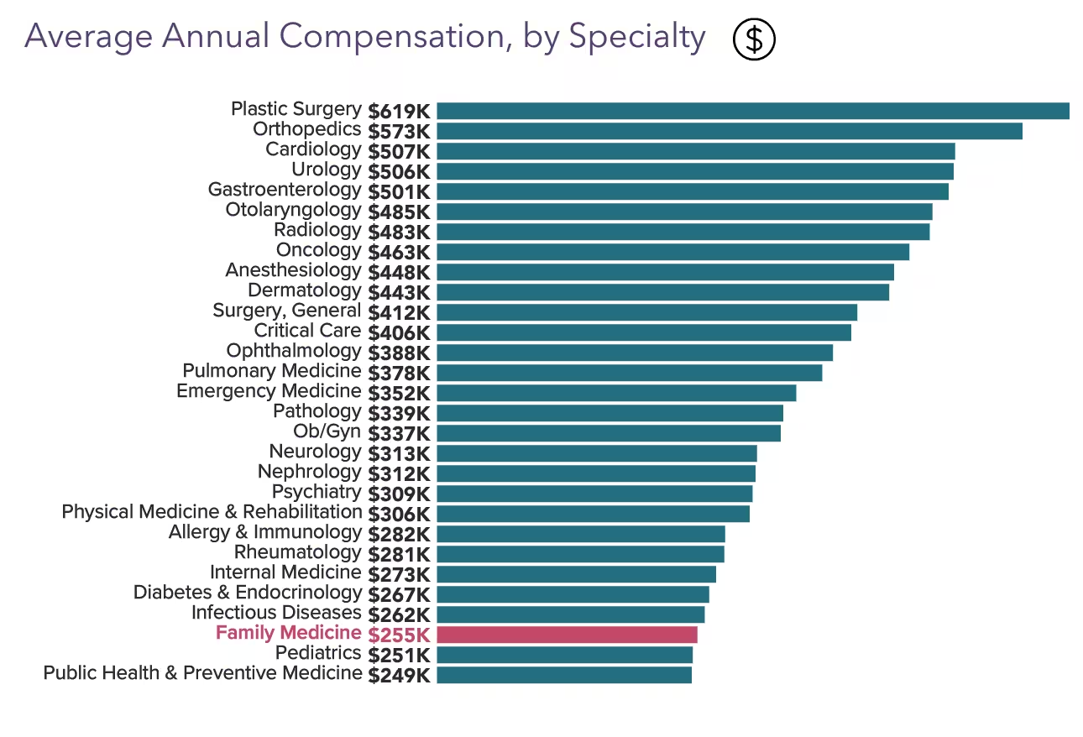
Physician earnings
Koval, M. L. (2023, May 24). Your Income vs Your Peers’: Medscape Family Physician Compensation Report 2023. Medscape.com. https://www.medscape.com/slideshow/2023-compensation-family-physician-6016358#6
Notes:
You can see that many of the primary care specialties are concentrated on the lower end of the spectrum compared to the surgical and procedural specialties on the higher end

Slide 7
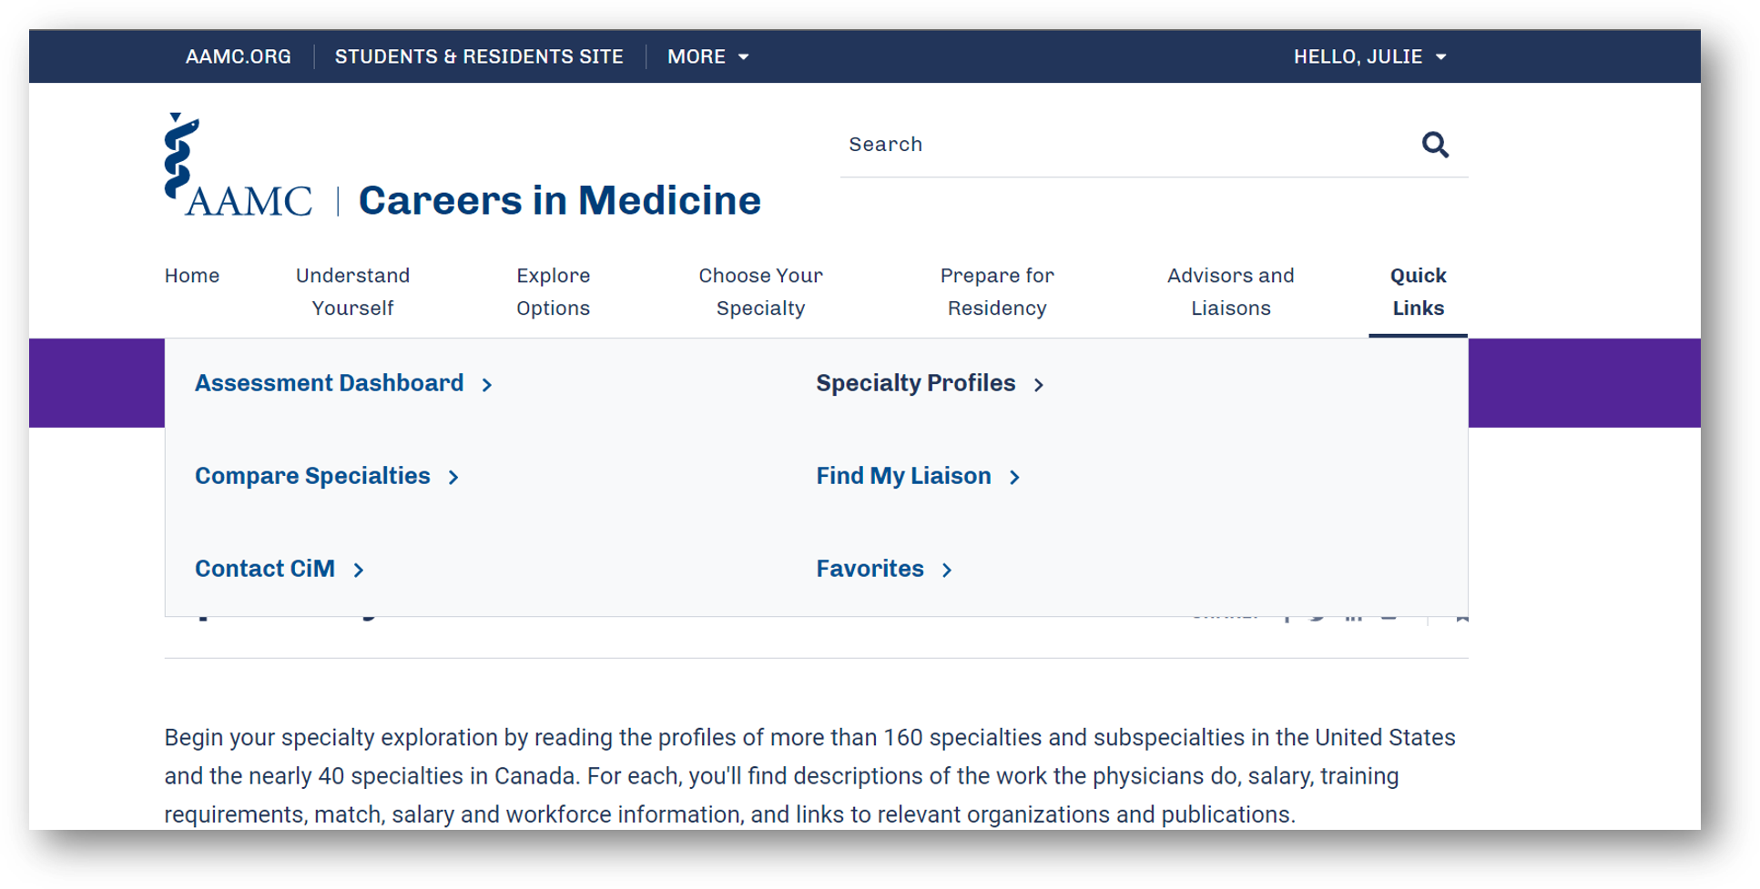
aamc.org/cim
Notes:
The AAMC Careers in Medicine is a great place to look for salary information
Assessment question: What resource is available through the Association of American Medical Colleges to help medical students explore different specialties, salary and workforce data? Answer: Careers in Medicine (CiM)

Slide 8
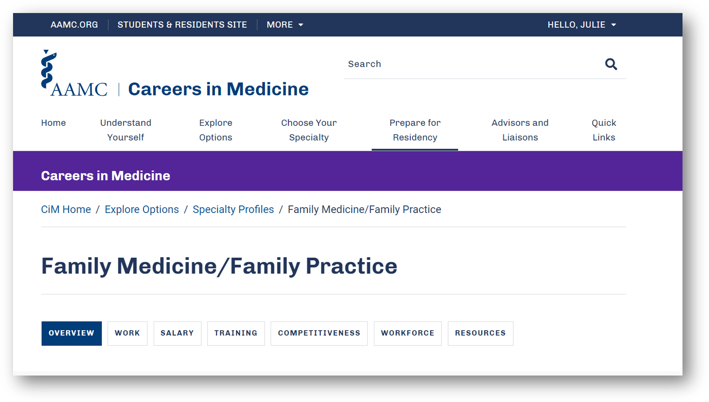
aamc.org/cim

Slide 9
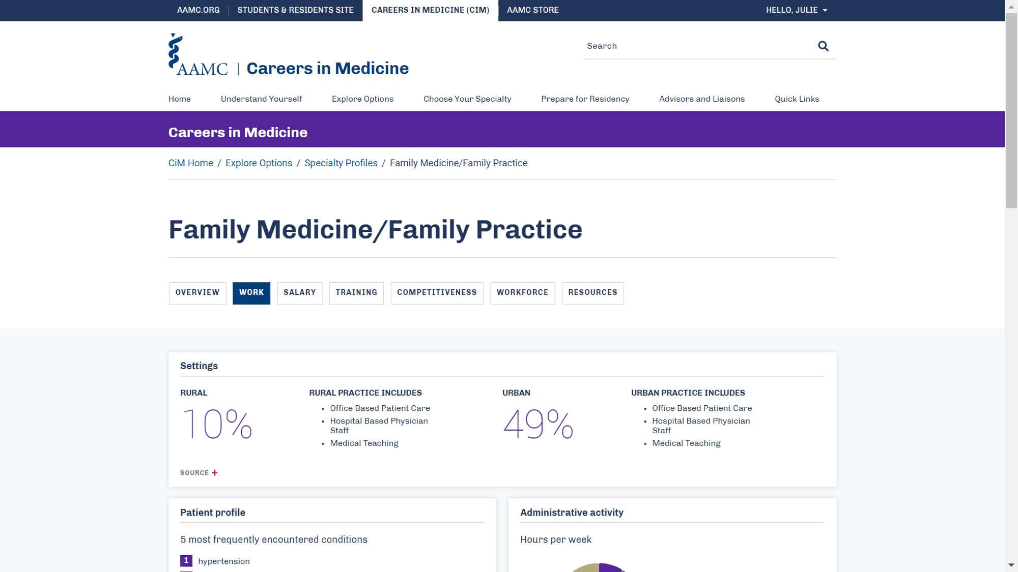

Slide 10
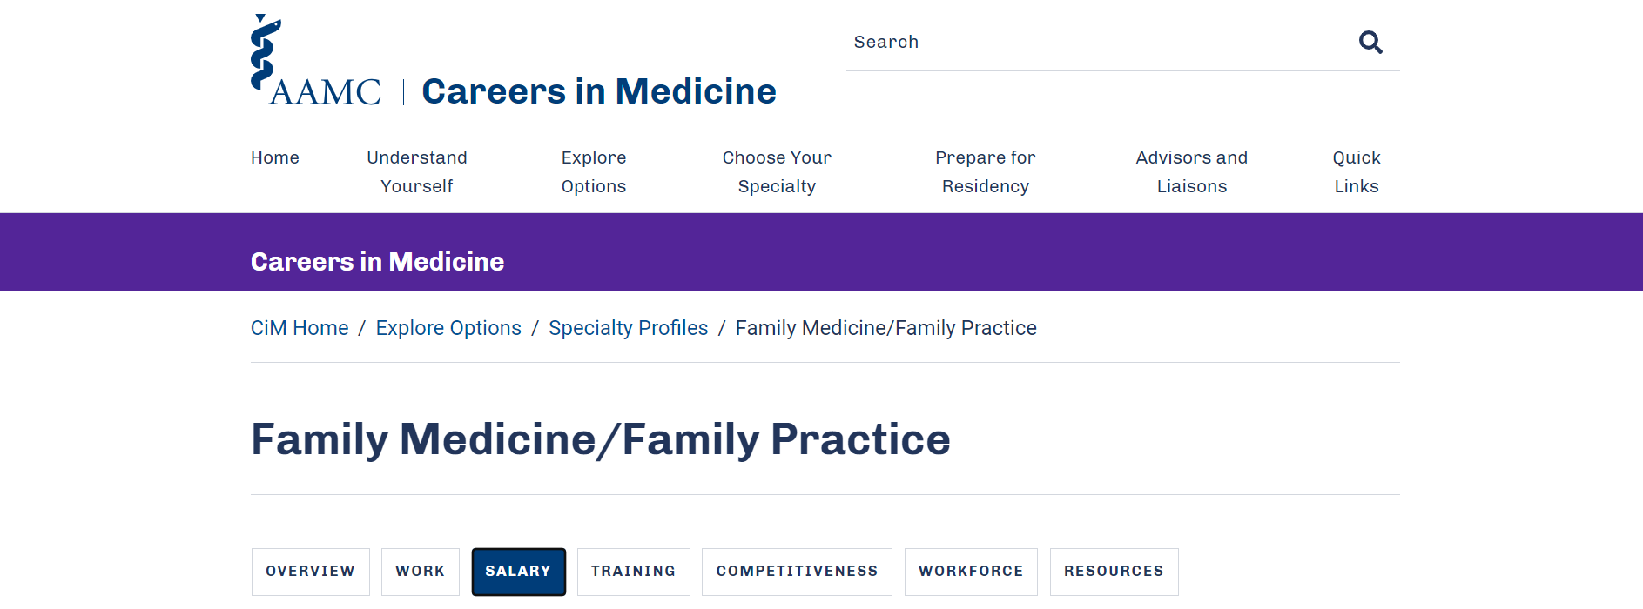

Slide 11
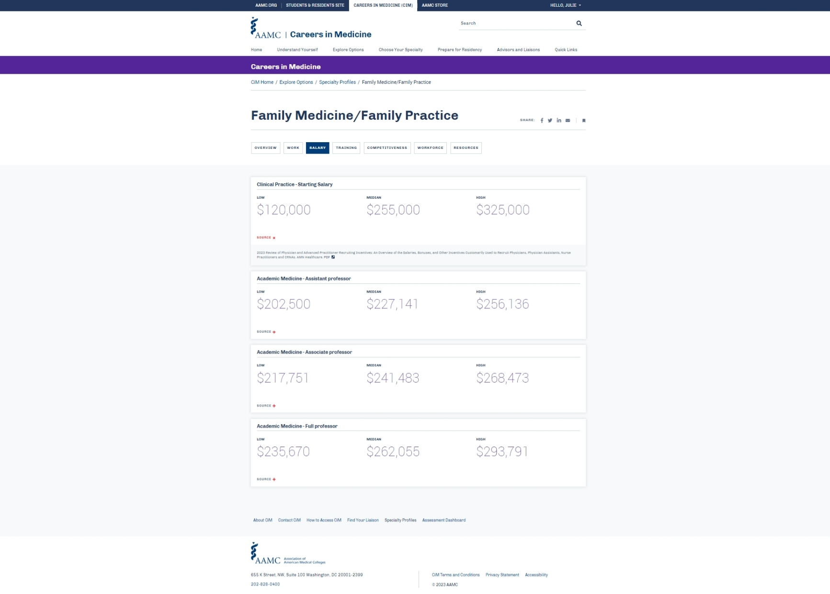
Notes:
As you can see, there is a wide range of salary opportunity in FM. Generally, clinical practice will have a higher salary compared to academic practice. Academic practice does offer some additional flexibility as well as the ability to teach generally as a tradeoff for the lower salary

Slide 12
Perspective
What is the median annual earnings of a full-time worker in America?
What is the median Family Medicine physician’s income?
Notes:
Having some perspective is helpful in this conversation
Assessment question: What were the median annual earnings of a full-time worker in America in 2022?
$30,000 - $40,000
$50,000 - $60,000
$70,000 - $80,000
$90,000 - $100,000

Slide 13
Perspective
What is the median annual income in America?
$54,132 (2022)
What is the median Family Medicine physician’s income?
$251,000 (2022)
Source: Bureau of Labor Statistics: https://www.demandsage.com/average-us-income/#:~:text=What%20Is%20The%20Average%20U.S.,is%20%2456%2C940%20as%20of%202023
Notes:
This is based on full time workers

Slide 14
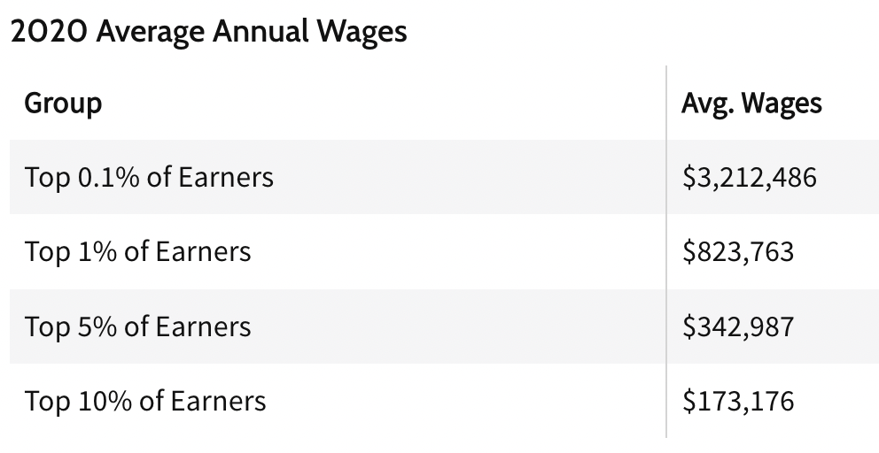
Perspective
Your income will be in the top 10% of incomes
Notes:
You’re income will be in the top 10% of incomes nationally, in fact, it’s about the top 8%. You will therefore be able to live a comfortable life on a Family Medicine salary.

Slide 15
Choosing Family Medicine
Opportunities to earn more
Notes:
Both percentile differences and increased income for some subspecialties

Slide 16
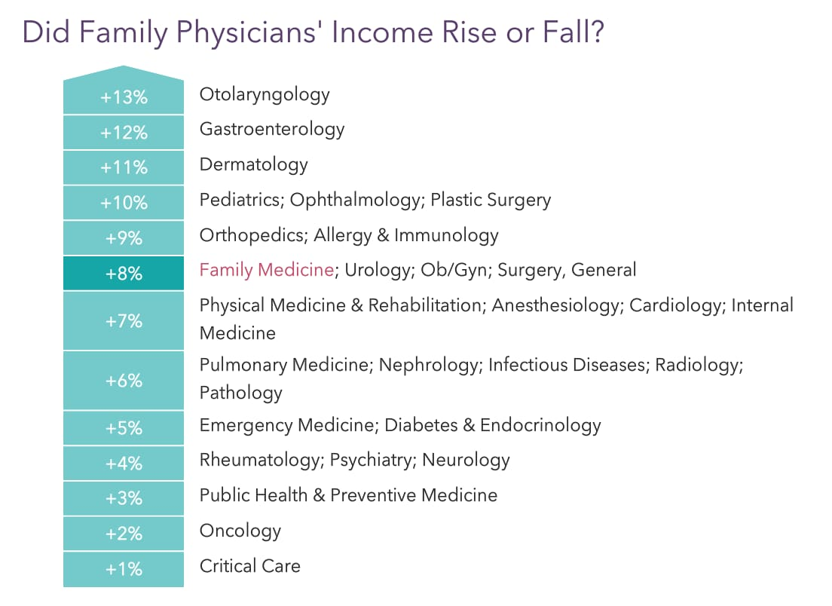
Choosing Family Medicine
Koval, M. L. (2023, May 24). Your Income vs Your Peers’: Medscape Family Physician Compensation Report 2023. Medscape.com. https://www.medscape.com/slideshow/2023-compensation-family-physician-6016358#6​
Notes:
Physician salaries are generally increasing and Family Medicine salaries are in the middle to upper half of that range

Slide 17
Improving financial wellbeing
Loan forgiveness options:
State programs
Indian Health Service
National Health Service Corps
HRSA (Health Resources and Service Administration) Faculty Loan Repayment Program
Military
Public Service Loan Forgiveness (PSLF)
Notes:
Many programs to encourage primary care and reduce the debt burden. Julie will be talking more about them in Module 6. One that we would like to highlight is PSLF

Slide 18
MAKE
120
QUALIFYING PAYMENTS
ENROLLED
IN A
QUALIFYING REPAYMENT
PLAN
PUBLIC SERVICE
LOAN FORGIVENESS (PSLF)
PROGRAM
EMPLOYED
FULL-TIME BY
QUALIFYING EMPLOYER
REPAYING QUALIFYING
DIRECT
LOANS
Tax Free Forgiveness
studentaid.gov/pslf
Notes:
Public Service Loan Forgiveness is a federal program for borrowers with Direct Loans, who make 120 qualifying payments while enrolled in a qualifying repayment plan, while working full-time for a qualifying non-profit employer. This is a great program for those who may be interested in working in the non-profit sector. You may want to review Module 6 for more information about this topic.

Slide 19
Improving financial wellbeing
Contract elements to look for:
Loan repayment
Residency stipend
Signing bonus
Relocation expenses
Notes:
You should also keep in mind that you will be in demand as a primary care physician. Some things you can look for in a potential contract include:

Slide 20
Personal finance pillars
Income
Loans
Budgeting
Retirement
Insurance
Continuing Financial Education
Notes:
Now let’s talk about some tips and action items you can take to improve your financial wellbeing. At this stage, there are 6 pillars of personal finance to be aware of
One additional important aspect of personal finance is investing. Most medical students and residents are not in a place where they have extra income to be able to invest. We will talk about investing for retirement and the principles of investing for retirement are similar to investing for other goals or purposes.

Slide 21
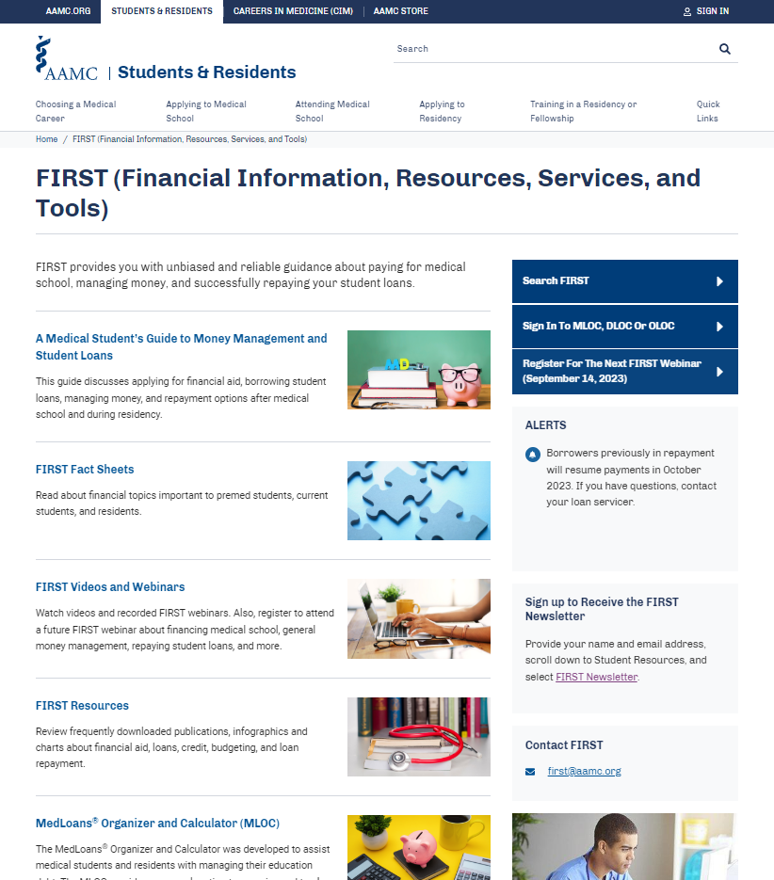
AAMC FIRST Program
aamc.org/first
Notes:
Before we dive into each of those pillars, I want to point out the AAMC FIRST program
FIRST stands for Financial Information, Resources, Services and Tools and it’s a program available through the AAMC that provides unbiased and reliable information about paying for medical school, managing money, borrowing wisely (when needed), and successfully and responsibly repaying student loans. The resources through the FIRST program are available to anyone by visiting aamc.org.
Some of the helpful materials include:
Fact Sheets and short articles about topics like financing medical school, taking out loans, money management and loan repayment.
There are also videos and live monthly webinars that people can register to attend
And there are charts, infographics, and publications available through the resources section of the program.
In addition to these resources, there are also loan repayment tools and financial education resources that will be discussed later in this presentation.

Slide 22
Personal finance pillars
Income
1. Know your worth
research market-rate for compensation: MGMA, AAMC, colleagues
2. Negotiate
salary, benefits, non-compete, CME, etc. Consider hiring an attorney to review your contract offer
3. Explore other income sources
e.g moonlighting, urgent care, team physician, nursing home medical director
Notes:
The first pillar of your personal finance life is your income.
The first step is to know your worth. When you begin looking for a position, you should do a bit of homework to determine the salary range you can expect
As we discussed previously, your income is more than just your salary. If there is minimal wiggle room with regard to salary in a position, there may be room to negotiate things like retirement benefits, non-compete restrictions, CME and vacation allowances, etc. Consider having an attorney look at your contract.
There are other opportunities to earn extra income as well - like moonlighting, picking up shifts at urgent care, or taking additional roles as a team physician or nursing home medical director
Most of this applies to residents looking for attending positions. There is not much variation in salary among residency programs, there is usually zero room to negotiate with a residency program, and there are often restrictions on the settings in which you can practice as a resident

Slide 23
Personal finance pillars
Loans
Find your loan balance, interest rate, payoff date, servicer
Compare repayment options (including Income Driven Repayment)
aamc.org/medloans
Determine if you are eligible for Public Service Loan Forgiveness
https://studentaid.gov/pslf/
Notes:
almost three quarters of physicians graduate medical school with debt and the median debt burden is over $200,000
you may have several different types of loans, undergraduate and medical school loans, etc
the first step in developing a loan repayment plan is to know what you have
Figure out what your loan balance is, interest rate, payoff date, and servicer. If you are in medical school, the financial aid office at your medical school can help with this.
the AAMC has a fantastic tool called Med Loans which can help you compare repayment options, including income driven options that could save you a lot of money while you are a resident
Determining whether you are eligible and whether you want to pursue Public Service Loan Forgiveness is another step that could save you significant money when repaying your loans
Julie will talk more about the specifics of the program in Module 6

Slide 24
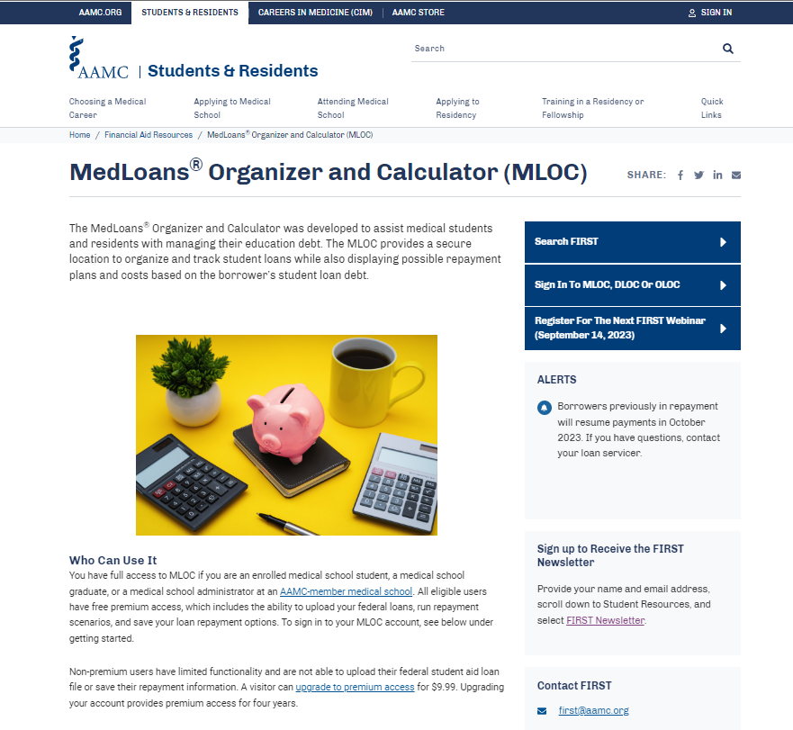
MedLoans® Organizer and Calculator (MLOC)
aamc.org/medloans
Notes:
The MedLoans Organizer and Calculator (or MLOC) is a great place to not only keep track of your current loans, but it’s a tool that can help you look at realistic loan repayment options based upon the loans you have taken out. While there is a loan calculator available through the Federal Student Aid website that can help borrowers review loan repayment, MLOC was specifically created for medical student and residents.
Assessment Question: What AAMC tool helps borrowers review loan repayment scenarios based upon their debt, residency length, residency stipend and post-residency salary? Answer: MedLoans Organizer and Calculator

Slide 25
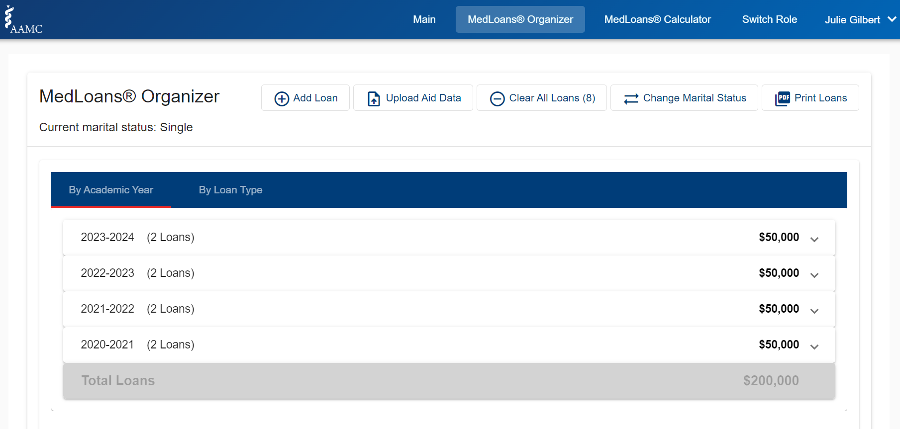
aamc.org/medloans
Notes:
With MLOC, you will enter your loans into the calculator each time you borrow a loan,

Slide 26
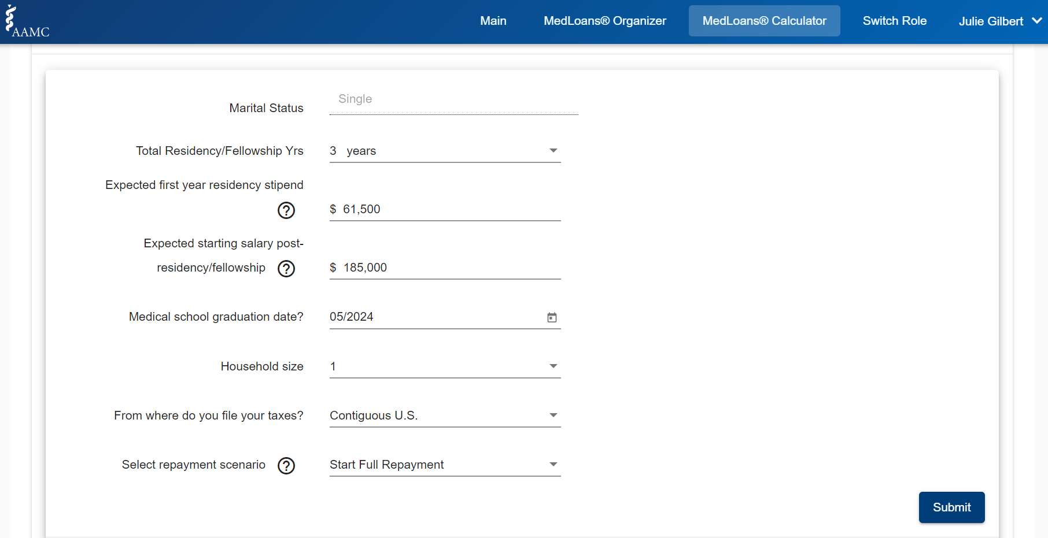
aamc.org/medloans
Notes:
Then you will answer questions about your marital status, residency and/or fellowship length, residency stipend, anticipated post-residency salary and a few additional details about the size of your household, where you file taxes, and what kind of repayment scenario you would like to see.

Slide 27
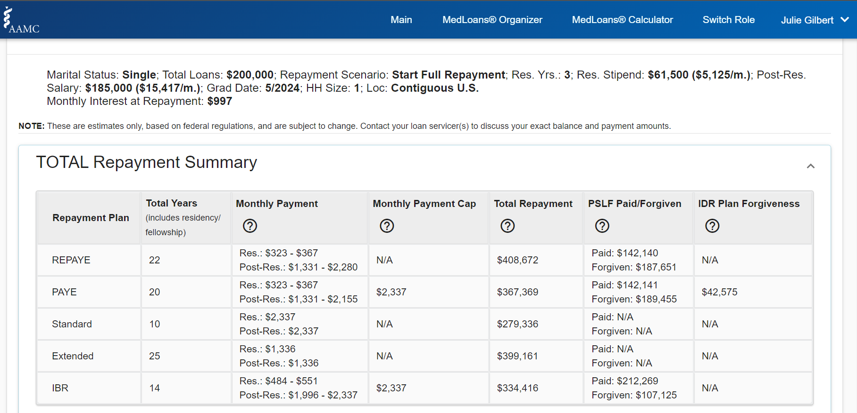
aamc.org/medloans
Notes:
Once all that information is entered, MLOC will provide a repayment scenario based upon the entered parameters. Here you will be able to see how long it may take you to repay your loans, what your estimated minimum monthly payment would be during residency and post-residency, the total repayment costs. Some of the repayment plans may even provide loan forgiveness, and some borrowers may even choose to participate in Public Service Loan Forgiveness.
As you may know, the loan repayment and forgiveness options are constantly changing and the MedLoans calculator will include the newest repayment options when they become available.

Slide 28
Personal finance pillars
Budgeting
Look at your last few months of expenses
aamc.org/first, spreadsheet software, smartphone apps
Determine your monthly saving, spending, debt repayment, investment goals
https://www.investor.gov/financial-tools-calculators/calculators/savings-goal-calculator
Adjust budget based on #2
Notes:
The next pillar is budgeting, or what I like to call “cash flow planning” and it may be the most important aspect of your financial life
Starting to build a budget can be intimidating but in order to know where to go, you have to know where you’re coming from
Start by looking at your last few months of expenses. You can track those through the AAMC FIRST tools, spreadsheet software or one of several free smartphone apps that will track your spending for you. An alternative approach would be to start now and commit to track your expenses for the next few months
Then you’ll want to determine all of your required expenses and your goals
You can then adjust your budget based on what you’ve decided in step 2

Slide 29
Personal finance pillars
Retirement
See if your employer offers 401(k) or 403(b) match
Determine your retirement goals and risk tolerance
https://www.investor.gov/introduction-investing
Choose investment accounts (e.g. 401(k), 403(b), IRA) and/or investment products (e.g. stocks, bonds, mutual funds) according to #2
Notes:
Something that is often included in a budget is money allocated to retirement. Retirement may feel very far away at this stage, but the earlier you start thinking about it, the better off you will be in the long term
401(k) and 403(b) are types of retirement accounts. 403(b) is just the term for a 401(k) offered by a non-profit organization. You may have a 401(k) or 403(b) match offered by your residency program, and will likely have one in a job post-residency. This means that whatever money you contribute to the account, your employer will contribute some percentage on top of that. If there is a match and you’re able to contribute enough to get the match, that is FREE money
If your budget allows you to contribute beyond the match, you’ll want to determine both your retirement goals and your risk tolerance
Those two items will help you determine which accounts are right for you and then what types of investments you want to put in those accounts.
Investor.gov is a great website that will introduce you to some of these terms and help you determine your risk tolerance. The types of investment products (stocks, bonds, mutual funds, etc) that you would invest in in a retirement account are the same as those you would invest in in a non-retirement account, so this information is helpful for any type of investing you hope to do.

Slide 30
Personal finance pillars
Insurance
Check your current health, disability, life insurance coverage
often employer-provided
Compare options consider independent broker
Pay attention to the details
“specialty-specific, own-occupation” for disability insurance, HSA (Health Savings Account) option for health insurance, etc.
Notes:
Insurance may not be the most exciting topic, but it is essential to protect what you’ve worked hard to gain and to protect yourself and your family
Your employer likely offers some insurances without any additional cost. Talk to your HR professional or residency administration about what your employer already covers. You can then determine if those are sufficient for you at your current stage
If you determine you need more coverage, consider using an independent broker to compare different insurance companies
You will likely have these policies for many years, so it is worth it to look at the details to make sure you are getting the right coverage for you and your family
Assessment question: which of the following insurance types are not typically provided by an employer?
A) life
B) disability
C) health
D) car

Slide 31
Personal finance pillars
Continuing Financial Education
Perform financial check-up every year
https://www.investopedia.com/personal-finance/how-conduct-financial-checkup/
Assign yourself CFE
e.g. one book/year, one podcast/month, or one blog post/week
Find a trusted person to talk to
friend, spouse, residency faculty, financial advisor
Notes:
The last thing I recommend before I turn it over to Julie is to commit to Continuing Financial Education just like you will be required to do Continuing Medical Education for the rest of your career.
Your financial picture and needs will change every year, so performing a financial check-up every year can catch any errors and facilitate planning for the upcoming year
Your continuing financial education can take many forms (commit to one book/year, one podcast/month, or one blog post/week)
Finally, you don’t have to do this alone! In fact, it can be beneficial to get different perspectives. Find a trusted person with whom you can keep open communication about your finances. If you are considering a financial advisor, I would encourage you to take a look at the Fact Sheet for financial advisors in the AAMC FIRST program.

Slide 32
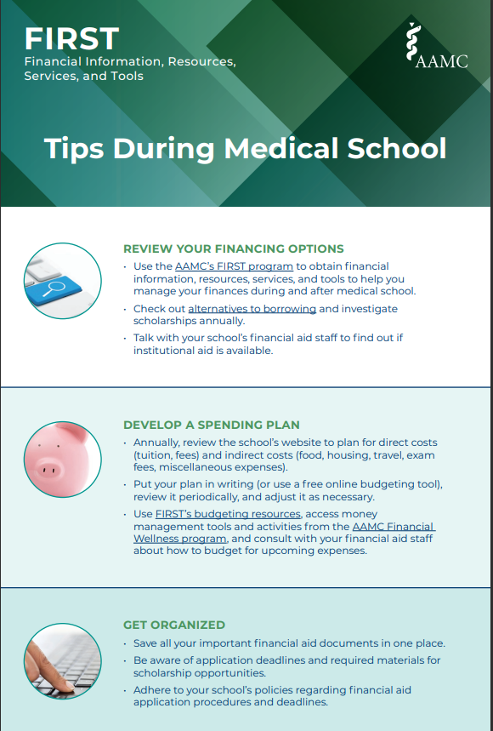
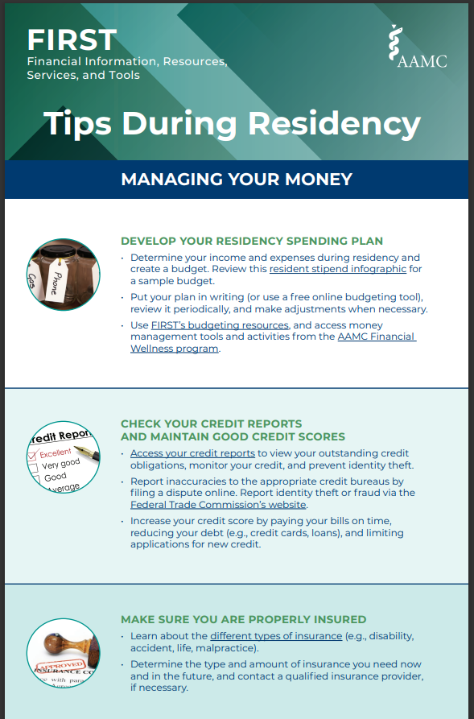
AAMC Personal Finance and Borrowing Tips
aamc.org/first/resources
Notes:
Julie will start here.

Slide 33
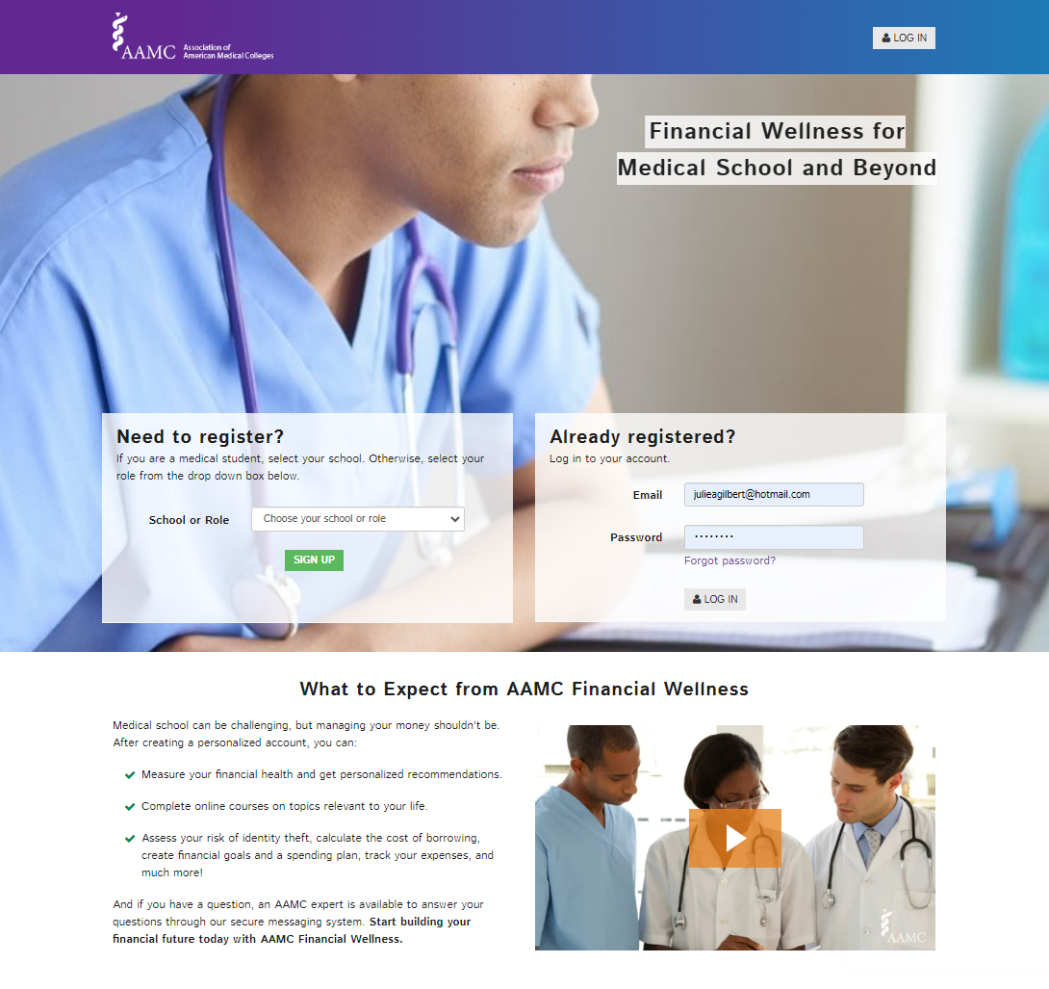
AAMC Financial Wellness Program
aamc.org/financialwellness
Notes:
Julie will start here.

Slide 34
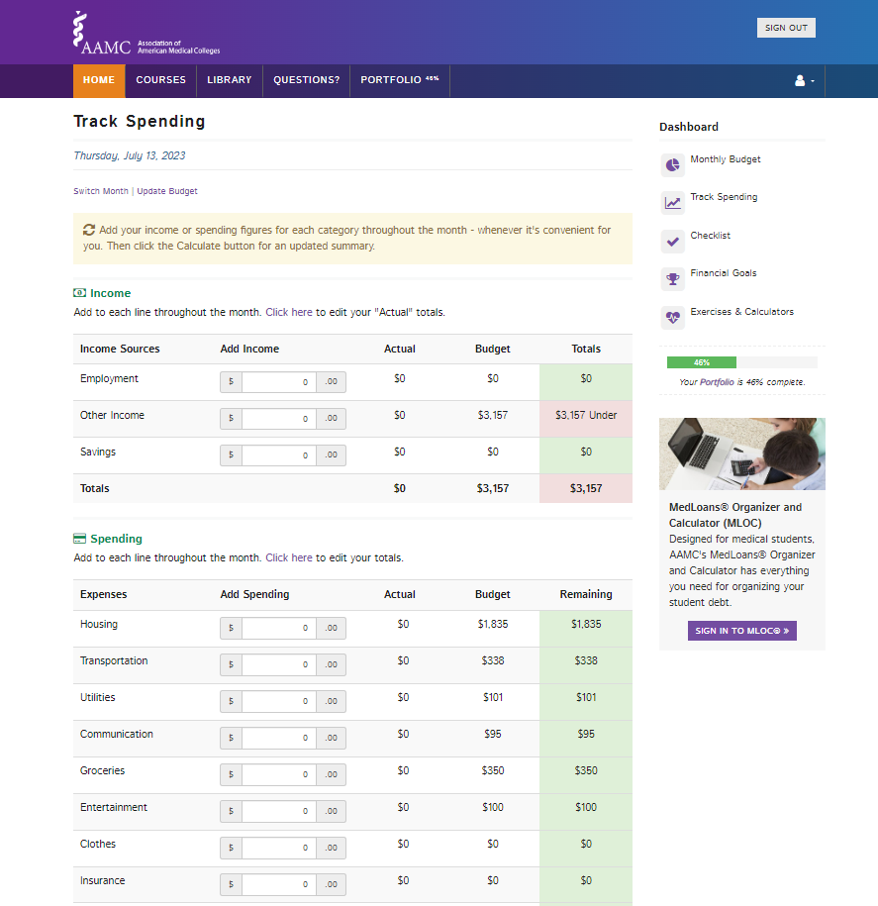
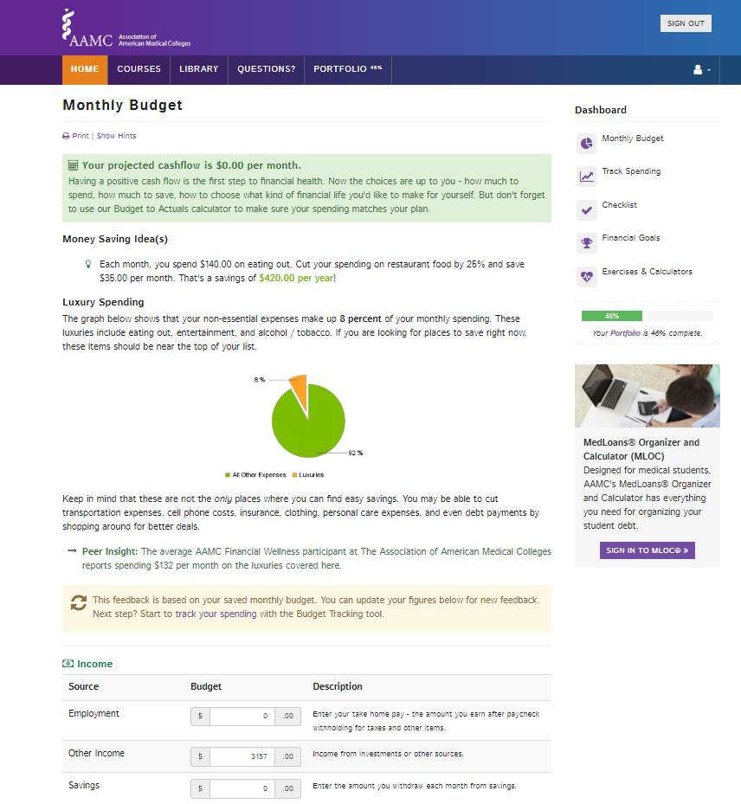
Notes:
Budgeting and Planning Resources – AAMC Financial Wellness
Library – Budgeting and Spending
Budgeting Tool
Track Spending Tool

Slide 35
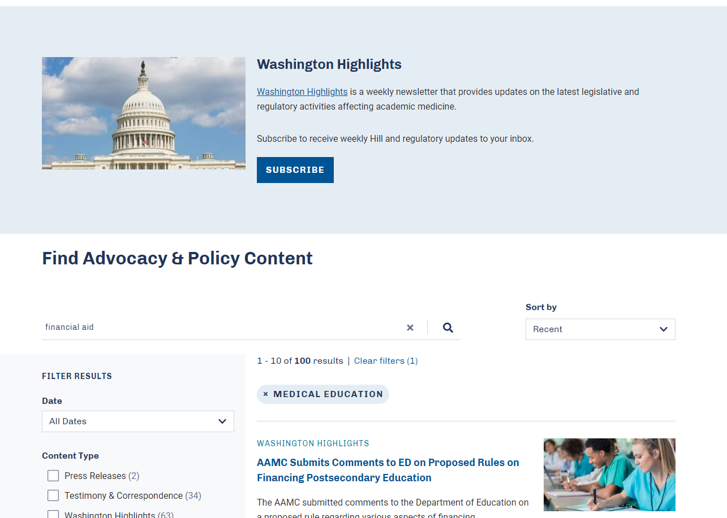
AAMC Advocacy and Policy
aamc.org/ advocacy

Slide 36
Conclusions
You can afford to be a family physician!
The AAMC has many resources available to you to improve your financial literacy.
There are several simple action items you can do today to improve your financial wellbeing.
Notes:
In conclusion, considerations about income and finance should not dissuade you from becoming a family physician if that is what suits you best
Take advantage of the free resources available to you through the AAMC
Consider committing to taking at least one step from each financial pillar we discussed today.
Best of luck on your financial wellbeing journey!

