Slide 2
What will you learn about today?
How tobacco and vaping are bad for you
How big tobacco and big vape trick you into using their harmful products
How to make a smoke- and vape-free school and community

Slide 3
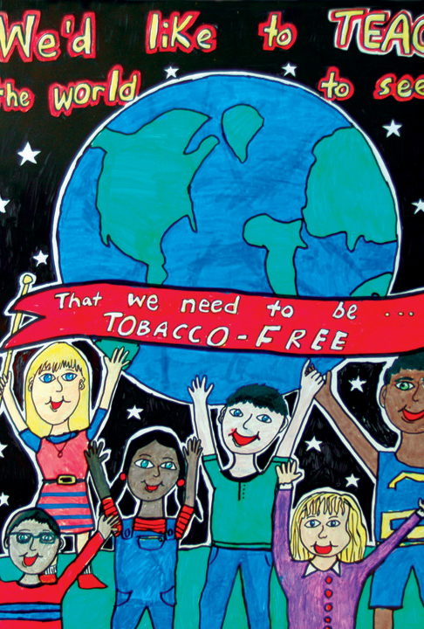
What is Tar Wars?
Created by the American Academy of Family Physicians (AAFP) to help kids like you understand the dangers of tobacco and vaping
Made by family doctors to help you live tobacco- and vape-free lives
Help you create a smoke- and vape-free school and community
Ethan—North Carolina
2004 Tar Wars Poster Contest

Slide 4
Cigarettes and Smoking

Slide 5
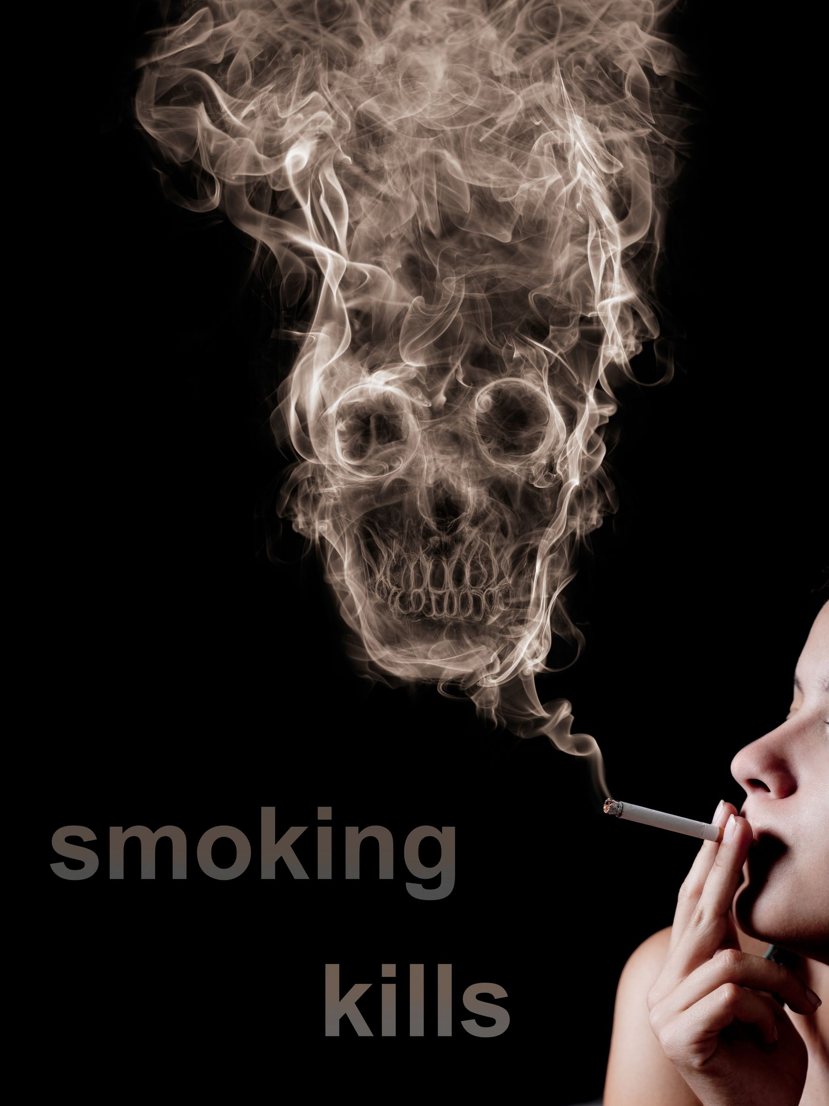
Smoking is the leading cause of death
or
Smoking is the leading cause of preventable death with:
Half a million people dying in the U.S. each year.
Seven million people dying worldwide each year.
Smokers dying 10 years earlier than non-smokers.
Smoking causing cancer, heart disease, stroke, lung diseases, diabetes, respiratory diseases, and several other diseases.
Source: Centers for Disease Control and Prevention. Smoking & Tobacco Use. Fast Facts. Accessed June 14, 2021. www.cdc.gov/tobacco/data_statistics/fact_sheets/fast_facts/index.htm
Notes:
Presenter note: At the end of the slide, reiterate that death and disease caused by tobacco use is 100% preventable.

Slide 6
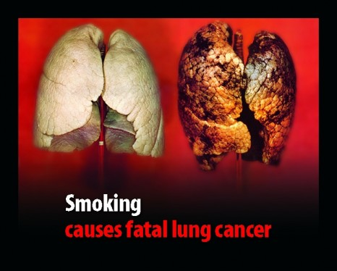
Smoking makes you sick and unhealthy
Healthy
Lung
Smoke-damaged
Lung
Smoking affects your breathing by:
Damaging the cells of the lungs.
Having more trouble breathing.
Causing lung disease, even for secondhand smoke.
Activity: See how your lungs would feel from the straw breathing exercise
This Photo by Unknown Author is licensed under CC BY-SA
Source: Centers for Disease Control and Prevention. Smoking & Tobacco Use. Fast Facts. Accessed June 14, 2021. www.cdc.gov/tobacco/data_statistics/fact_sheets/fast_facts/index.htm
Notes:
Presenter note: The Love Your Lungs Video shows how smoke affects lungs. It is about five minutes long. The video is hosted here: www.youtube.com/watch?v=96PiRqFPLqs. Instructions for the straw breathing exercise are shown below. This activity also aligns with Activity #4 in the Tar Wars Presenter’s Guide.
Activity Instructions
Effects on Breathing – Straw Breathing Exercise
Purpose: This exercise demonstrates to students how smoking decreases lung capacity and the ability to hold enough oxygen. The only supplies needed are drinking straws.
Instructions: (1) Hand out drinking straws to students. (2) Instruct them to place the straw in their mouth, hold their noses, and breathe through the straw only. (3) Instruct students to stand and run-in place for 15 to 30 seconds while breathing through the straw.
Special Considerations: Students with asthma or other respiratory conditions may not want or be able to participate in this exercise. You could have them participate by handing out the straws or time fellow students who are running in place.
Required Items: Drinking straws.

Slide 7
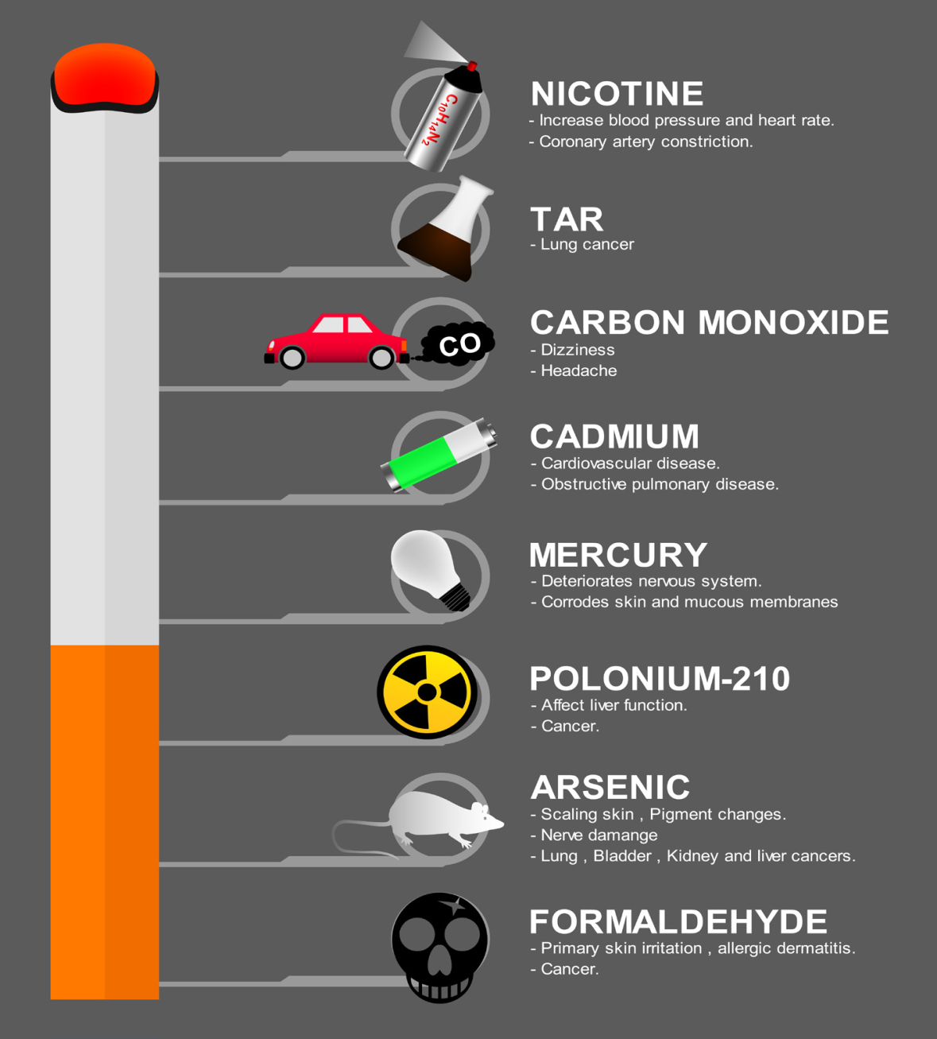
Cigarettes contain many harmful ingredients
There are more than 600 ingredients in cigarettes, including:
Nicotine – also used as an insecticide
Tar – also used to pave roads
Carbon monoxide – like car exhaust
Arsenic – also used in rat poison
Formaldehyde – also used as an embalming fluid
Acetone – also found in nail polish remover
Source: American Lung Association. What’s in a cigarette? Accessed June 14, 2021. www.lung.org/quit-smoking/smoking-facts/whats-in-a-cigarette

Slide 8
Smoking makes you more attractive.
or
Smoking makes you less attractive.
A twin who smoked was viewed as less attractive than their non-smoking twin.
Smoking causes coughing, bad breath, and stained teeth and fingers.
Smoking makes you look older with more wrinkles, droopier eyes, and dryer lips.
Sources: Okada HC, Alleyne B, Varghai K, Kinder K, Guyuron B. Facial changes caused by smoking: a comparison between smoking and nonsmoking identical twins. Plast Reconstr Surg. 2013;132(5):1085-1092. Accessed June 15, 2021
Skinner AL, Woods A, Stone CJ, Penton-Voak I, Munafò MR. Smoking status and attractiveness among exemplar and prototypical identical twins discordant for smoking. R. Soc. Accessed June 15, 2021
Notes:
Presenter note: If you choose, this would be a good time to do Activity #2: “Sticky Person” in the Tar Wars Presenter’s Guide. The Tar Wars Presenter’s Guide can be found here: www.aafp.org/dam/AAFP/documents/patient_care/tobacco/tar_wars/2020-21-Tar-Wars-Program-Guide.pdf.
Activity Instructions
“Sticky Person” – Effects of Tobacco Use
Purpose: This activity increases students’ knowledge about the immediate short-term health effects of tobacco use.
Instructions: Divide the class into teams. Ask one person on each team to write the responses, and one person to act as the “sticky person.” When an individual has written the team’s response on a sticky note, someone places it on the “sticky person.” Teams are given one minute to write as many responses as possible. The “sticky person” for each team comes to the front of the class and presents the team’s responses. The team with the most responses wins.
Required Items: A picture of a person (a stick figure on the white board will work). Post-it notes. Pens or markers.
Possible Answers
1.Difficulty breathing/wheezing
2.Coughing/Hacking phlegm
3.Bad breath/zoo breath
4.Tobacco smoke odor on clothes and hair
5.Burn holes in clothes
6.Tobacco-stained teeth and fingers
7.Increased facial wrinkles and premature aging
8. Spit stains on clothes and shoes from chewing tobacco
9.Affects heart rate, blood pressure, and circulation
10.Affects taste and smell

Slide 9
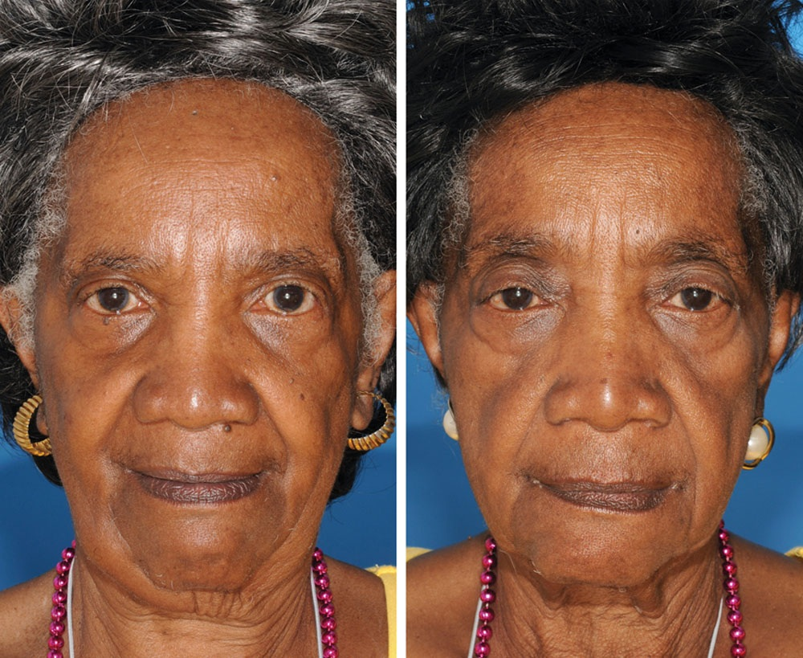
Smoking makes you more attractive.
or
A twin who smoked was viewed as less attractive than their non-smoking twin.
Can you tell who is the non-smoker?
Sources: Okada HC, Alleyne B, Varghai K, Kinder K, Guyuron B. Facial changes caused by smoking: a comparison between smoking and nonsmoking identical twins. Plast Reconstr Surg. 2013;132(5):1085-1092. Accessed June 15, 2021
Skinner AL, Woods A, Stone CJ, Penton-Voak I, Munafò MR. Smoking status and attractiveness among exemplar and prototypical identical twins discordant for smoking. R. Soc. Accessed June 15, 2021
Notes:
Presenter note: If you choose, this would be a good time to do Activity #2: “Sticky Person” in the Tar Wars Presenter’s Guide. The Tar Wars Presenter’s Guide can be found here: www.aafp.org/dam/AAFP/documents/patient_care/tobacco/tar_wars/2020-21-Tar-Wars-Program-Guide.pdf.
Activity Instructions
“Sticky Person” – Effects of Tobacco Use
Purpose: This activity increases students’ knowledge about the immediate short-term health effects of tobacco use.
Instructions: Divide the class into teams. Ask one person on each team to write the responses, and one person to act as the “sticky person.” When an individual has written the team’s response on a sticky note, someone places it on the “sticky person.” Teams are given one minute to write as many responses as possible. The “sticky person” for each team comes to the front of the class and presents the team’s responses. The team with the most responses wins.
Required Items: A picture of a person (a stick figure on the white board will work). Post-it notes. Pens or markers.
Possible Answers
1.Difficulty breathing/wheezing
2.Coughing/Hacking phlegm
3.Bad breath/zoo breath
4.Tobacco smoke odor on clothes and hair
5.Burn holes in clothes
6.Tobacco-stained teeth and fingers
7.Increased facial wrinkles and premature aging
8. Spit stains on clothes and shoes from chewing tobacco
9.Affects heart rate, blood pressure, and circulation
10.Affects taste and smell

Slide 10
Smoking is expensive
or
How much does smoking cost?
$11 per pack x 7 days = $77 per week
$77 per week x 4 weeks = $308 per month
$308 per month x 12 months = $3,696 per year
Illinois tax on cigarettes is nearly $3/pack – Chicago adds more
Illinois also taxes other tobacco products (Vapes, smokeless, cigars etc.)
What could you buy instead?
Clothes, shoes, concert tickets, a new phone, video games, movies, etc.
This Photo by Unknown Author is licensed under CC BY-NC-ND
Source: Orzechowski and Walker. Tax burden on tobacco, 1970-2019. Centers for Disease Control and Prevention. Accessed June 14, 2021. https://catalog.data.gov/dataset/the-tax-burden-on-tobacco-1970-2018
Notes:
Presenter note: If you choose, this would be a good time to do Activity #3 “Financial Impact” in the Tar Wars Presenter’s Guide. The Tar Wars Presenter’s Guide can be found here: www.aafp.org/dam/AAFP/documents/patient_care/tobacco/tar_wars/2020-21-Tar-Wars-Program-Guide.pdf.
Activity Instructions
Financial Impact of Tobacco Use
Purpose: Students learn how much it costs to use tobacco.
Instructions: (1) Ask students how much they think one pack of cigarettes or other tobacco products cost. Then calculate the cost on a weekly, monthly, and yearly basis. This information is provided in the slide and animated so that it appears one after the other. (2) Ask students what they would do with $2,352. After they volunteer answers and discuss, you can list these on the board. Ask them if they can believe that’s how much it costs to smoke a pack of cigarettes a day for a year.
Required Items: A white board and dry erase marker.

Slide 11
E-cigarettes and Vaping

Slide 12
Which have you heard of?
Electronic Cigarette (e-cigarette or e-cig)
ENDS (Electronic nicotine delivery systems)
Vape
Vape pen
Tanks or Mods
JUUL® or Suorin® (Pod Mods)
Puff Bar
Notes:
Presenter note: Bringing a copy of the Truth Initiative’s Vaping Lingo Dictionary to teachers may be a good way to educate them and might be useful for the students as well. The link to the Vaping Lingo Dictionary is: https://truthinitiative.org/research-resources/emerging-tobacco-products/vaping-lingo-dictionary

Slide 13
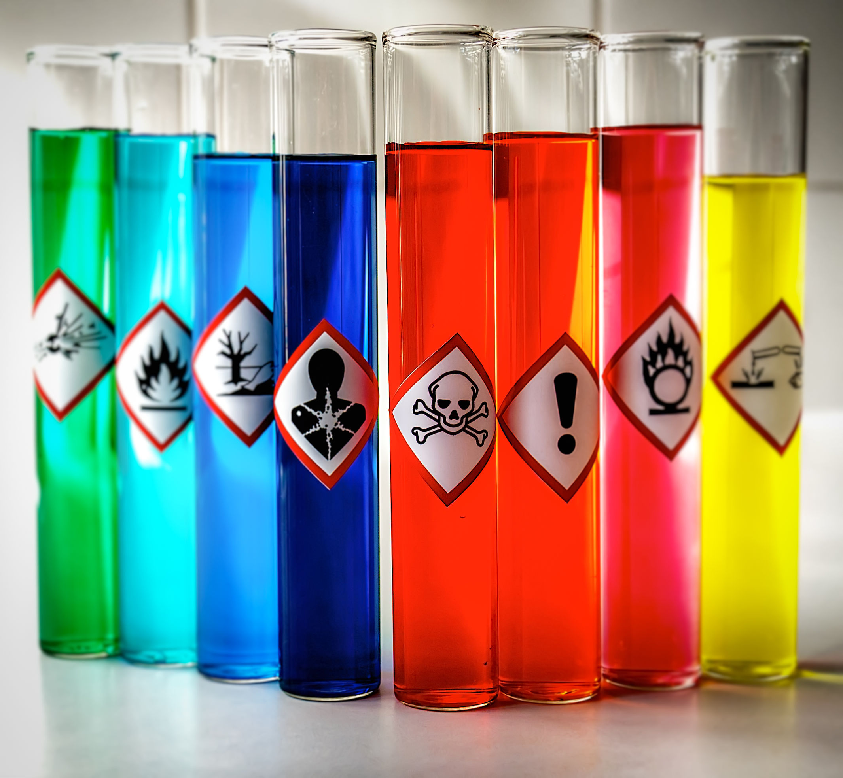
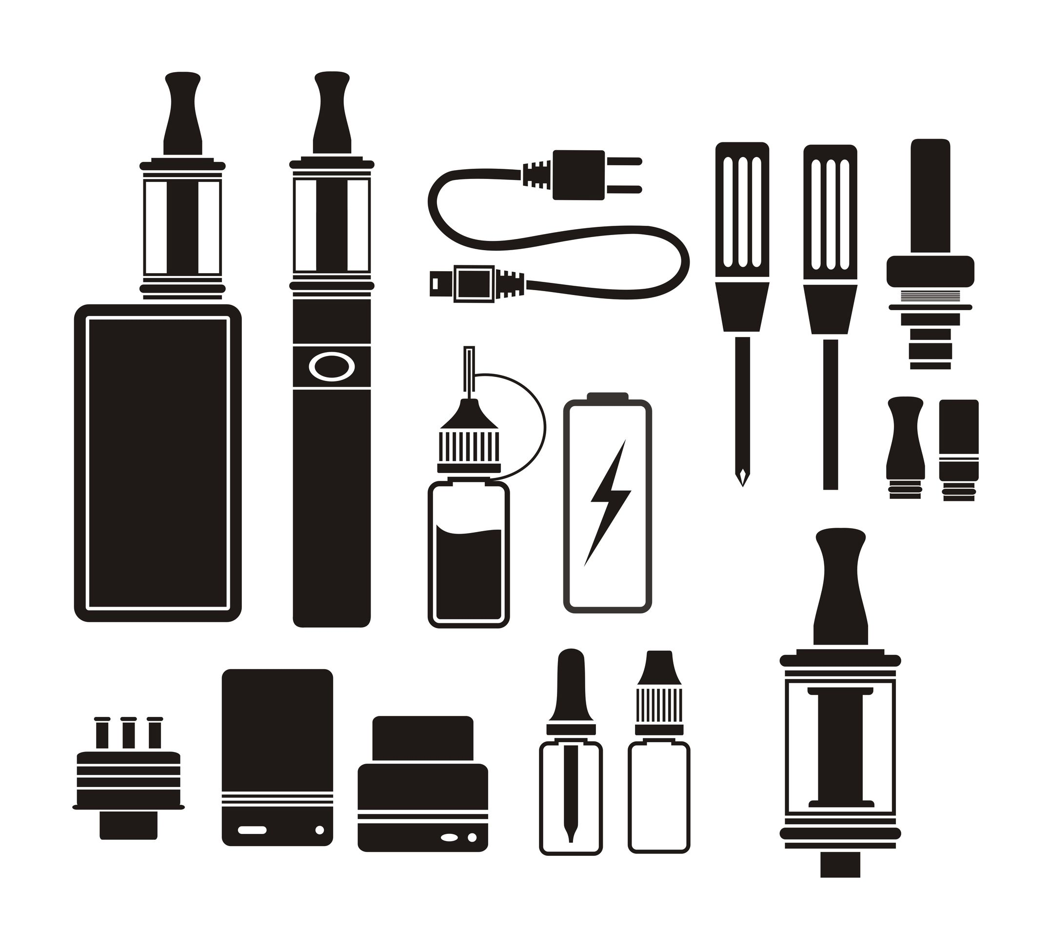
What's in an e-cigarette?
Battery-powered devices used to smoke or “vape” liquid solutions, sometimes called “juice”
Almost always contain nicotine, flavoring, and other chemicals
All shapes and sizes: can look like cigarettes, cigars, pipes, USB flash drives, pens, and other common items

Slide 14
What's the Big Deal?
Vaporize liquid nicotine or “juice”
Very addictive, just like cigarettes
Contain dangerous, cancer-causing chemicals, just like cigarettes
Create a vapor from the addictive liquid
NOT water vapor
Bad for your health. Can cause:
Lung damage and “popcorn lung”
Affects brain development – the brain isn't completely developed until 24-25
Nicotine addiction

Slide 15
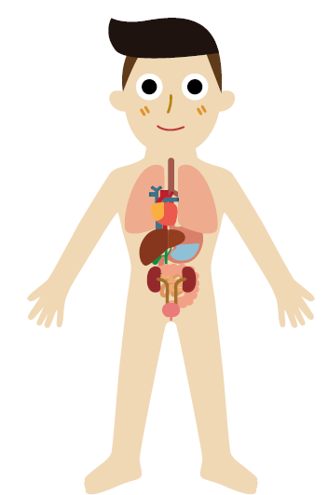
Any source of nicotine is bad for you
Headaches
Poor focus
Lightheadedness
Brain
Mouth
Dry mouth
Blood clotting
Change in heartrate
Increased blood pressure
Heart and Blood
Nausea
Diarrhea
Heartburn
Stomach
Lungs
Coughing
Muscles and Joints
Tremor
Soreness
Notes:
Presenter note: If you choose, this would be a good time to do Activity #9 “Effects of Vaping on the Body” in the Tar Wars Presenter’s Guide. The Tar Wars Presenter’s Guide can be found here: www.aafp.org/dam/AAFP/documents/patient_care/tobacco/tar_wars/2020-21-Tar-Wars-Program-Guide.pdf.
Activity Instructions
Effects of Vaping on the Body
Purpose: Students learn how vaping can affect their body.
Instructions: (1) Break students into two or three groups and hand out the printout from the Tar Wars Presenter’s Guide, (2) have each group brainstorm how they think vaping would affect the different parts of their body, (3) have groups report out and discuss.
Required Items: Printouts of Activity #9 in the Tar Wars Presenter’s Guide, a white board and dry erase marker.

Slide 16
Vaping is NOT safe
Addictive: Often contains more nicotine than cigarettes
Toxic substances: Contains ingredients known to be harmful to your health
Secondhand exposure: Bystanders can breathe in aerosol too
Not proven to help people quit smoking: Many people just use both
They can explode: Tips to help avoid vape battery explosions
Sources: Allen JG, Flanigan SS, LeBlanc M, et al. Flavoring chemicals in e-cigarettes: diacetyl, 2,3-pentanedione, and acetoin in a sample of 51 products, including fruit-, candy-, and cocktail-flavored e-cigarettes. Environ Health Perspect. 2016;124(6):733-739.
Jankowski M, Krzystanek M, Zejda JE, et al. E-cigarettes are more addictive than traditional cigarettes – a study in highly educated people. Int J Environ Res Public Health. 2019;16(13):2279.
16
Notes:
Presenter note: Please see the FDA’s Tips to Help Avoid “Vape” Battery Explosions (www.fda.gov/tobacco-products/products-ingredients-components/tips-help-avoid-vape-battery-explosions).

Slide 17
Vaping is NOT safe
Image source: Centers for Disease Control and Prevention. Electronic cigarettes. What is in e-cigarette aerosol? Accessed March 22, 2021. www.cdc.gov/tobacco/basic_information/e-cigarettes/pdfs/Electronic-Cigarettes-Infographic-508.pdf
Notes:
Presenter note: Communicate with the students that the aerosol from e-cigarettes is not just water vapor.

Slide 18
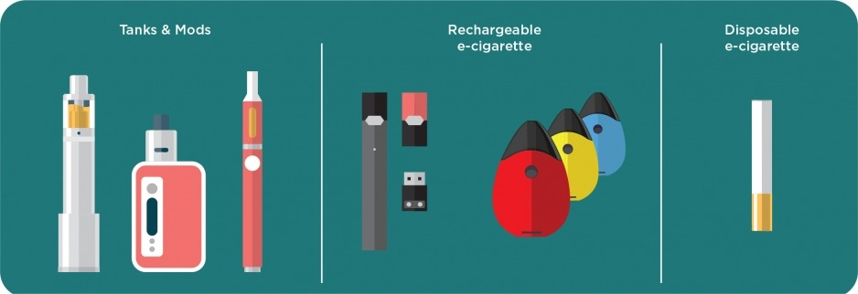
It is easy to identify a vaping device
or
Image source: National Institute on Drug Abuse; National Institutes of Health; U.S. Department of Health and Human Services.
Notes:
Presenter note: No, it is not easy to identify a vaping device. There are numerous types of devices, and some are made to look like other common things or to be hidden. Ways vaping devices are concealed include made to look like a USB drive or pen, or made to be concealed in sweatshirts, backpacks, cell phones, and smart watches.

Slide 19
Other Types of Tobacco

Slide 20
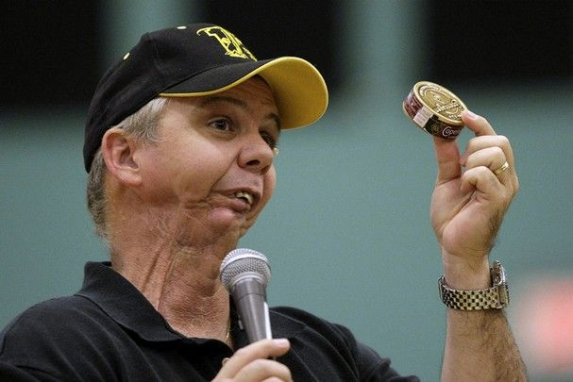
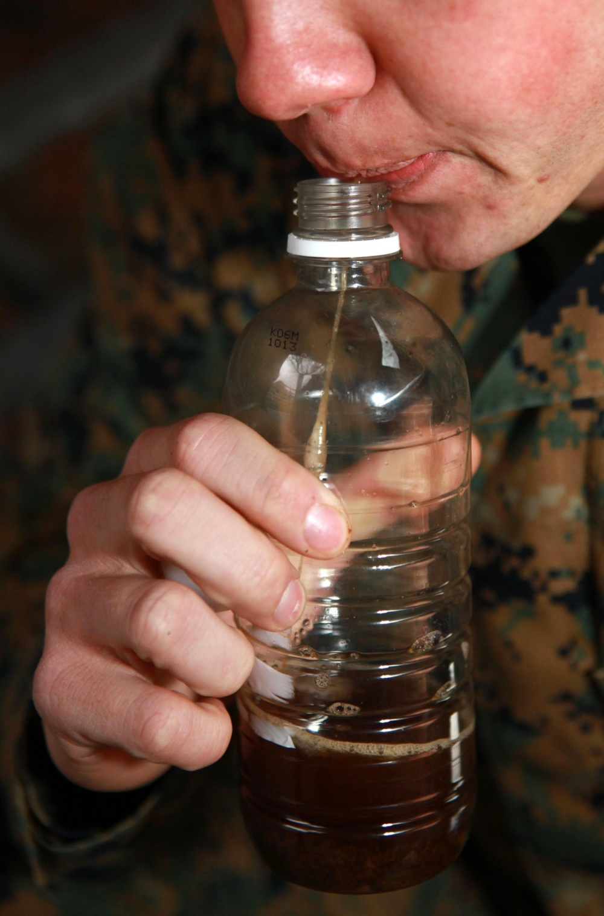
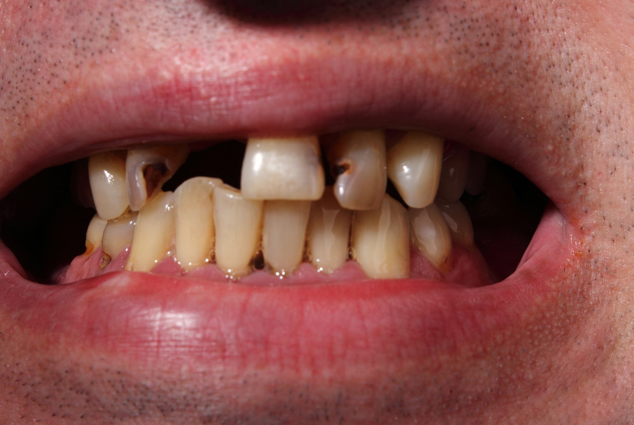
Smokeless tobacco (chew) is safe because there is no smoke
or
Smokeless tobacco causes cancer and ruins your teeth. It also:
Contains nicotine and is addictive
Causes gum disease
Causes yellow teeth
Causes mouth, throat, and pancreatic cancer
Is disgusting to chew and spit
This baseball player had part of his jaw removed after getting mouth cancer from using smokeless tobacco
Source: Centers for Disease Control and Prevention. Smoking & Tobacco Use. Smokeless tobacco: health effects. Accessed June 18, 2021. www.cdc.gov/tobacco/data_statistics/fact_sheets/smokeless/health_effects/index.htm
Image source: Defense Visual Information Distribution Service: U.S. Department of Defense, www.dvidshub.net/image/882293/ smokeless-tobacco-no-healthier-than-smoking

Slide 21
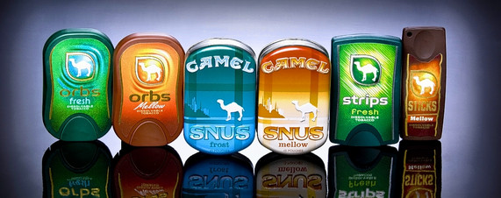
Smokeless Flavored Tobacco Is Not A Safe Alternative To Cigarettes
Sweet and fruity flavors to mask the taste of nicotine
Available in orbs, sticks, strips, lozenges, snuff, and small bags/cans
Designed to be placed in the mouth to dissolve so nicotine is absorbed into the bloodstream
Snuff is inhaled through the nose or placed in the mouth

Slide 22
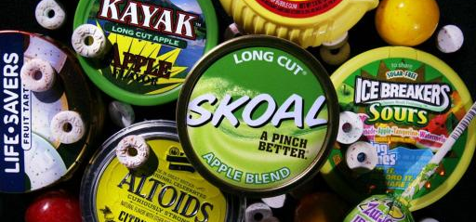
Can you spot the tobacco products?​
22
Notes:
Presenter note: Tobacco companies intentionally make tobacco products look like candy to appeal to kids. Have the students see if they can identify the candy products from the tobacco products.

Slide 23
Hookah
Inhale large amounts of smoke (100-200 times the amount of smoke found in a cigarette)
Are exposed to many toxic substances and more nicotine than cigarette smokers
Incur many of the same health risks as those who use cigarettes
Share mouthpieces and risk getting colds, the flu, herpes, and other illnesses

Slide 24
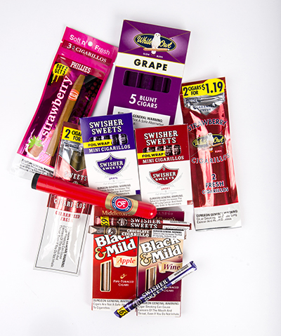
Flavored Cigars and Cigarillos
Sometimes come in fruity and candy flavors
Tobacco companies make these flavors to attract kids to smoke
Tobacco companies want to recruit kids to smoke so they can keep selling their products

Slide 25
Big Tobacco – Selling Harmful Substances

Slide 26
Big Tobacco Spends $8 Billion a Year to Get You to Smoke
What could you buy with $8 billion?
Two professional sports franchises
College for 80,000 kids
A Tesla car for 80,000 people
The top 15 zoos in the world
A trip to space for everyone in your family, including aunts, uncles, cousins, and grandparents

Slide 27
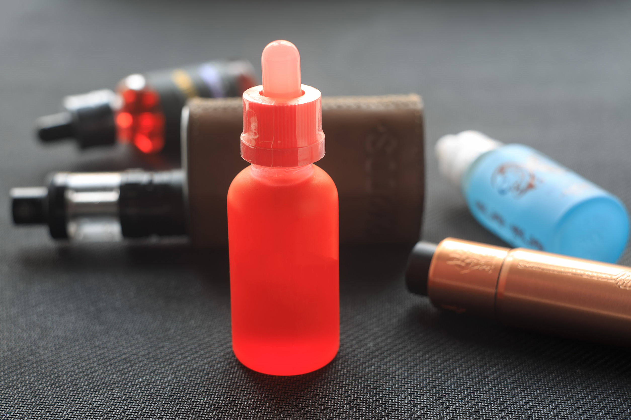
Which brands are e-cigarettes/vapes?
JUUL
Blue Crush
Puff Bar
Logic
Do these sound dangerous or fun?
Why would they want them to sound fun?
Who would enjoy these flavors:
Bubble Gum
Cotton Candy
Gummy Bear
Who are they marketing to?
Notes:
Answer: These are all forms of e-cigarettes or vapes.
Making these sound fun is a marketing technique. It's also why the names are constantly changing. As we educate children about the dangers and raise awareness about e-cigarettes/vapes, there's a new product on the market.
Approximately 3.6 million middle and high school students reported being current users of e-cigarettes in 2020. Of those, more than 80% used fruit, mint, candy, or methanol flavors.
Help students understand that they are being bamboozled and taken advantage of by the tobacco industry. There is more in the marketing section later, and these questions are to initiate the thinking of the students on their own.
Source: Wang TW, Neff LJ, Park-Lee E, Ren C, Cullen KA, King BA. E-cigarette use among middle and high school students — United States, 2020. MMWR. 2020;69:1310-1312.

Slide 28
Deceptive Marketing
Big tobacco/vape intentionally targets kids so they have an addicted customer base.
People who use tobacco are shown as young, attractive, and cool, but the ads never show the brown teeth, wrinkles, spit stains, and phlegm that result from its use.
Big tobacco/vape promote tobacco use at events they sponsor like concerts and music festivals.
Source: Campaign for Tobacco-Free Kids. Electronic cigarettes and youth. Accessed July 27, 2021. www.tobaccofreekids.org/assets/factsheets/0382.pdf

Slide 29
Deceptive Marketing
Big Vape Uses Social Media to Trick You
My friend who doesn’t vape
Me with my empty Juul pod
Me when I’m not Juuling!
Notes:
Presenter note: JUUL extensively used hashtags, including #juul, to expand the reach of the company’s postings on Instagram. The popularity of #juul increased the visibility of the product among youth. Enthusiasm for #juul also encouraged several youthful users of the product to post their own images to the hashtag.

Slide 30
Share the information at home
Illinois Quite Line is 1-866-QUIT-YES
WWW.QUITYES.ORG
US FDA information for students about Vaping
https://digitalmedia.hhs.gov/tobacco/educator_hub/students?locale=en

Slide 31
31

